Slide 1

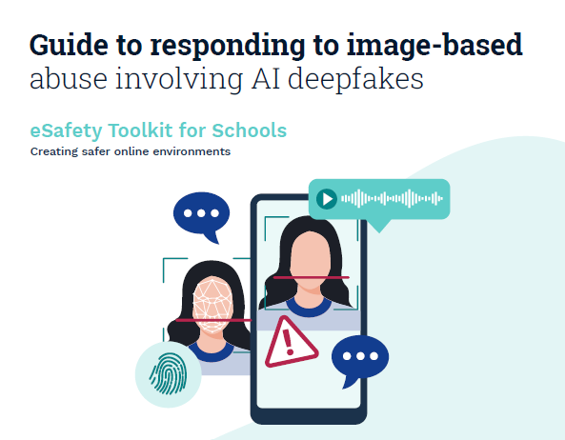
Notes:
esafety.gov.au/sites/default/files/2025-07/Respond-4-Guide-to-responding-to-image-based-abuse-15July.pdf?v=1764940257567

Slide 2

What is this guidance?
eSafety Toolkit by Australian Gov. produced for schools.
Aligned with Australian legislation, not UK, but nonetheless informative in its approach.
Offers clarity on language, approach and incident response that can be adapted to our contexts.

Slide 3
Preparing for an incident
Effective policy clearly specifies the response and actions in case of creating/distributing explicit deepfakes as well as the potential likelihood of an incident.
Includes disciplinary measures, pathways for reporting and support for all involved.
Includes comms protocols that consider all potential stakeholders as well as privacy and legal considerations.

Slide 4
Managing an incident
Wellbeing of CYP/staff principal concern, not reputation.
Need-to-know approach to info sharing to maintain confidentiality and minimise unintended effects.
Involve impacted parties in support that promotes their agency and decision-making.
Keep family appropriately informed.

Slide 5
Steps to report
Upon notification, designated leads should find out whether images depict students/staff in explicit contexts.
Collect necessary evidence for reporting while avoiding unnecessary exposure to/storage of explicit material.
Coordinate response with leadership team.
Consult/report to relevant support multi-agency response (wellbeing support, police, etc).
Follow school policy and statutory guidance where available.
Ensure all involved are supported.

Slide 6
Support for affected people
Recognition of implicit harm in deepfake creation and distribution (compromising dignity, feelings of shame/self-blame/humiliation, fear, isolation).
Recognise the potential barriers to help-seeking.
Trauma-informed, confidential support for victim(s) and affected peers and family.
Restorative and trauma-informed approach to creator(s) of material, in line with policies and statutory guidance.

Slide 7
Including AI in RSE
Exploring legality and morality.
Reflection on potential harm, despite synthetic nature of material.
Understanding related and intersecting issues (such as misogyny, blackmail, coercion, relationships etc).
Understanding where and how to report.

Slide 8
Strengths
Weaknesses
Recognises harm of AI image abuse.
Primary focus on affected people and their support.
Considers integrated prevention and preparation for incidents as well as response.
Designed for a different context.
Short on information about responding to young creators of explicit AI images.
Lacks wider technological context.
What else?

Slide 9

Licensing
Creative Commons Attribution-NonCommercial-NoDerivatives 4.0 International
This license requires that reusers give credit to the creator (GBV Education Team, Salford Foundation) It allows reusers to copy and distribute the material in any medium or format in unadapted form and for noncommercial purposes only.
BY
Credit must be given to the creator (GBV Education Team, Salford Foundation)
NC
Only noncommercial use of this work is permitted. Noncommercial means not primarily intended for or directed towards commercial advantage or monetary compensation.
ND
No derivatives or adaptations of this work are permitted.
See the License Deed

