Slide 1



Steps
Week 1
Healthy Relationships

Slide 2


Today’s session
Group Agreement
Recap ‘What do we remember from last session?’
Healthy Friendships
Behaviors in relationships
Summary and next week
Steps

Slide 3


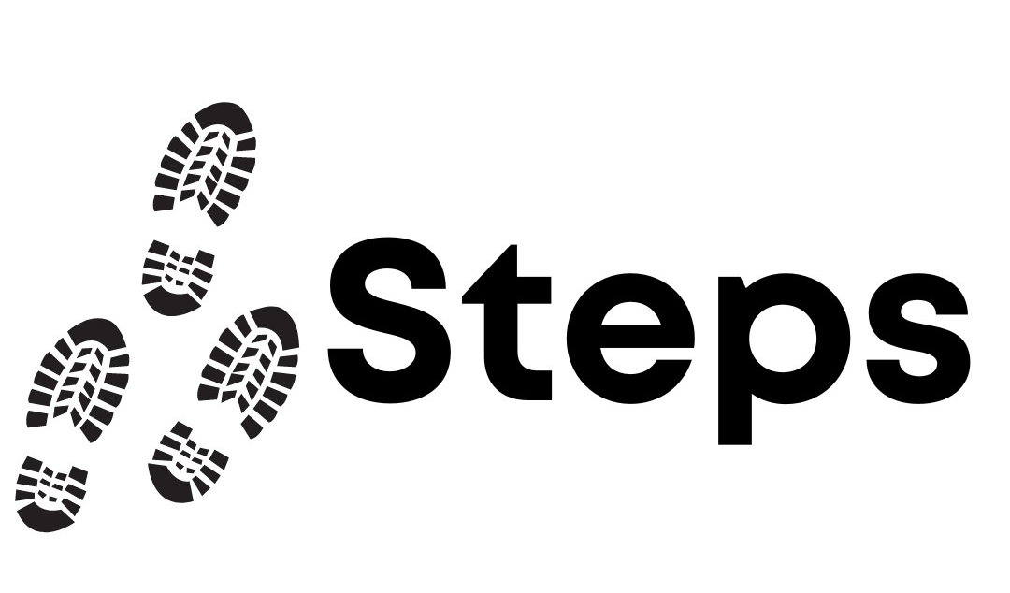
Group agreement
When others talk, we listen.
Respect others' opinions.
Respect our own opinions.
During the sessions, we can talk in a way that feels the most natural for us.

Slide 4

Language Reminder

Slide 5
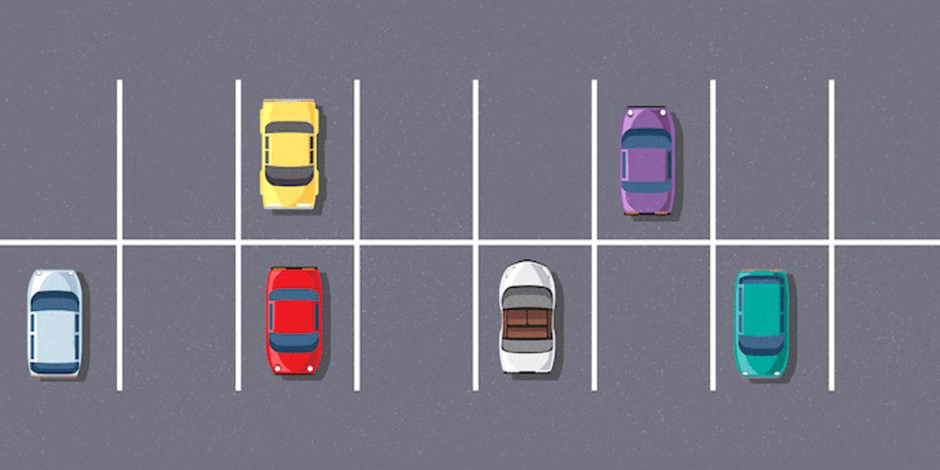
Question Car Park

Slide 6

Recap
What do we remember from last session?

Slide 7

Stand up
Activity 1
Healthy Friendships
Notes:
Placeholder slide for movement in classroom

Slide 8

Activity 2
Traffic Light Behaviours
Notes:
Placeholder slide for movement in classroom

Slide 9
What are the signs of a healthy relationship?

Slide 10
What are the red flags in a relationship?

Slide 11
What are the signs of abusive behaviors?

Slide 12
Activity 3
What is ‘Respect’?
Scenario Cards
Notes:
Placeholder slide for movement in classroom

Slide 13

Can you define the word ‘respect’?
Who do you respect and why do you respect them?
What does respect look like in different relationships? Friends? Family? Romantic partners?
Can you respect someone you fear?
Notes:
Placeholder slide for movement in classroom

Slide 14

Scenario Questions
How do you think the person feels in this situation?
Do you think respect is present in this scenario?
How would you of handled the situation?
Notes:
Placeholder slide for movement in classroom

Slide 15

Next week
Gender Stereotypes

