Slide 1
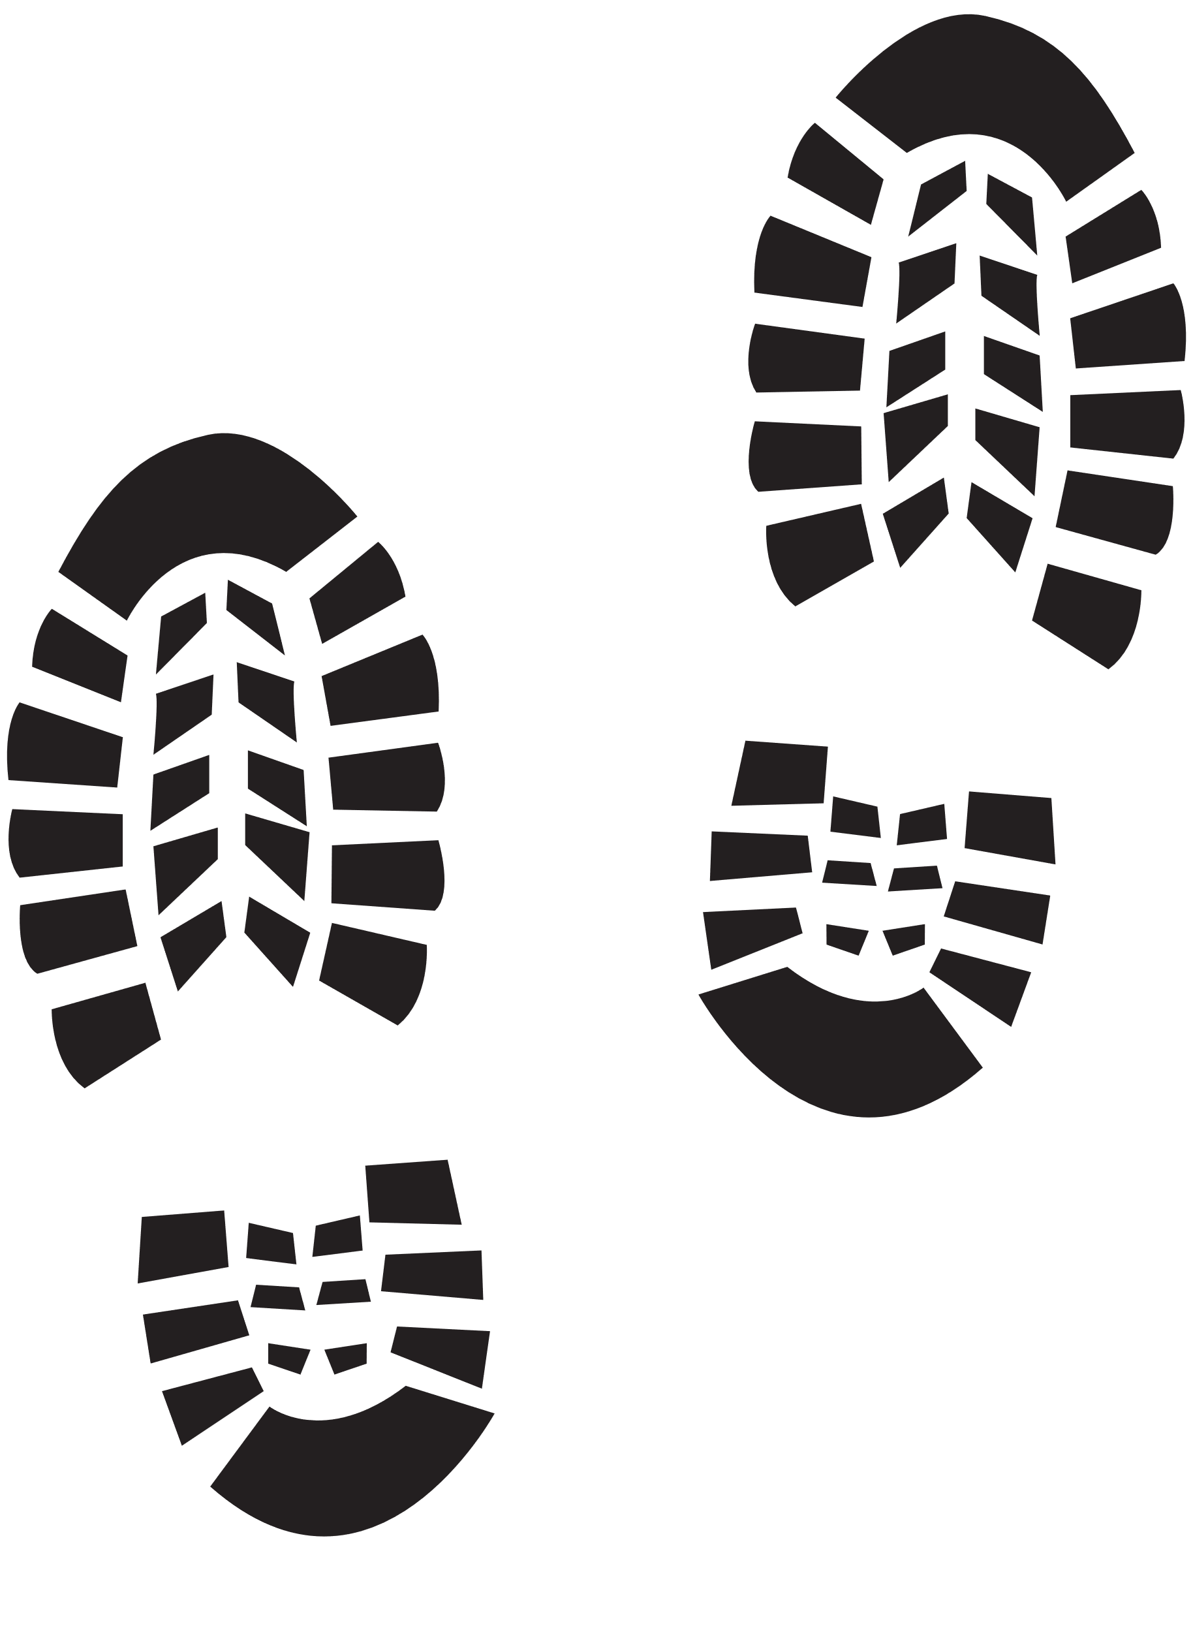


Steps
Week 2
Gender Stereotypes

Slide 2

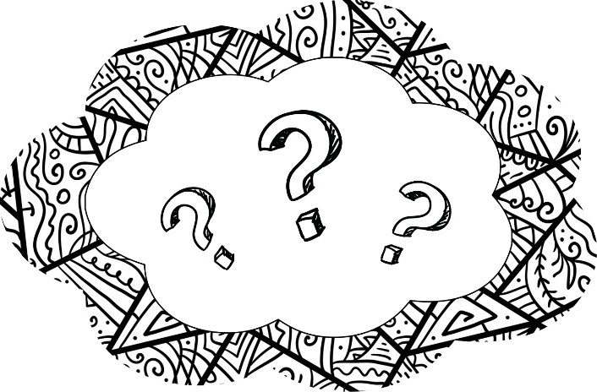
Today’s session
Group Agreement
Recap ‘What do we remember from last session?’
Recognizing Gender Stereotypes
Summary and next week
Steps

Slide 3



Group agreement
When others talk, we listen.
Respect others' opinions.
Respect our own opinions.
During the sessions, we can talk in a way that feels the most natural for us.

Slide 4

Language Reminder

Slide 5
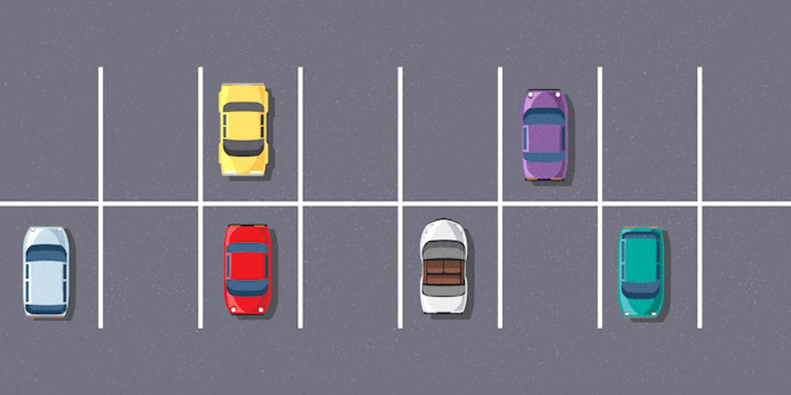
Question Car Park

Slide 6

Recap
What do we remember from last session?

Slide 7

Activity 1
Questions
Fact or Myth Quiz
Notes:
Placeholder slide for movement in classroom

Slide 8
What are ‘gender stereotypes’?
What does ‘misogyny’ mean?
Notes:
Placeholder slide for movement in classroom

Slide 9

Fact or Myth Quiz
Write down your answers please
Notes:
Placeholder slide for movement in classroom

Slide 10
Q1 Are males biologically more competitive?
Steps

Slide 11
Q2 Are females biologically more emotional than males?
Steps

Slide 12
Q3 Are males biologically more prone to be aggressive than females?
Steps

Slide 13
Q4 Are female brains designed to be more chatty/talkative than males?
Steps

Slide 14
Q5 Are males better at maths than females?
Steps

Slide 15
Q6 Gender stereotypes don’t impact career choices?
Steps

Slide 16
Q7 Only males can act in a misogynistic way?
Steps

Slide 17
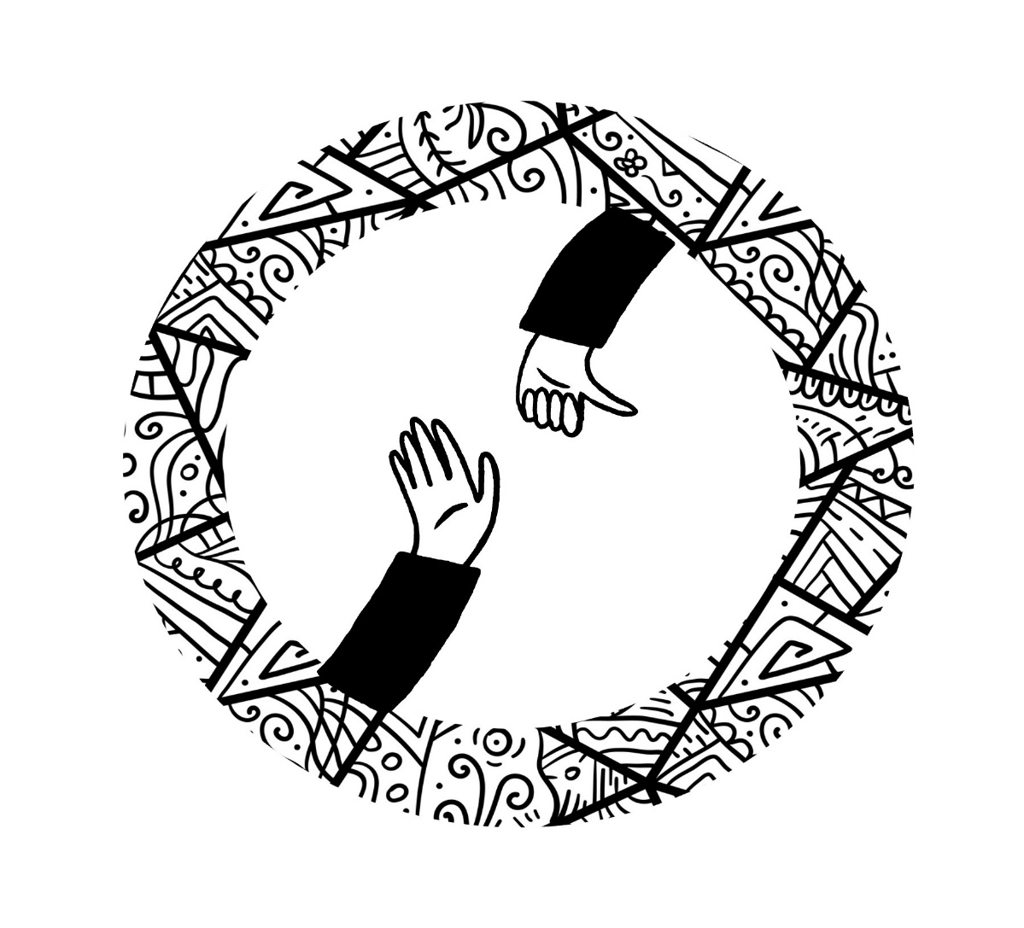
Activity 2
Gender Stereotypes Role Play
Notes:
Placeholder slide for movement in classroom

Slide 18

Think about these questions
How did the characters actions make you feel?
Could the characters have done anything differently to challenge gender stereotypes or promote equality?
Notes:
Placeholder slide for movement in classroom

Slide 19

Next week
The media

