Slide 1



Steps
Week 3
Gender Stereotypes & Media

Slide 2


Today’s session
Group Agreement
Recap ‘What do we remember from last session?’
Who can be a hero?
Portrayal of stereotypes in the media
Summary and next week
Steps

Slide 3
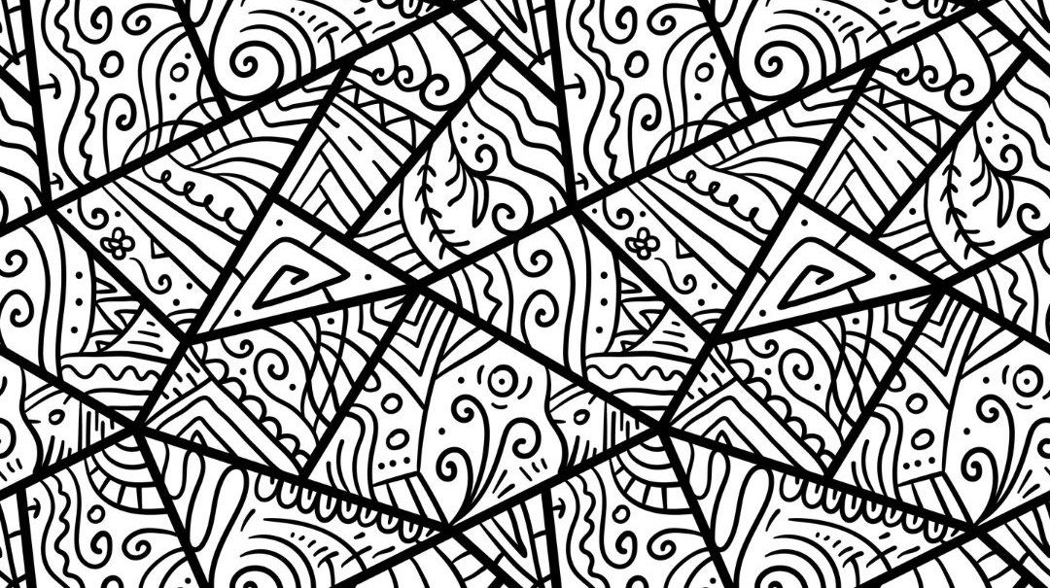


Group agreement
When others talk, we listen.
Respect others' opinions.
Respect our own opinions.
During the sessions, we can talk in a way that feels the most natural for us.

Slide 4

Language Reminder

Slide 5
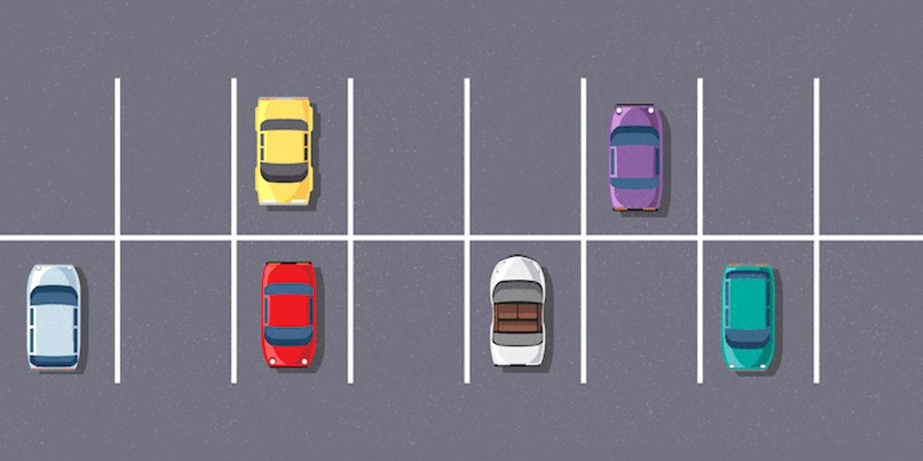
Question Car Park

Slide 6

Recap
What do we remember from last session?

Slide 7

Activity 1
Who can be a hero?
Notes:
Placeholder slide for movement in classroom

Slide 8
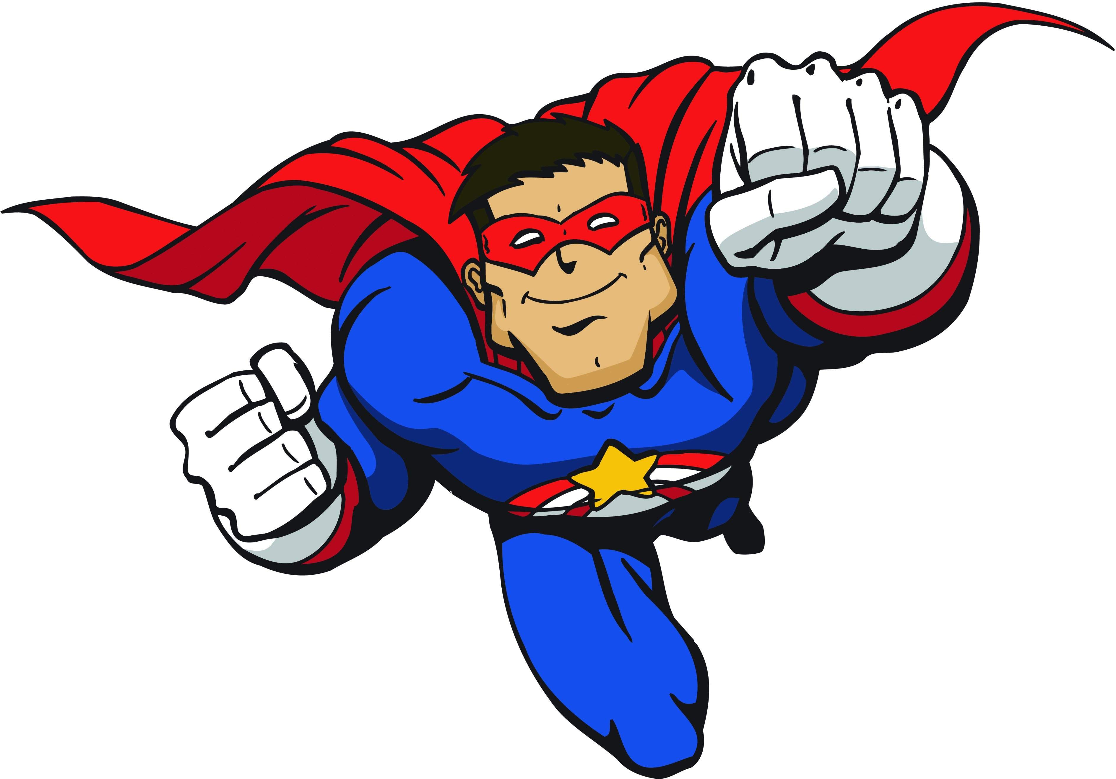
Notes:
Placeholder slide for movement in classroom

Slide 9
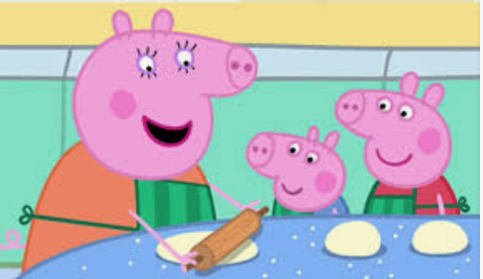
Notes:
Have we ever seen Daddy Pig cook anything? And the trope where Daddy Pig is incompetent but super-confident and Mummy Pig makes not-so-subtle digs at him while also accepting his behaviour.

Slide 10
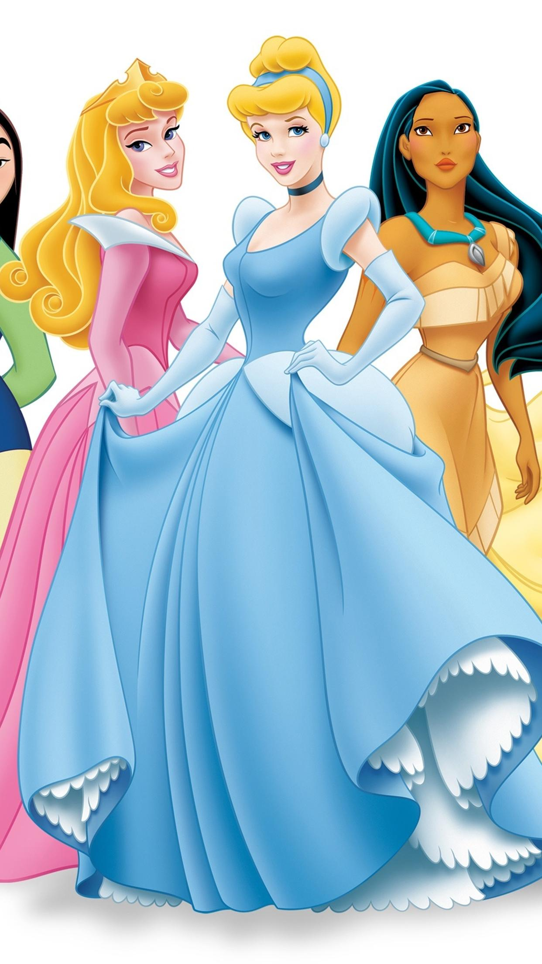
Notes:
Placeholder slide for movement in classroom

Slide 11
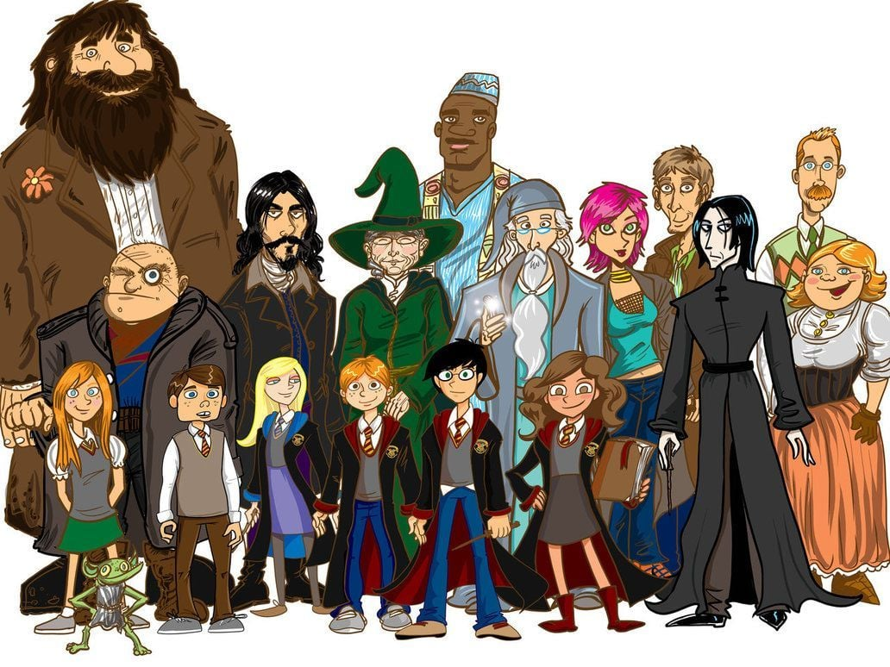
Notes:
Placeholder slide for movement in classroom

Slide 12
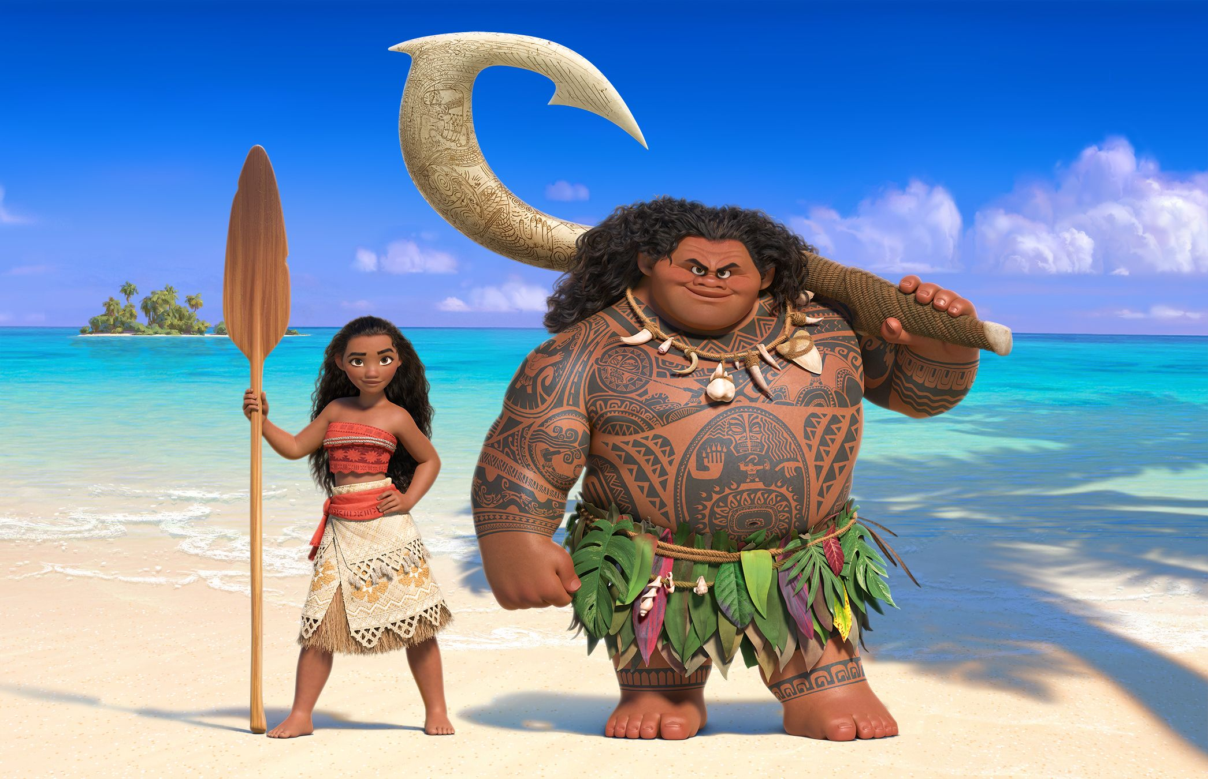
Notes:
Placeholder slide for movement in classroom

Slide 13
How do these portrayals influence how we see boys and girls?

Slide 14

Activity 2
What is objectification?
What is the Consequence Wheel?
Notes:
Placeholder slide for movement in classroom

Slide 15
How would you describe an object?
What words would you use?
Notes:
Placeholder slide for movement in classroom

Slide 16
How would you describe a person?
What words would you use?
Notes:
Placeholder slide for movement in classroom

Slide 17


What content or videos do you see of males and females online?
Notes:
Placeholder slide for movement in classroom

Slide 18
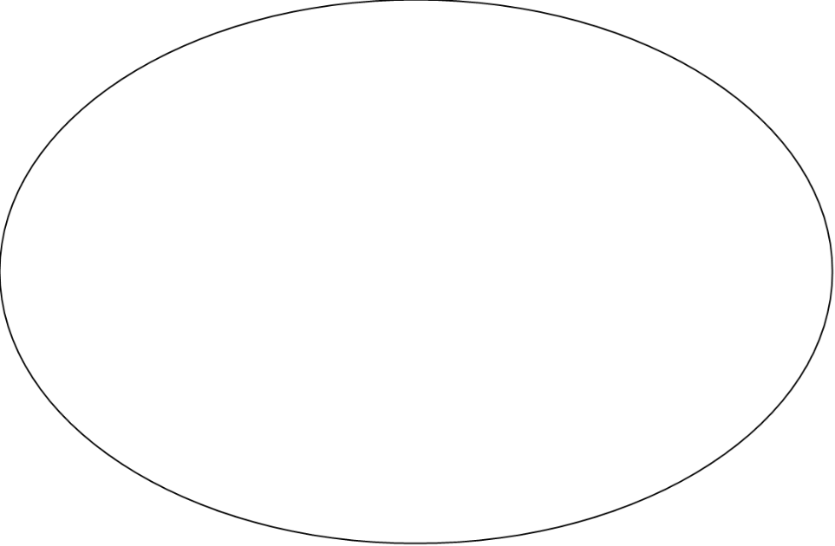
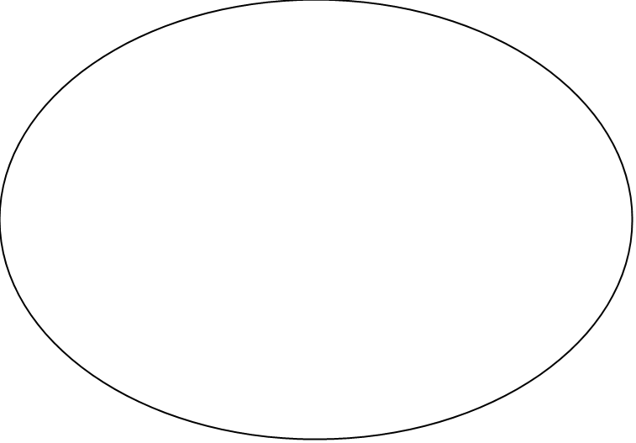
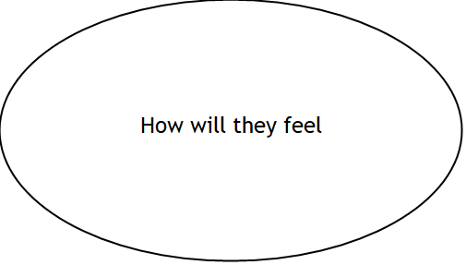
What might happen in society?
What might happen at school
Steps

Slide 19
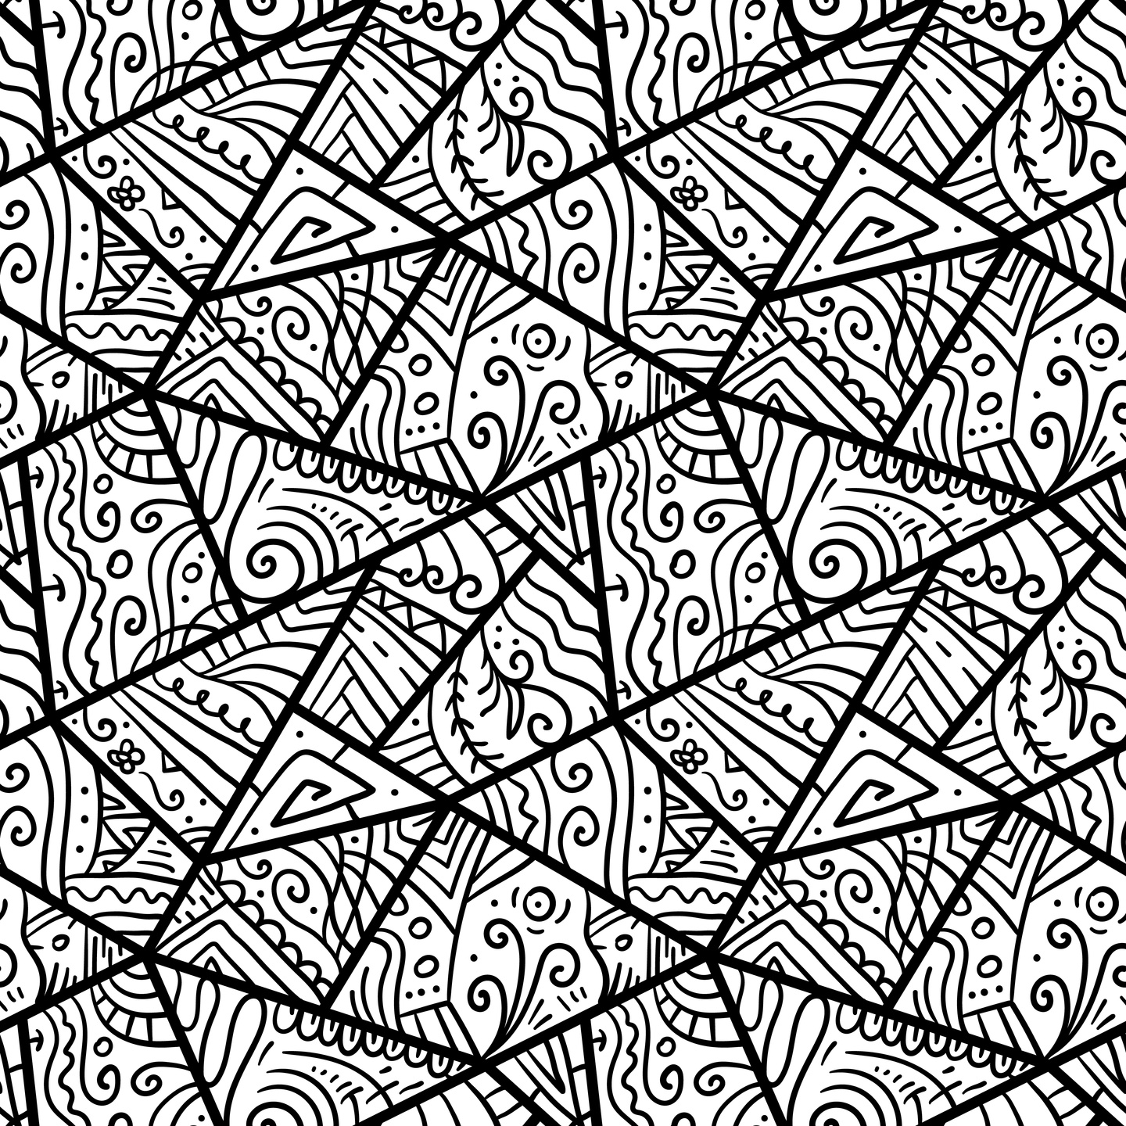
Next week
Allyship &
Positive Bystander

