Slide 1



Steps
Week 4
Allyship & Positive Bystander

Slide 2


Today’s session
Group Agreement
Recap ‘What do we remember from last session?’
What is Allyship?
How can I be a positive bystander?
Summary and next week
Steps

Slide 3



Group agreement
When others talk, we listen.
Respect others' opinions.
Respect our own opinions.
During the sessions, we can talk in a way that feels the most natural for us.

Slide 4

Language Reminder

Slide 5
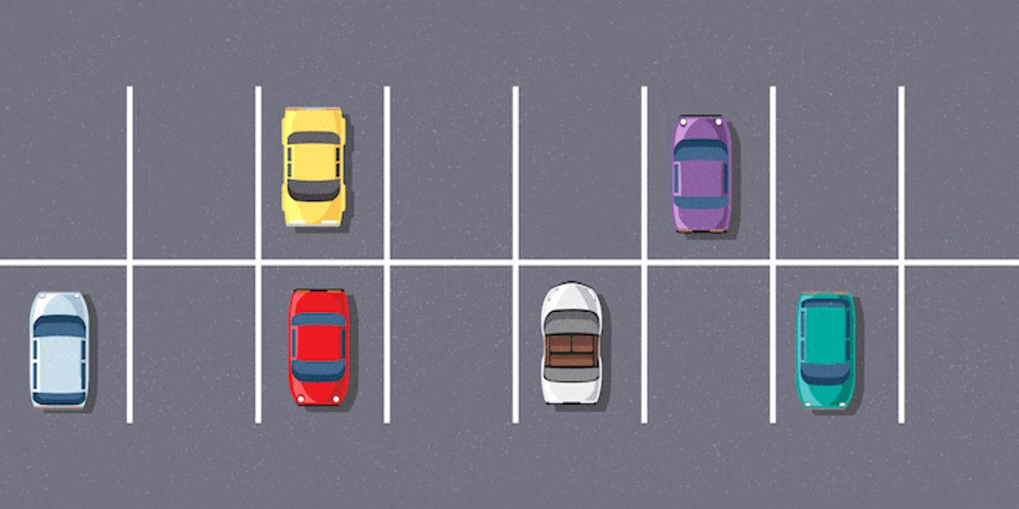
Question Car Park

Slide 6

Recap
What do we remember from last session?

Slide 7

Stand up
Activity 1
Move to one side of the room if you agree/disagree
Notes:
Placeholder slide for movement in classroom

Slide 8

Activity 2
What is an Allyship?
Notes:
Placeholder slide for movement in classroom

Slide 9
Why is allyship important?
Notes:
Placeholder slide for movement in classroom

Slide 10
Create an acrostic poem
A -
L -
L -
Y -
S -
H -
I -
P -
Notes:
Placeholder slide for movement in classroom

Slide 11

Activity 3: Being a positive bystander
Notes:
Placeholder slide for movement in classroom

Slide 12
Scenario 1: ‘Eve is in class working in a group with Simon, Peter and Joe. The boys start to ignore Eve as a joke, but she becomes upset as she is not included in the groupwork’.
Notes:
Placeholder slide for movement in classroom

Slide 13
Scenario 2: ‘Jack starts wearing nail vanish to school. The teacher tells him to remove it and the other boys in his class start laughing at him and calling him gay’.
Notes:
Placeholder slide for movement in classroom

Slide 14
Scenario 3: ‘Sam asks Holly to be his girlfriend. Holly says no as she doesn’t fancy Sam. Sam pushes her over and tells everyone she is ugly’.
Notes:
Placeholder slide for movement in classroom

Slide 15

Next week
Self Identity

