Slide 1



Steps
Week 5
Self Identity & Male Culture

Slide 2


Today’s session
Group Agreement
Recap ‘What do we remember from last session?’
What is male/boy culture?
Self Identity
Recap
Feedback Forms
Steps

Slide 3



Group agreement
When others talk, we listen.
Respect others' opinions.
Respect our own opinions.
During the sessions, we can talk in a way that feels the most natural for us.

Slide 4

Language Reminder

Slide 5
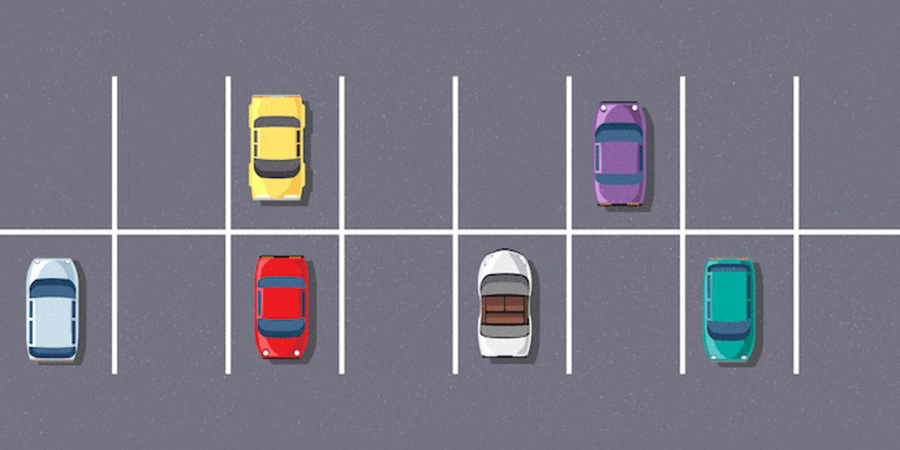
Question Car Park

Slide 6

Recap
What do we remember from last session?

Slide 7

Activity 1
Boy/Male Culture
Notes:
Placeholder slide for movement in classroom

Slide 8
What is male or boy culture?
Notes:
Placeholder slide for movement in classroom

Slide 9
What are examples of male culture?
Notes:
Placeholder slide for movement in classroom

Slide 10
Split into groups of pairs
Think about what do you think the problems could be with male/boy culture?
Notes:
Placeholder slide for movement in classroom

Slide 11
Split into groups of pairs
What could be the solution to combat these problems? In school? In society? What can you do?
Notes:
Placeholder slide for movement in classroom

Slide 12

Activity 2
Self Identity
Notes:
Placeholder slide for movement in classroom

Slide 13

Speedy Recap
Notes:
Placeholder slide for movement in classroom

Slide 14
Healthy and Unhealthy relationships, what can you remember?
Notes:
Placeholder slide for movement in classroom

Slide 15
Gender stereotypes, what can you remember?
Notes:
Placeholder slide for movement in classroom

Slide 16
Objectification and stereotypes in the media, what can you remember?
Notes:
Placeholder slide for movement in classroom

Slide 17
Allyship and being a positive bystander, what can you remember?
Notes:
Placeholder slide for movement in classroom

Slide 18

Feedback

