Slide 1
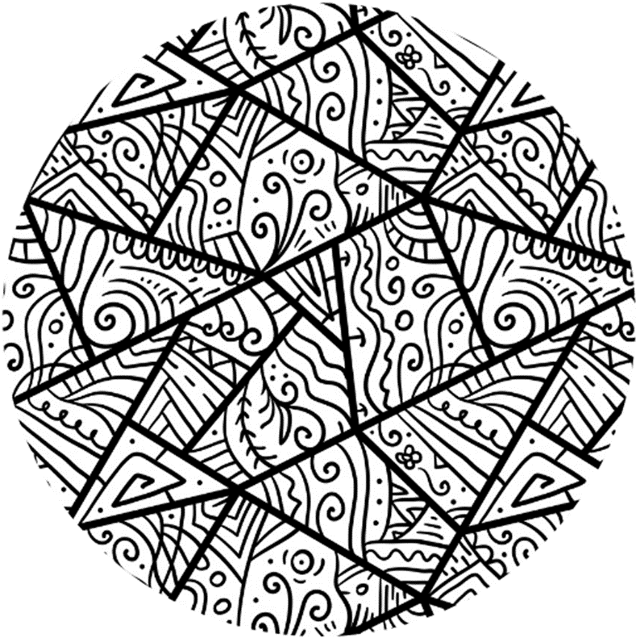



Session 1

Slide 2
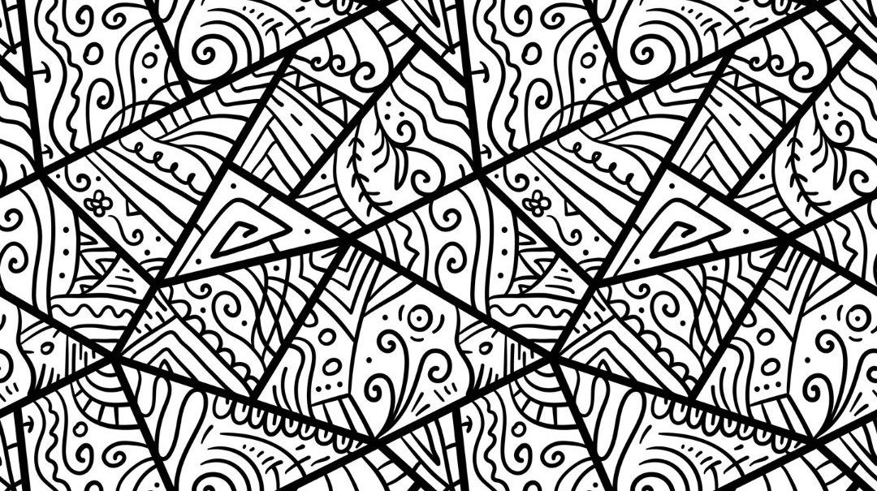

Today’s session
Project overview
Group Agreement
Understanding our associations
Talking about Gender Stereotypes

Slide 3
What is Steps?

Slide 4
In Steps, we:
Develop the confidence to be a positive influence in your school
Be prepared for different situations you may experience currently or in the future
Develop the skills to identify negative attitudes and behaviours about women and girls and understand how this is harmful to everyone

Slide 5

Group Agreement
1. When someone talks, we listen.
2. We respect each other’s opinions and voice.
3. We respect our own opinions and voice.

Slide 6

Stand up
Push seat in
Make sure you can see the board
Notes:
Placeholder slide for movement in classroom

Slide 7
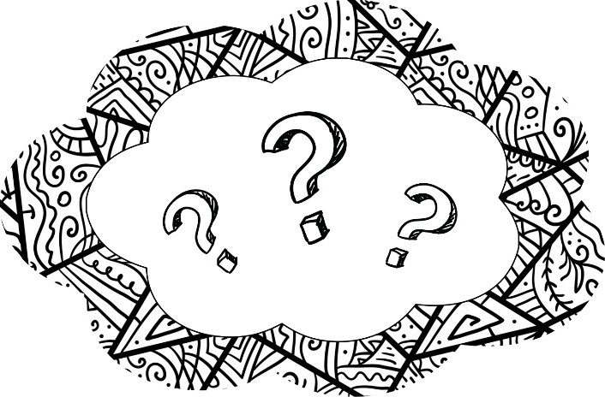
What do you think of when I say…
Strong
Rich
Cooking

Slide 8
What do you think of when I say…
Girl
Boy

Slide 9

Stereotypes

Slide 10
Stereotypes
Stereotypes are internalised beliefs about people, or groups of people, and how they should look or act.
These beliefs are not true, restrict what people do, and limit people’s choices.

Slide 11
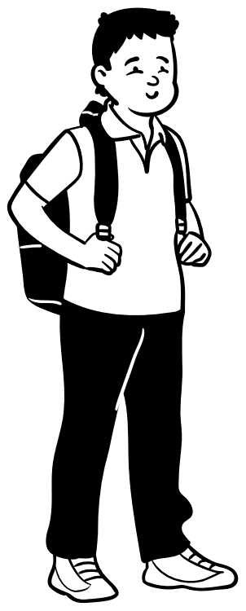
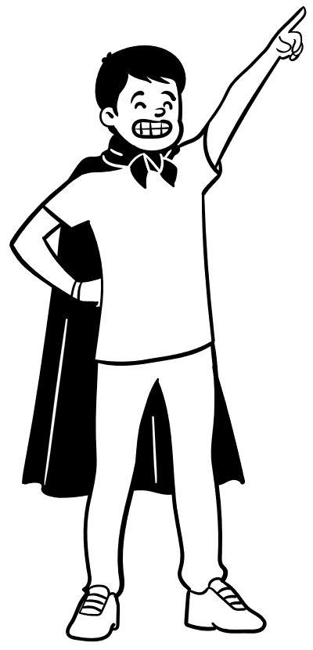

How do stereotypes affect us?
Primary School
Secondary School

Slide 12


How do stereotypes affect us?
“Men should never cry. Don’t show your emotions, only girls cry!”
“Your drawing looks so bad. Boys are never good at drawing.”
“Go play football, you should be good at it because you’re a boy.”
“To be a real man, you have to be strong and tall.”
My drawing looks awful. I will never be good at drawing.
Those boys on the rugby team are well tall and strong. I feel like I look so bad compared to them.
I feel really upset; I want to cry. I can’t tell anyone though, I’m not a girl!
I need to get better at football, all the other boys are good at it. I feel really embarrassed when I play.
Notes:
Use on screen format – get boys to suggest/come up to screen to match them

Slide 13
Girls should never play football; they are always really bad at it.
Is he someone who:
Tells the truth?
Includes everyone?
Why are you crying? Man up!
Supports people’s right to be themselves?
Supports people if they express emotions?
I only wear the colour blue, if you wear any other colours you’re a girl!

Slide 14
Stereotypes are…
We should be aware of them and question them because…
Notes:
Quick recap

