Slide 1
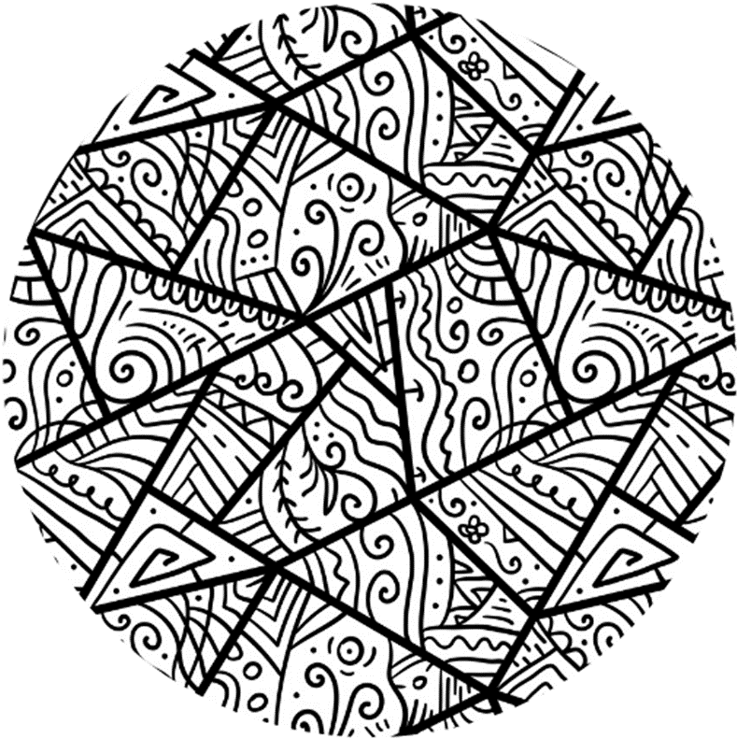



Session 2

Slide 2
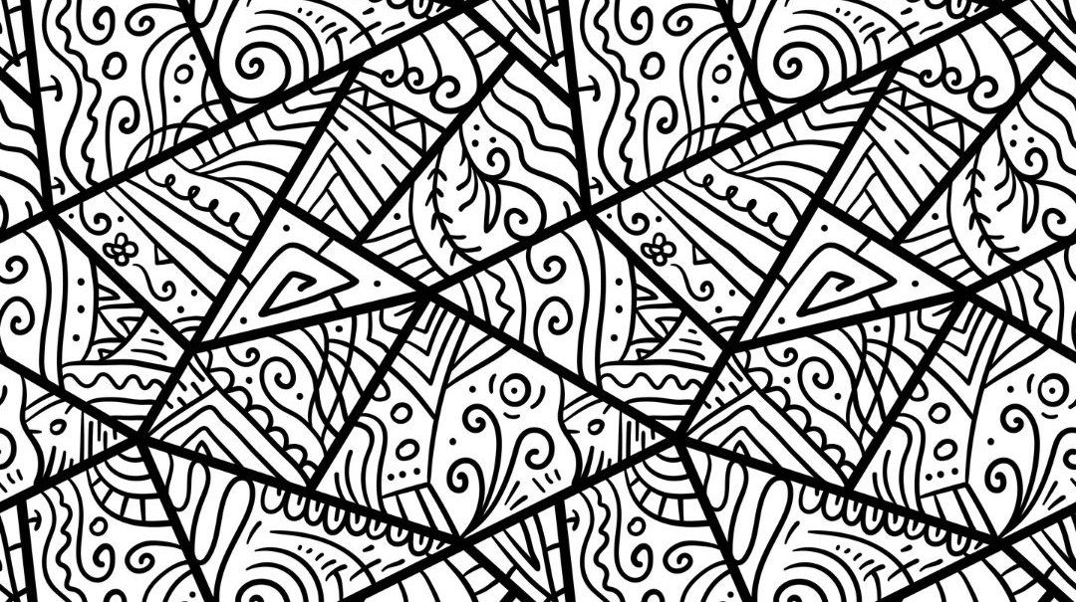

Group Agreement
1. When someone talks, we listen.
2. We respect each other’s opinions and voice.
3. We respect our own opinions and voice.

Slide 3


St____t___s
Int_rn_l_se
Notes:
Whole class engagement- Last week we talked about two key words/phrases, there’s some clues on the board
Hands up if you can guess what they are
Use student feedback, guide convo to set terms
Highlight that misogyny will be part of our session today, but we will refer to gender stereotypes a bit as well

Slide 4

Harmful expectations of how women and girls should act like or look like.
Gender Stereotypes
Unhealthy expectations of how men and boys should act like or look like.
Healthy relationships with others
Confidence in ourself
No limits on what we can do or achieve
More opportunities to learn and grow as people
Misogyny

Slide 5
Misogyny
(Mi-soh-jeh-nee)
Misogynist
(Mi-soh-jeh-ne-st
Notes:
Let them practise

Slide 6
Misogyny describes prejudice, negative opinions, or negative behaviours towards women and girls.
2. Someone who is a misogynist thinks men and boys should be above women and girls.
3. Someone who is misogynist thinks women and girls should not have the same rights or freedom as men and boys.
Misogyny
(Mi-soh-jeh-nee)
Misogynist
(Mi-soh-jeh-ni-st
Notes:
Ask for reading volunteers

Slide 7
Someone who is a misogynist will hold views and show behaviours that are emotionally and physically harmful to all women and all girls.
This means misogynists do not have healthy and respectful interactions with the women and girls around them.

Slide 8
How do we feel talking about this?
Why?
What can we do to address or stop misogyny?

