Slide 1

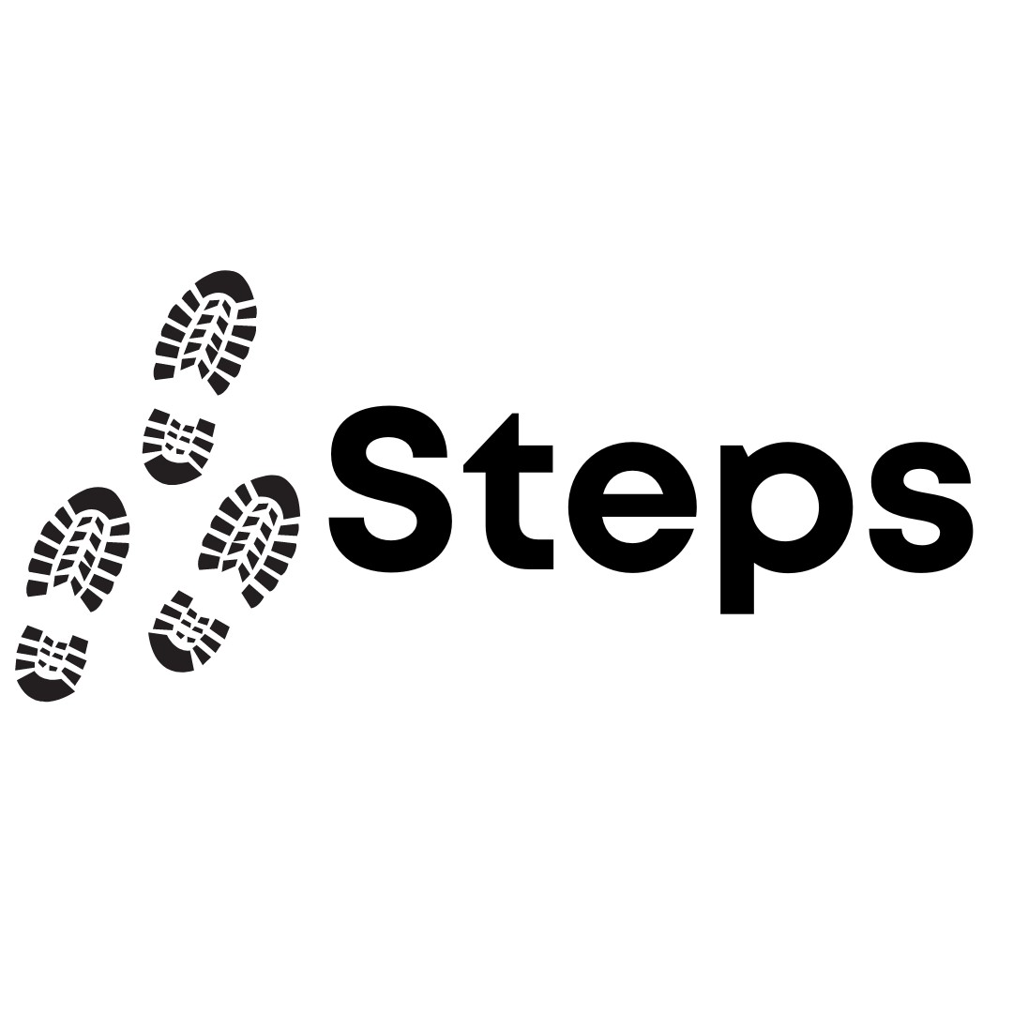


Session 4

Slide 2
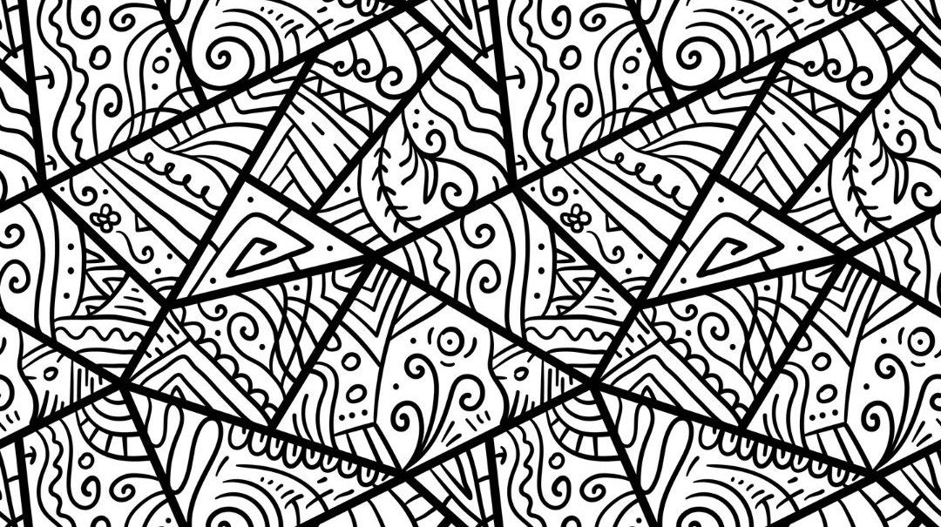

Group Agreement
1. When someone talks, we listen.
2. We respect each other’s opinions and voice.
3. We respect our own opinions and voice.

Slide 3
Today’s Plan
Recap: Misogyny
Our Online Diet

Slide 4
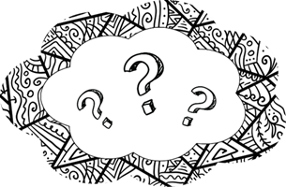
What are these words?
M_s_g_ny
St_r_ot_pe
In_e_nal_ze

Slide 5
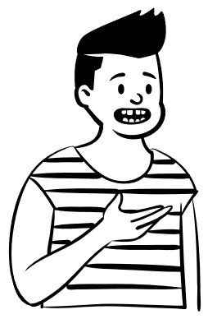
Misogyny
Let’s recap
Notes:
Take time to check understanding, pronunciation

Slide 6
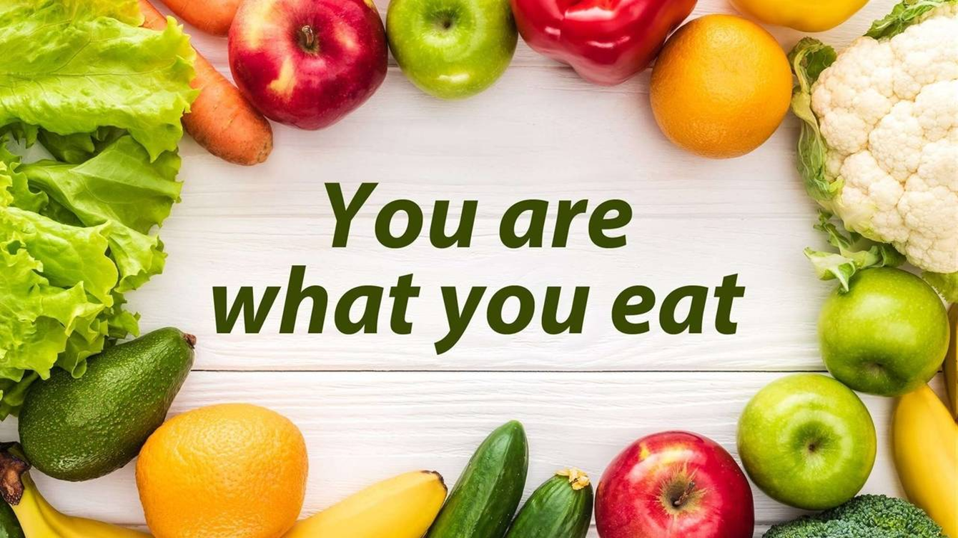

Slide 7
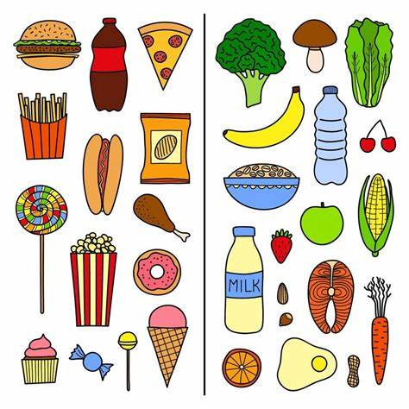
How would you describe these diets?
How might a person feel if they only ate one or the other?

Slide 8
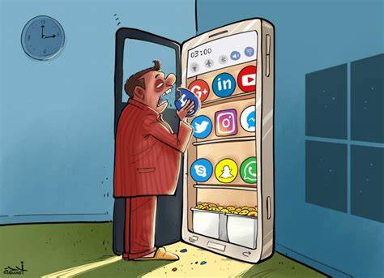
We also consume information, especially online.
Our online ‘diets’ can also be healthy or unhealthy.

Slide 9
The videos we watch, the comments we read and the voices we listen to can change our mood and our health, just like foods and drinks.

Slide 10
We think carefully about the content we internalize to have a healthy online diet.

Slide 11
Station 1
Social Media OR online platforms that we use.
Station 2
Types of
content we
use.
Station 3
Creators
that we like.
Notes:
Provide worksheet for individual pupils, encourage once each box has been filled with at least two things to then talk about it with someone else

Slide 12
How would you describe your online diet?
What did you notice about other people’s answers?

