Slide 1
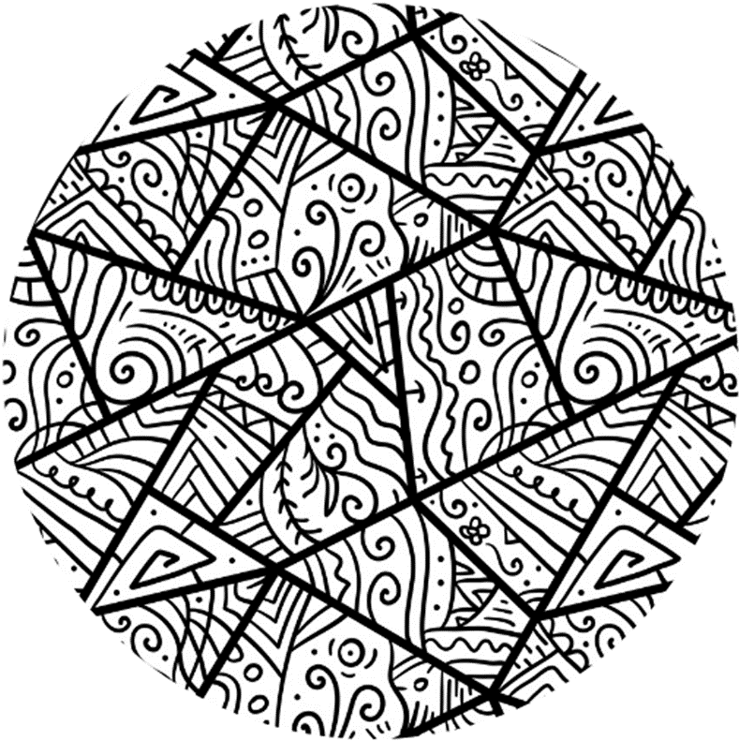



Session 5

Slide 2
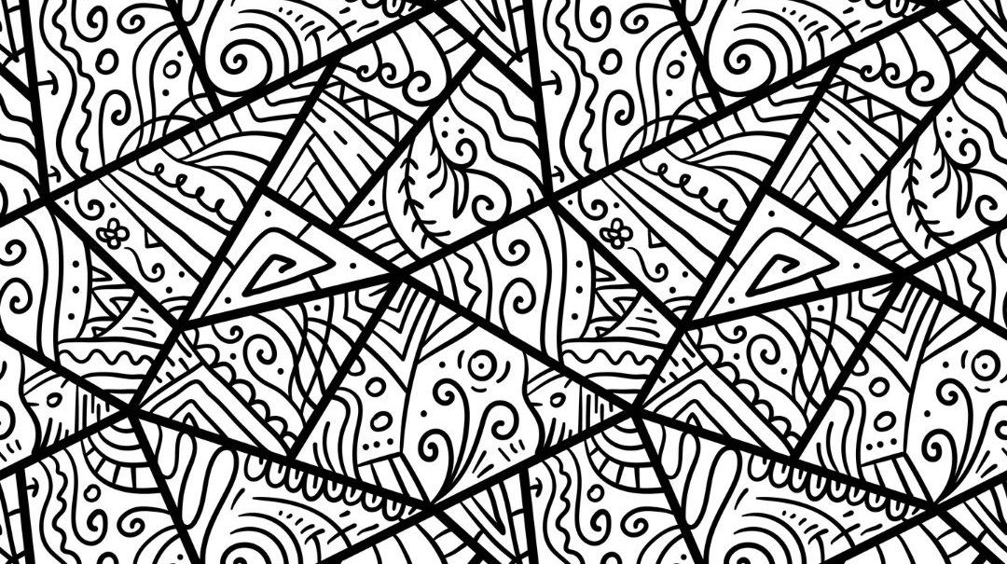

Today
Recap : Online Diet
The Impact of Harmful Content

Slide 3
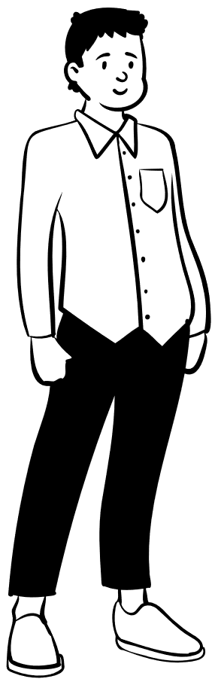
“You are what you eat.”
Notes:
Don’t need to use slides 3-7, but can help structure recap

Slide 4
What we consume online also shapes who we are as a person.

Slide 5
Every time we go online, we are adding to our online diet.

Slide 6
We internalise the messages, attitudes, and behaviours we see online.

Slide 7
This can impact what we think about ourselves, and how we act towards others.

Slide 8
We must be careful about what we take in if we want to have a healthy online diet.

Slide 9
Close your eyes
Raise your hand if you have asked yourself any of these questions.
If you don’t feel comfortable, just answer in your own head.

Slide 10
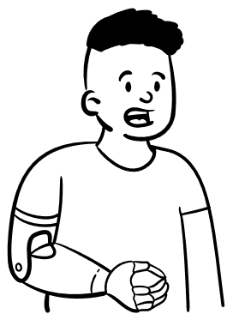
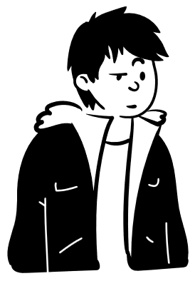
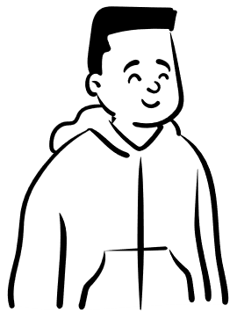
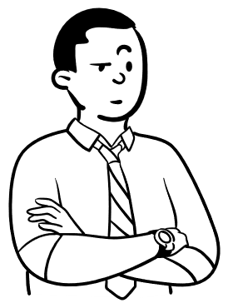
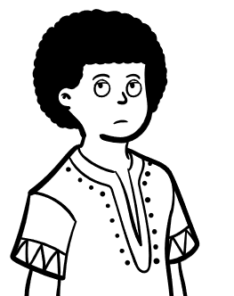

We might ask these questions because we feel…
Not confident
Embarrassed
Unhappy
Worried

Slide 11
Everyone feels them, even if they say they don’t

Slide 12
There are adults online who use these feelings to become popular and rich.
They make content online that targets men and boys.

Slide 13
They want lots of attention and will pretend to have the answers to what men and boys are worried about.
They don’t care about helping people!

Slide 14
These adults show misogyny by blaming women and girls for men and boys feeling embarrassed, insecure or confused.

Slide 15
They also tell men and boys to hide their emotions, and say emotions make men and boys weak.

Slide 16
These adults online who target young men and boys through misogynistic content. We sometimes call them the
MANOSPHERE.
(Man-oh-s-feer)
Notes:
Added pronunciation

Slide 17
How might misogynistic content affect our online diet?
Notes:
Changed wording to be more direct for age group

Slide 18
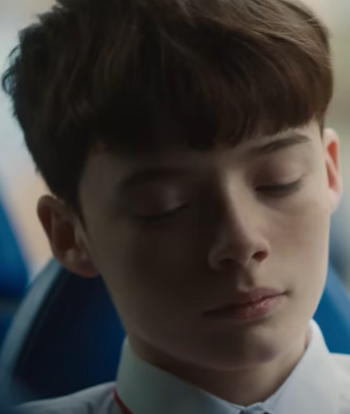
This is our main character Ollie. He is internalizing attitudes and behaviours from manosphere videos.
Notes:
Slide 18-19 is to help support understanding of video on Slide 21

Slide 19
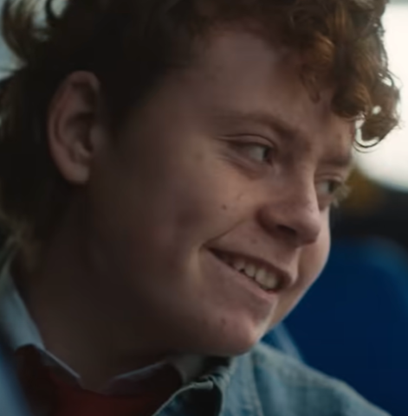
This boy represents the manosphere. He is not really there.

Slide 20
How is Ollie affected?
How does he change?
What sort of attitudes does the manosphere show?
Do we recognize any stereotypes or misogyny?
Notes:
Highlight insecurities at the start and normalize.

Slide 21

