Slide 1

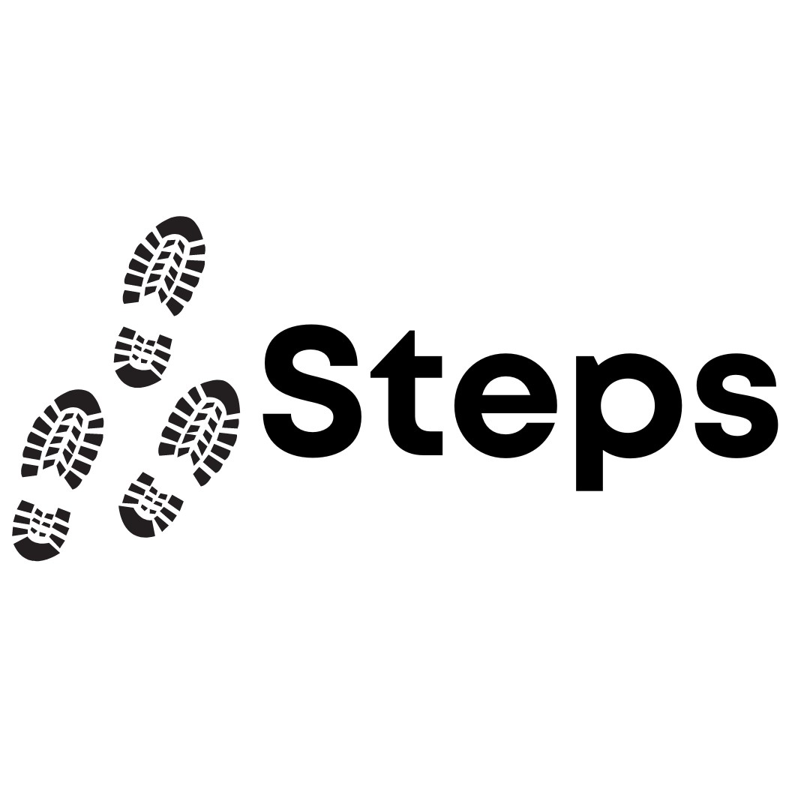


Session 7

Slide 2


Today
Misogyny and Rage bait
Our Responsibility Online

Slide 3
Group Agreement
1. When someone talks, we listen.
2. We respect each other’s opinions and voice.
3. We respect our own opinions and voice.

Slide 4
Social Media wants us to keep on using their apps and websites. They like it when people make content that keeps people engaged through watch time, likes, comments.

Slide 5

Sometimes people make posts that are deliberately trying to make people shocked, angry or annoyed.

Slide 6
Some manosphere content is designed to become popular this way.
They don’t care about what they say, they just want attention and money!

Slide 7
But what if we think it’s funny, or not a big deal?
Notes:
Acknowledge that this is very likely.

Slide 8
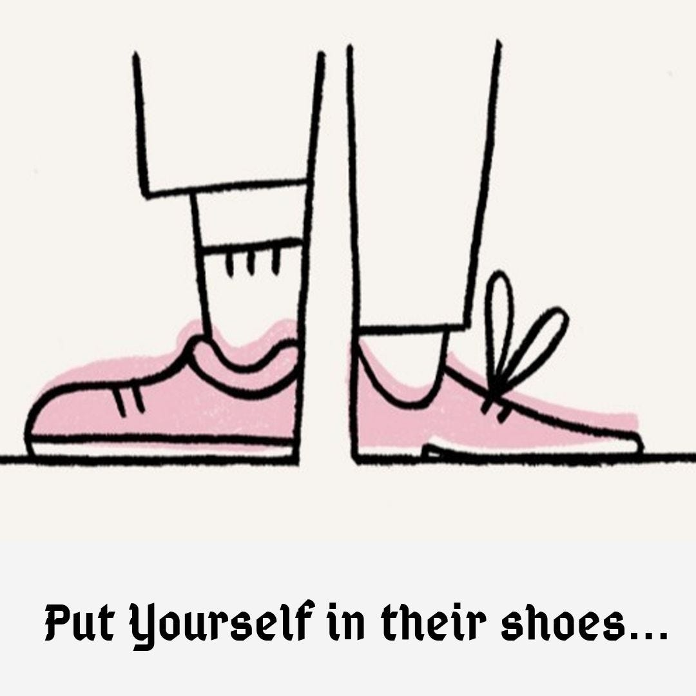
We may see content that we know is rage bait, and it doesn’t have an impact on us.
To keep online spaces healthy, we can take a moment to think about how it may affect other people.
Notes:
Introduce saying, make sure everyone understands. Link back to misogyny, someone saying ‘women should all be in the kitchen’ wont impact boys/men , might seem like a joke, but how would it impact other people. Could use racism/religious bias in ragebait as an example, if confident that cohort can navigate this.

Slide 9
If we aren’t careful what we engage with, our online diet can become:
Out of our control
Unhealthy
Misogynist
If we aren’t careful about what we engage with, misogynist posts can: Become popular
Show up on other people’s feeds
Notes:
Reaffirm we have responsibility to ourselves, and to others

Slide 10
In pairs
What should we do when we see posts or comments that are misogynist?

Slide 11
Use a different app
Take some time off
Block
Don’t like
Ignore
Think about how it might affect others
Report
Notes:
Likely point for discussions about social media companies

Slide 12
Thank you

