Slide 1

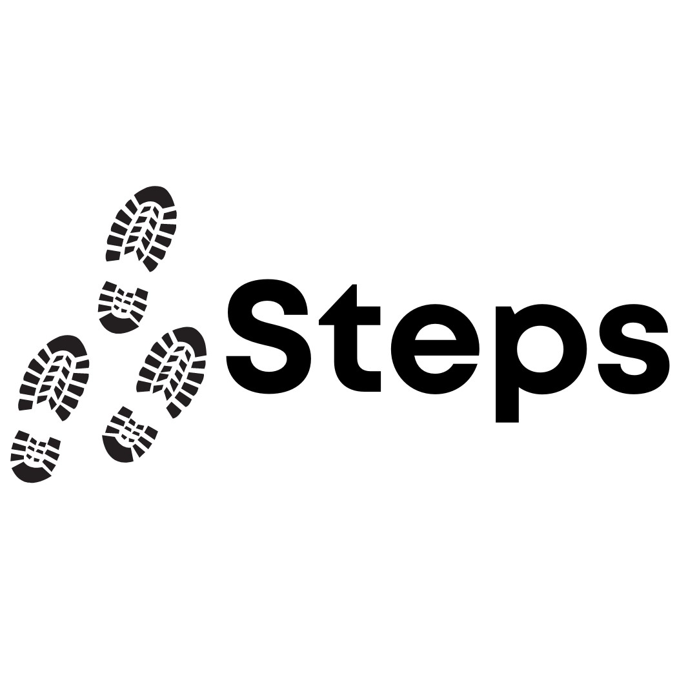


Session 8

Slide 2


Group Agreement
1. When someone talks, we listen.
2. We respect each other’s opinions and voice.
3. We respect our own opinions and voice.

Slide 3
Today
Healthy relationships.

Slide 4

What is a relationship?

Slide 5
Friends
Coach
Cousins
Parents
Teachers
Teammates
Romantic partner
Grandparents
Siblings
Lots more!

Slide 6
A relationship is connection between two people, shaped by how they treat each other.
Notes:
Needs to have something to distinguish close relationships and interactions in public.

Slide 7
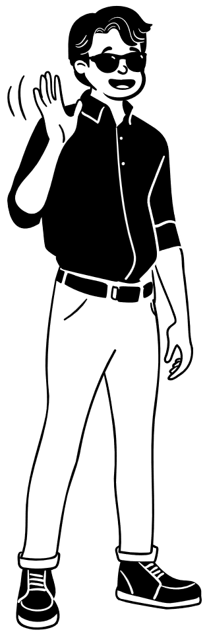
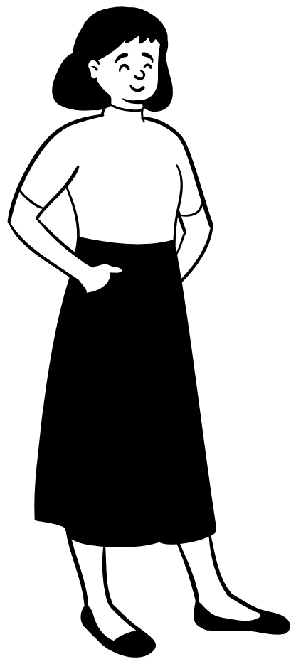
In all our relationships, we are responsible for how we treat the other person.
Our actions have consequences and can affect the other person.

Slide 8
50%
50%
We can never control 100% of how a relationship goes, but we are responsible for our 50%

Slide 9
In our 50%, we must show respect for the other persons:
Choices
Identity
Boundaries
Their ability to give consent

Slide 10
Giving consent is when someone agrees, freely and willingly, to let something happen – without being threatened or forced.

Slide 11
In other words, consent should always be:
Freely given: Given without pressure, force, exploitation.
Reversible: Can be withdrawn at any time.
Informed: Knowing what you’re agreeing to.
Enthusiastic: Body language, tone etc.
Specific: Consent for one thing is not for everything.
F.R.I.E.S.

Slide 12
Matching Game
2 teams.
Match scenario cards to response cards.
Not all responses are positive.
Finish first = 4pts
Correct pair = 2pts

Slide 13
Put cards away

Slide 14
Why would someone not respect another person’s consent?

Slide 15
What can we do when we see someone treating another person this way?
Notes:
Use cards as an example – not directly referring to misogyny yet, focusing on lack of consent/boundaries

