Slide 1




Session 9

Slide 2


Group Agreement
1. When someone talks, we listen.
2. We respect each other’s opinions and voice.
3. We respect our own opinions and voice.

Slide 3
Today
How misogyny impacts relationships
Keeping our communities safe.

Slide 4
A relationship is connection between two people, shaped by how they treat each other.
Notes:
Needs to have something to distinguish close relationships and interactions in public.

Slide 5
In a relationship, we must show respect for the other persons:
Choices
Identity
Boundaries
Their ability to give consent

Slide 6
Giving consent is when someone agrees, freely and willingly, to let something happen – without being threatened or forced.

Slide 7

Why would someone not respect another person’s consent?

Slide 8
Misogynists often believe that women and girls can’t be trusted to make decisions for themselves.
They think they can decide what women wear, where they go and how they act.
Misogynists cannot have healthy relationships with others.

Slide 9
What can we do when we see someone treating another person this way?

Slide 10

Delegate
If you feel unsafe or unable to act.
Get someone else to help.
Tell a trusted adult (teacher, parent etc.).
Distract
If you feel unable to address the harmful behaviour directly, change the topic of conversation
or come up with an idea to take the victim away from the situation.
Active Bystander
Delay
If you feel unsafe, you can
wait for a situation to pass
and support the victim afterwards.
Direct Action
Only if you feel safe.
Ask the person to stop the harmful behaviour.
Don’t aggravate – be calm and explain why that behaviour isn’t okay.

Slide 11


Watch this short video and pay attention to how the characters act.
Imagine how the characters feel and what might happen next.

Slide 12
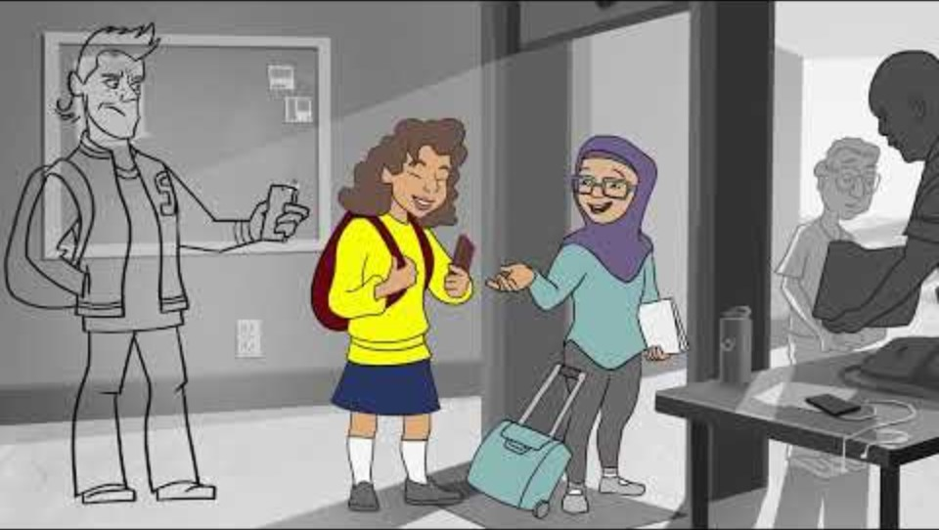

Slide 13
How would you describe the boy in the video?
How might the girl in blue feel?
How might the girl in yellow feel?

Slide 14
Give advice to the girl in yellow
Should she distract, delegate, delay or take direct action?
What risks might she consider?

Slide 15

Hands up
Share what we have written

