Slide 1
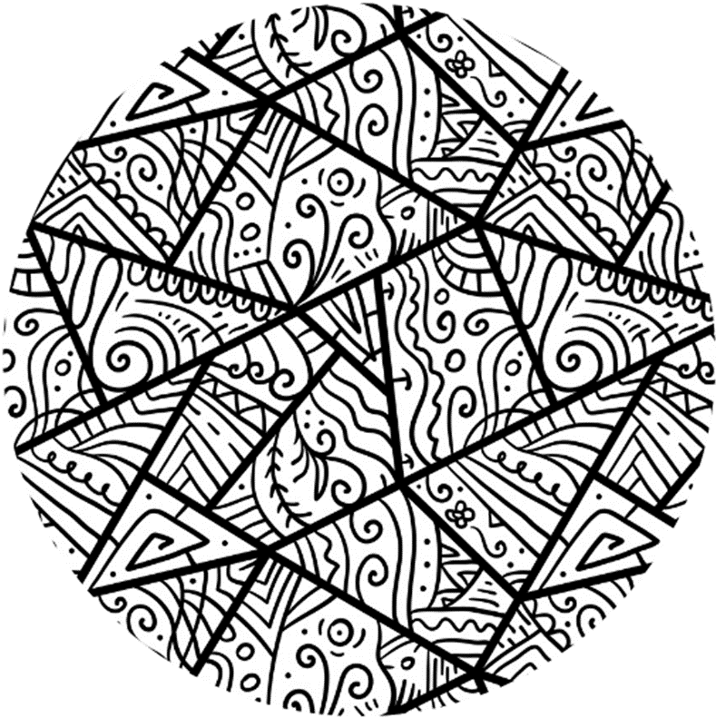


Week 1

Slide 2
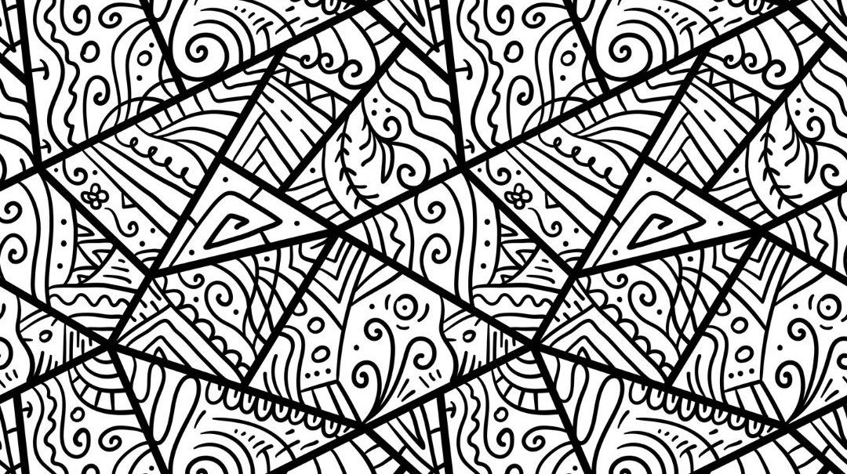
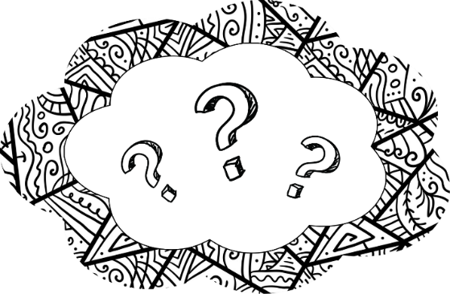
Today’s session
What is Steps?
Word Association Game
Talking about Gender Stereotypes

Slide 3
Steps is for boys to…
Understand how harmful expectations about gender can impact what boys think about themselves and how they act towards others
Be more knowledgeable about harmful attitudes and behaviours towards women and girls

Slide 4
Steps will help boys…
Feel confident in being a positive influence for other boys
Be prepared for social situations and know when to ask an adult for help
Notes:
Help vs for boys to..

Slide 5

Group agreement
When someone talks, we listen.
We respect each other’s opinions and voice.
We respect our own opinions and voice.

Slide 6
Stand up
Answer the question one by one – Work as a team, and take turns!

Slide 7
What is your favorite color?

Slide 8
Cats or dogs?

Slide 9
What do you think of when I say…
Rich

Slide 10
What do you think of when I say…
Cooking

Slide 11
What do you think of when I say…
Strong

Slide 12
What do you think of when I say…
Boy

Slide 13
What do you think of when I say…
Girl

Slide 14
Stereotypes

Slide 15
Stereotypes are beliefs about how people in a group act like or look like.
They may sound like rules or commands.
“Boys should never…” “Girls always…”

Slide 16
Stereotypes are harmful because:
They are not true.
They restrict people’s choices
They could stop people from being themselves.

Slide 17
However, we may already be aware of some gender stereotypes.
This is because we may see them in different places.

Slide 18
Where might we see or hear gender stereotypes?
Notes:
Introduce internalization at this point
Highlight that they’re bad, but at a default we all know them

Slide 19
Magazines
TV shows
History
Films
Music
Where might we see or hear gender stereotypes?
Online spaces
People around us
Books
Notes:
Introduce internalization at this point
Highlight that they’re bad, but at a default we all know them

Slide 20
If we hear or see information, We internalise it

Slide 21
This means we take that information in. It stays in our heads. It changes what we know or think.

Slide 22
We
internalise
These stereotypes
It stays in our heads. It affect what we think about ourselves and other people.
If we hear or see gender stereotypes

Slide 23
It’s good to take time to think about what information or messages we internalise.
This can help us understand our behaviours and how we see the world.

Slide 24
“Men should never cry, crying means you’re girly and weak”

Slide 25
“Men should never cry, crying means you’re girly and weak”
How do I act towards other people?
What do I think about myself?

Slide 26

Licensing
Creative Commons Attribution-NonCommercial-NoDerivatives 4.0 International
This license requires that reusers give credit to the creator (GBV Education Team, Salford Foundation) It allows reusers to copy and distribute the material in any medium or format in unadapted form and for noncommercial purposes only.
BY
Credit must be given to the creator (GBV Education Team, Salford Foundation)
NC
Only noncommercial use of this work is permitted. Noncommercial means not primarily intended for or directed towards commercial advantage or monetary compensation.
ND
No derivatives or adaptations of this work are permitted.
See the License Deed

