Slide 1



Week 2

Slide 2
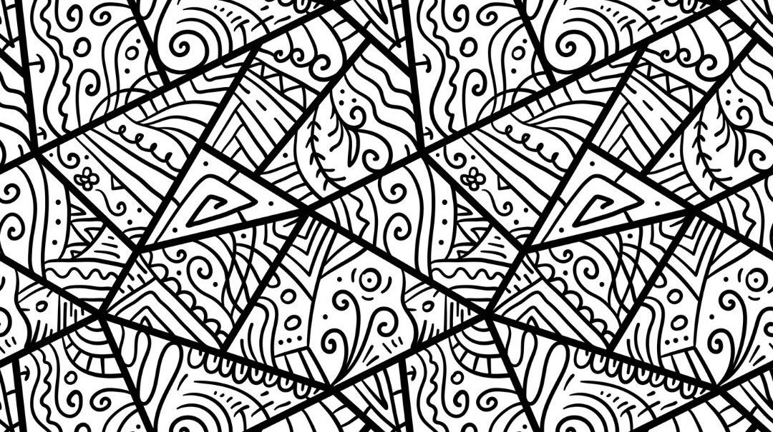
Today
Recap
Understanding Misogyny
True or False Quiz
Being a Supportive Friend
What’s an Active Bystander?
Notes:
(Need to provide signposting)

Slide 3

Group agreement
When someone talks, we listen.
We respect each other’s opinions and voice.
We respect our own opinions and voice.

Slide 4
Key Words
_ _ _ _ E R
_ _ E _ E O _ _ _ E
I N T _ _ _ _ L _ _ _

Slide 5
Key Words
G E N D E R
S T E R E O T Y P E
I N T E R N A L I S E

Slide 6
Gender stereotypes are false beliefs about how people should act or look like based on whether they’re a boy, girl, man, or woman.

Slide 7
When gender stereotypes aren’t challenged, people might develop a harmful belief called:
Misogyny
(Meh- soh- ji-nee)

Slide 8
Misogyny is prejudice, negative opinions, or an irrational hatred of women and girls.

Slide 9
1. Say women and girls deserve less freedom and rights than men and boys.
2. Not trust women and girls to make decisions just because of their gender.
3. Assume women and girls can never be as smart, capable, or successful as men and boys.
4. Only value women and girls based on how they look.
Someone who believes in misogyny would be called a misogynist.
A misogynist would…

Slide 10
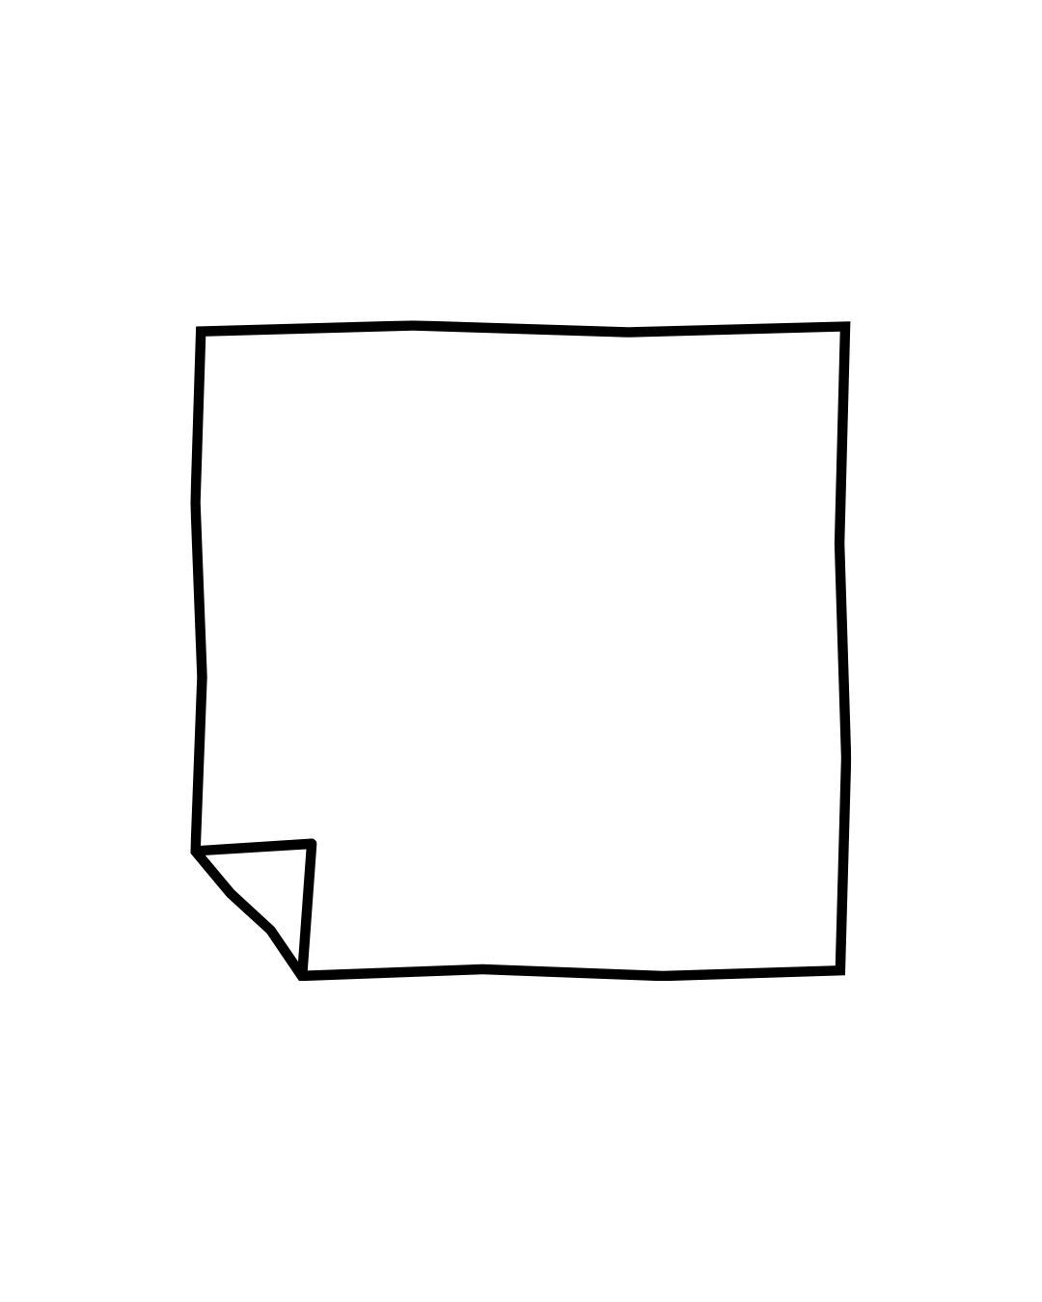
Misogyny is something that all women and girls may experience.
Take some time to reflect on how do you feel hearing about misogyny.
Extension: What do you think could be done to stop it?
Write it down on your piece of paper.
Hearing about misogyny makes me feel ____
because _____.

Slide 11

Facts will appear on the screen
Decide if you think they are True or False
Notes:
Assign sides of the room for True/False

Slide 12
True or False?
30% of children aged 9-16 understand what misogyny means

Slide 13
30% of children aged 9-16 understand what misogyny means
False

Slide 14
Only 16% of children aged 9-16 understand what misogyny means
Notes:
16

Slide 15
Online Misogyny describes hateful comments, harassment, and threats made towards women and girls online.

Slide 16
Online Misogyny describes hateful comments, harassment, and threats made towards women and girls online.
True

Slide 17
True or False?
Online misogyny only impacts women and girls when they go online.

Slide 18
Online misogyny only impacts women and girls when they go online.
False

Slide 19
After experience online misogyny, women and girls report feeling:
Stress and anxiety
Unsafe out in public
That they can’t take part in their usual activities

Slide 20
True or False?
25% of parents think it is important for children to learn about the impact of online misogyny.
Notes:
75% of parents

Slide 21
25% of parents think it is important for children to learn about the impact of online misogyny.
False
Notes:
75% of parents

Slide 22
75% of parents think it is important for children to learn about the impact of online misogyny.
Notes:
75% of parents

Slide 23
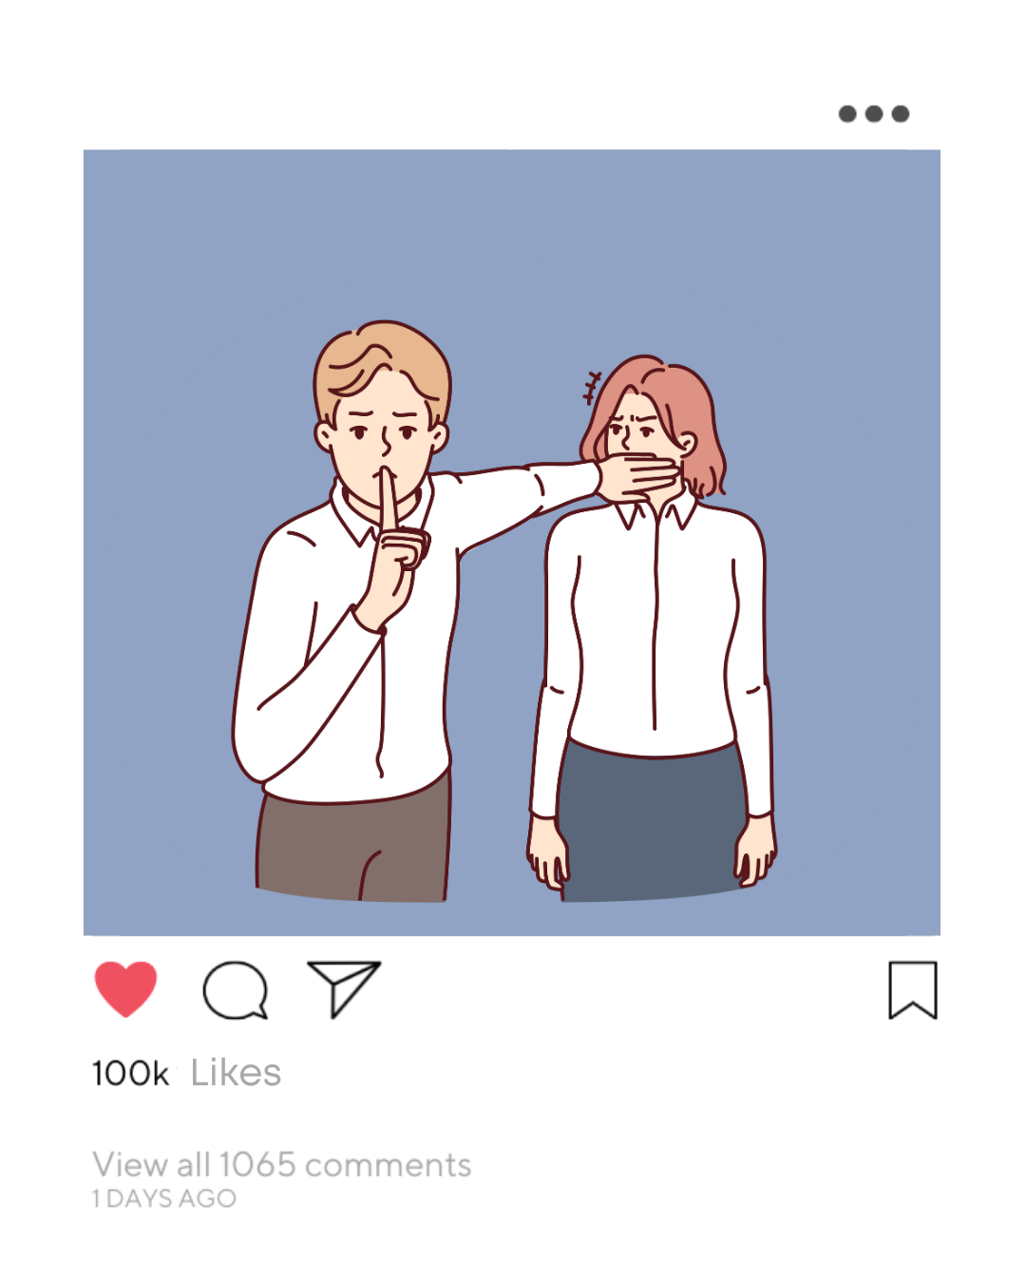
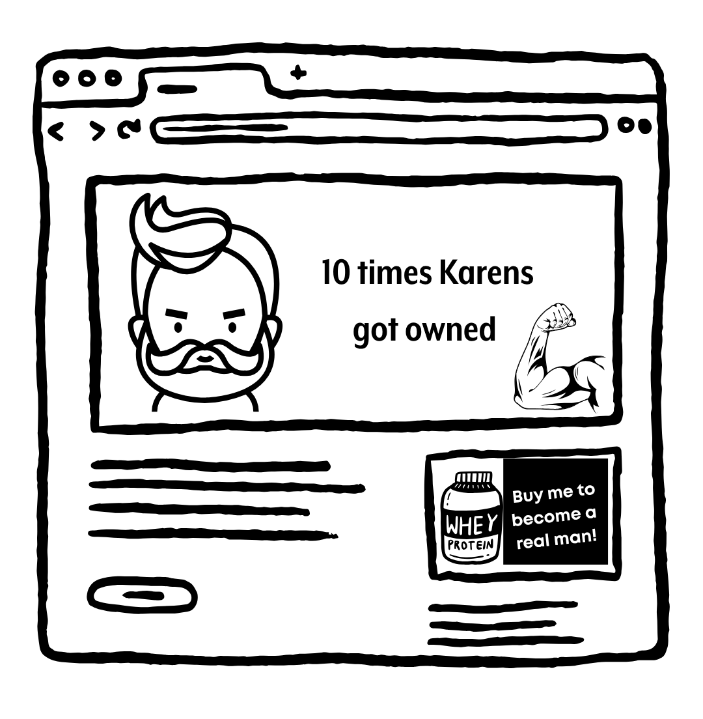

Some ways we might see misogyny online are…
Comment Sections/ Chats/ Direct Messages
Pictures/Memes
Videos

Slide 24
Online misogyny is a common experience for many women and girls.
Watch the following video where we’ll see Kaylee’s experience of misogyny online.
Notes:
Lead into Kaylee’s story

Slide 25
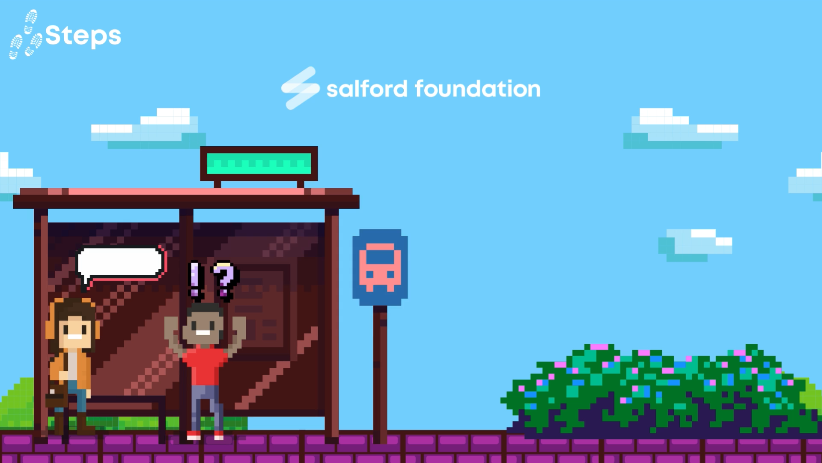
Steps
Notes:
NOTE – Video can be printed off to support later group discussion (See WK 2 – Story)

Slide 26
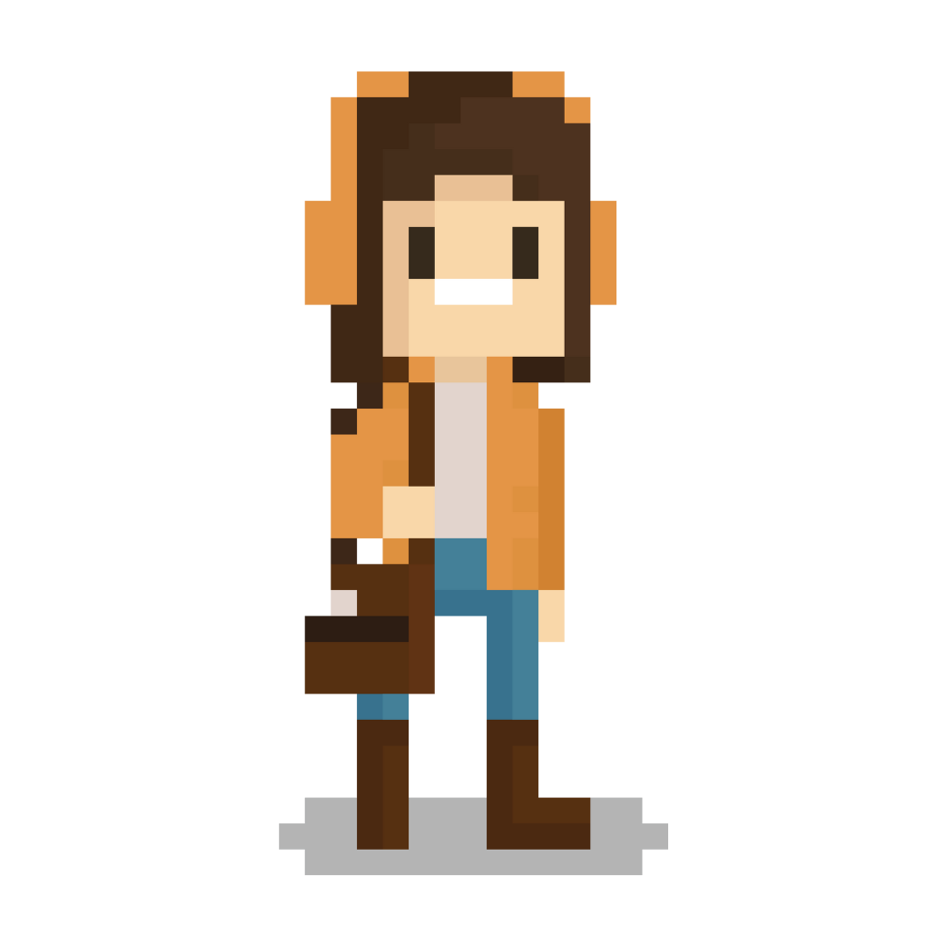
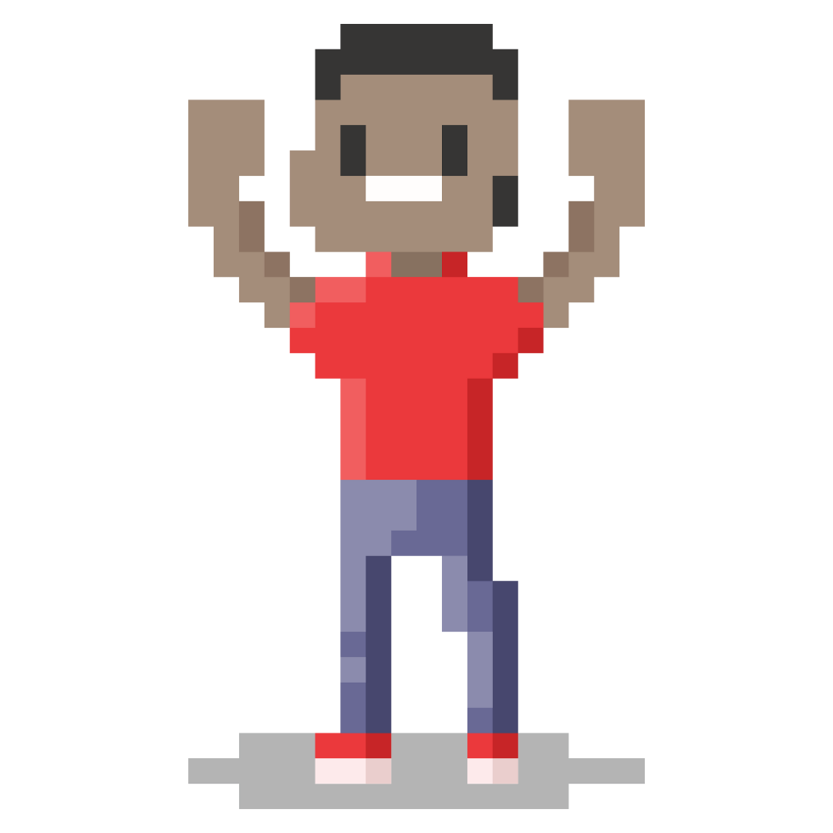
Discuss the questions on your sheet.
How can Greg be a good friend to Kaylee and support her?
Notes:
Lead into Kaylee’s story

Slide 27
When we see or hear someone being affected by online misogyny, we can be active and support them.
Notes:
Lead into Kaylee’s story

Slide 28
How can I be an active bystander?
Being an active bystander means:
Supporting the person affected by misogyny.
Knowing who to ask for help.
Calling out harmful behaviours if we’re safe to do so.
Notes:
Lead into Kaylee’s story

Slide 29

Licensing
Creative Commons Attribution-NonCommercial-NoDerivatives 4.0 International
This license requires that reusers give credit to the creator (GBV Education Team, Salford Foundation) It allows reusers to copy and distribute the material in any medium or format in unadapted form and for noncommercial purposes only.
BY
Credit must be given to the creator (GBV Education Team, Salford Foundation)
NC
Only noncommercial use of this work is permitted. Noncommercial means not primarily intended for or directed towards commercial advantage or monetary compensation.
ND
No derivatives or adaptations of this work are permitted.
See the License Deed

