Slide 1
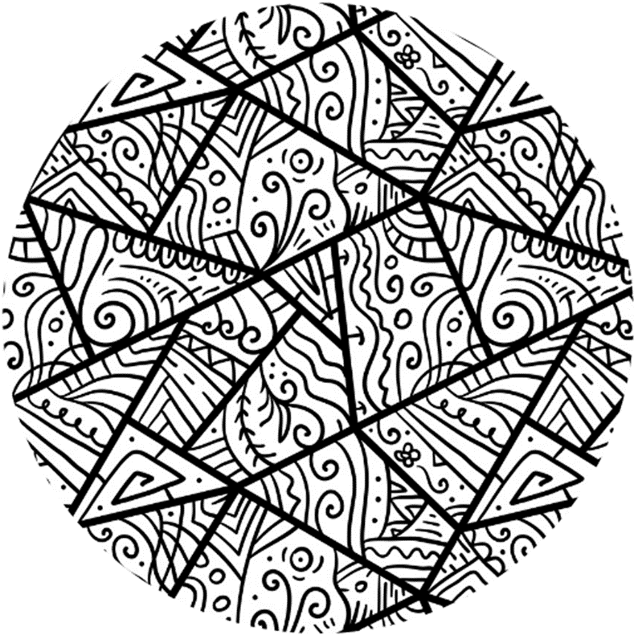


Week 3

Slide 2
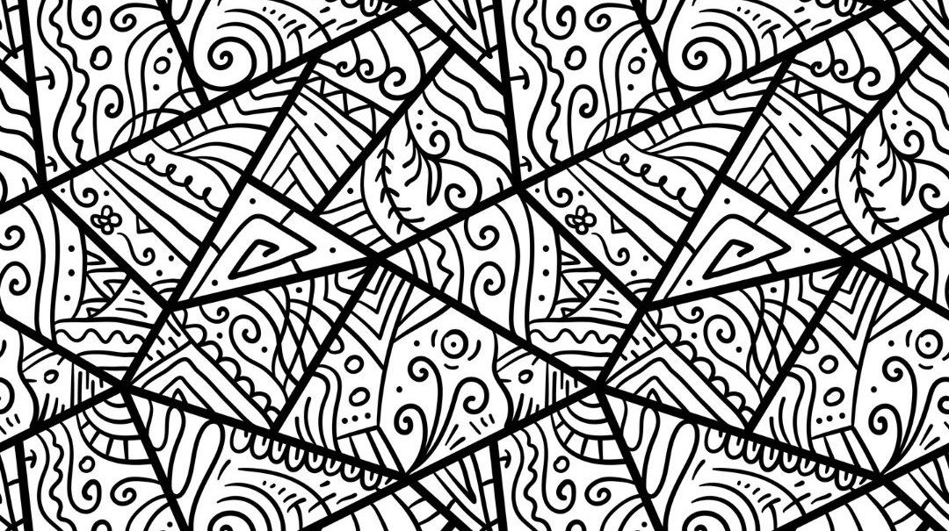

Group Agreement
1. When someone talks, we listen.
2. We respect each other’s opinions and voice.
3. We respect our own opinions and voice.

Slide 3

What are these words?
M_s_g_ny
St_r_ot_pe

Slide 4
Recap
Influencers and Our Online Diet
Misogyny Online

Slide 5
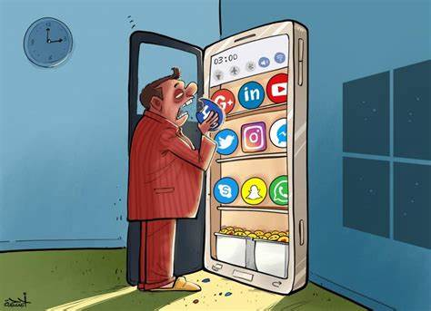
What is your online diet?
Notes:
Ask about what social media platforms the class uses, which creators they follow and what it is they like about those people.

Slide 6
The videos we watch, the comments we read and the voices we listen to can change our mood and our health, just like foods and drinks.

Slide 7
We think carefully about the content we internalize as we want to have a healthy online diet.

Slide 8
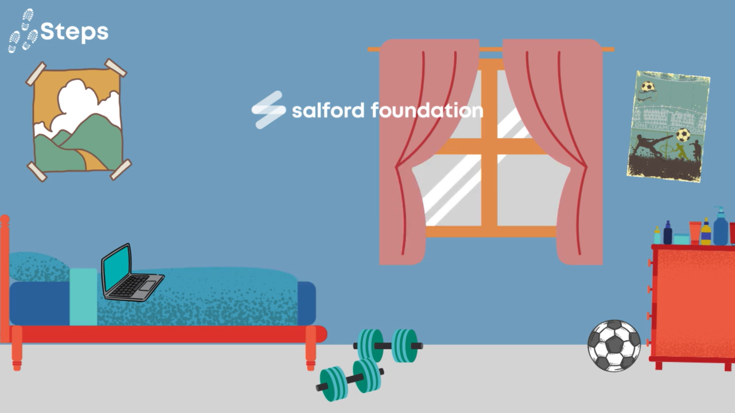
Notes:
Create bingo game for along with video

Slide 9
A lot of content we see online is made by individual people. They are sometimes called influencers

Slide 10
Influencer
An influencer is person who has lots of followers on social media and uses their posts to share ideas, promote products, or encourage people to do things or think in certain ways.

Slide 11
Close your eyes
Raise your hand if you have asked yourself any of these questions.
If you don’t feel comfortable, just answer in your own head.

Slide 12
We might ask these questions because we feel…
Not confident
Embarrassed
Unhappy
Worried

Slide 13
Everyone feels these emotions, even if they say they don’t

Slide 14
When we have these feelings, we may not ask for help. We may try and find answers online.
Notes:
Maybe change to adults out there who want young men to think these emotions make them weak or less of a man.
They pretend they want to help, but instead fill their videos with lies about what a man is and misogyny

Slide 15
Some influencers build a following by pretending they have a way to ‘help’ young men and boys when they feel difficult emotions.

Slide 16
They might start with some useful advice, but mix in gender stereotypes, misogyny, and lies.

Slide 17
This is usually by saying that when men and boys feel confused, lost or sad, it’s women and girl’s fault.
We know this is misogyny.

Slide 18
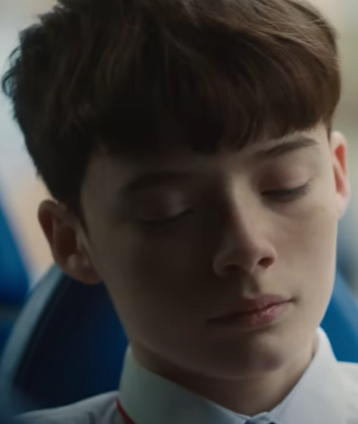
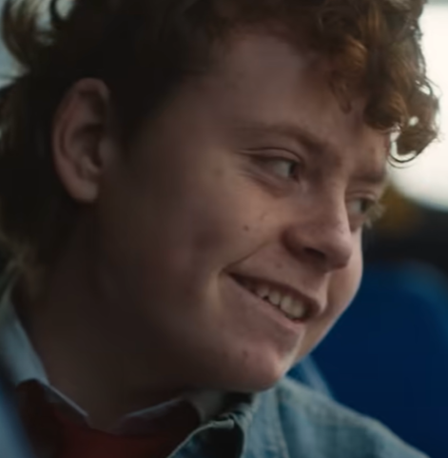
This is our main character. He is being affected by misogynistic influencers.
This boy represents the influencers. He is not really there.

Slide 19
How is this boy affected?
How does he change?
Do we recognize any stereotypes or misogyny?

Slide 20

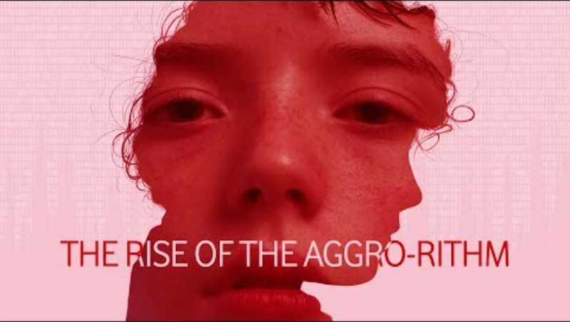
Notes:
The rise of the aggro-rithm | Vodafone UK (youtube.com)

Slide 21

Licensing
Creative Commons Attribution-NonCommercial-NoDerivatives 4.0 International
This license requires that reusers give credit to the creator (GBV Education Team, Salford Foundation) It allows reusers to copy and distribute the material in any medium or format in unadapted form and for noncommercial purposes only.
BY
Credit must be given to the creator (GBV Education Team, Salford Foundation)
NC
Only noncommercial use of this work is permitted. Noncommercial means not primarily intended for or directed towards commercial advantage or monetary compensation.
ND
No derivatives or adaptations of this work are permitted.
See the License Deed

