Slide 1

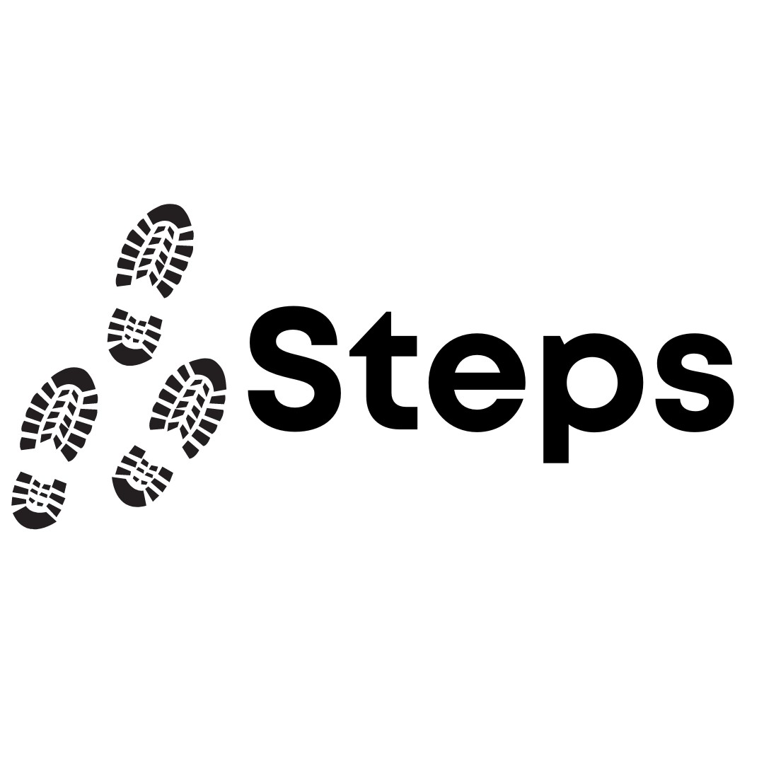

Week 5

Slide 2
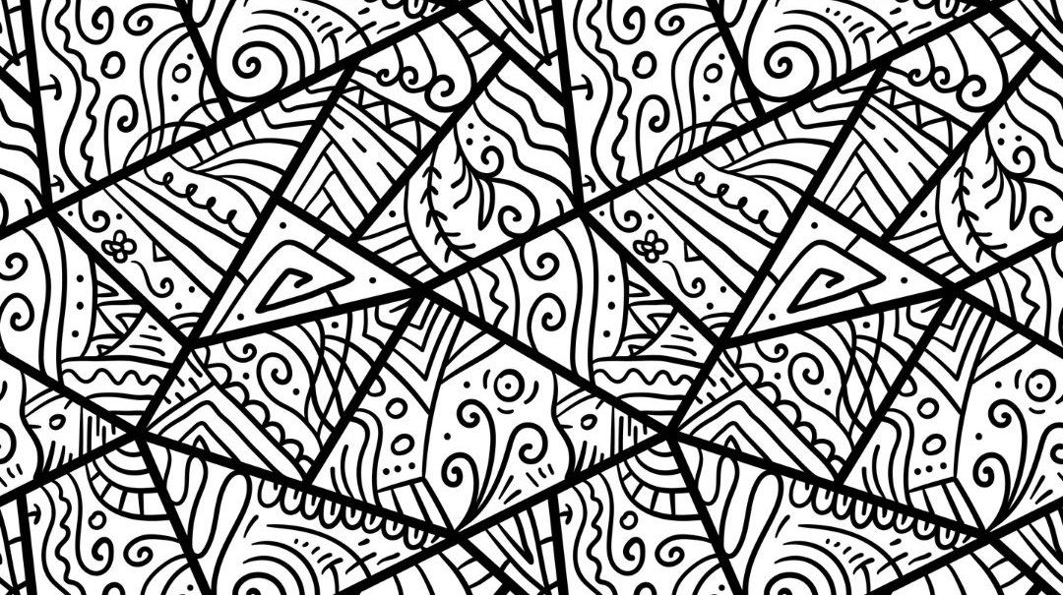

Group Agreement
1. When someone talks, we listen.
2. We respect each other’s opinions and voice.
3. We respect our own opinions and voice.

Slide 3
Today
Healthy relationships.
Responding to expressions of misogyny

Slide 4

Recap

Slide 5
What is a relationship?

Slide 6
Friends
Coach
Cousins
Parents
Teachers
Teammates
Romantic partner
Grandparents
Siblings
Lots more!

Slide 7
A relationship is connection between two people, shaped by how they treat each other.

Slide 8
In all our relationships, we are responsible for how we treat the other person.

Slide 9
Our behaviors, beliefs, and attitude can affect the other person.

Slide 10

We can’t control 100% of a relationship, but we can try to make a positive impact in our 50%.
50%
50%

Slide 11
In our 50%, we should consider the other person’s:
Choices
Identity
Boundaries
Consent

Slide 12
What do we associate with consent?

Slide 13

Freely given: Given without pressure, force, exploitation.
Reversible: Can be withdrawn at any time.
Informed: Knowing what you’re agreeing to.
Enthusiastic: Body language, tone etc.
Specific: Consent for one thing is not for everything
Notes:
Make each part of the acronym bold

Slide 15
Informed: Knowing what you’re agreeing to.

Slide 17
Freely given: Given without pressure, force, exploitation.

Slide 19
Reversible: Can be withdrawn at any time.

Slide 21
Enthusiastic: Body language, tone etc.

Slide 23
Specific: Consent for one thing is not for everything

Slide 24
Why would someone not respect another person’s consent?

Slide 25
If someone shows misogyny, they may believe that women and girls can’t be trusted to make decisions for themselves, so they would not respect their consent.
They may think they can decide what women wear, where they go and how they act.
Misogyny makes it impossible to have a healthy relationship or interactions with women and girls.

Slide 26
What can we do when we see someone treating another person in a misogynistic way?

Slide 27

Delegate
If you feel unsafe or unable to act.
Get someone else to help.
Tell a trusted adult (teacher, parent etc.).
Distract
If you feel unable to address the harmful behaviour directly, change the topic of conversation
or come up with an idea to take the victim away from the situation.
Active Bystander
Delay
If you feel unsafe, you can
wait for a situation to pass
and support the victim afterwards.
Direct Action
Only if you feel safe.
Ask the person to stop the harmful behaviour.
Don’t aggravate – be calm and explain why that behaviour isn’t okay.

Slide 28
Scenario 1 :
You’re out with family, and you decide to stop at the local corner shop to get a snack. Outside the corner shop, you hear a couple of boys repeatedly shouting at a girl from your school “Give us your number”. The boys look a bit scary, and the girl looks upset.
Notes:
Delgate – family member or shop staff, check in with girl

Slide 29
Scenario 2 :
You’re chatting with your friend from school via text. He’s got a girlfriend called Sarah and he tells you that they’ve been dating for about a month. He says “I hate the clothes she wears though; she wears jeans and a hoodie all the time. She better be dressing like a proper woman next time I see her, in a dress or something.” You feel uncomfortable reading the message and feel worried for Sarah.
Notes:
Delegate/Direct Action.

Slide 30
Scenario 3 :
You’re sitting in the park after school. You’re with a large group of boys and girls from your year group. John asks Jane to go to the cinema with him at the weekend. Jane says no, she can’t because she is busy. John spends the next week being mean to Jane. He calls her “ugly” and “boring” every time she tries to talk.
Notes:
Distract/Delay

Slide 31

Licensing
Creative Commons Attribution-NonCommercial-NoDerivatives 4.0 International
This license requires that reusers give credit to the creator (GBV Education Team, Salford Foundation) It allows reusers to copy and distribute the material in any medium or format in unadapted form and for noncommercial purposes only.
BY
Credit must be given to the creator (GBV Education Team, Salford Foundation)
NC
Only noncommercial use of this work is permitted. Noncommercial means not primarily intended for or directed towards commercial advantage or monetary compensation.
ND
No derivatives or adaptations of this work are permitted.
See the License Deed

