Slide 1



Welcome!

Slide 2
Project Overview
Why are We Here
Policy and Practice
Key Concept – Gender
Key Topic – Online Content
Notes:
Agenda for the day

Slide 3

Curriculum Development
Universal and Targeted (Talk Listen Change)
Direct Delivery in Schools
8 Schools
745 pupils
External Evaluation
89% of boys said they thought it was important other students received this provision.
Initial Pathfinder Work
2024/2025 Academic Year

Slide 4
Pathfinder Schools
Co-Delivery in Schools
Free Training and Resources
Advocating for Free, Accessible, Regional Training and Provision
2025/2026 Academic Year

Slide 5
Concerns about issues young people face on a national/regional level
Want to learn about a specific topic
Why are you here?
What’s on your mind?
Wanting to feel confident addressing issues relating to misogyny
Addressing concerns within my setting
Notes:
Firstly, I wanted to take some time for us to consider this.
Obviously, everyone is looking to implement VAWG prevention/anti-misogyny work within their setting. However, on an individual level, why are you here? What’s on your mind?

Slide 6
VAWG Prevention in Education
Changes to social norms and outcomes for women/girls and men/boys
Manufactured “Culture Wars”
Moral panics
The role of parents and the nuclear family structure
Political polarisation
Interactions between genders
Perception of youth culture
Gender within the school environment
Notes:
I say this because, VAWG prevention can seem like a huge task. It is, I won’t lie. To implement this through education, we’re not simply providing information to young people about what to do/not to do. We’re helping them navigate an array of social, political, economic, or even philosophical or theological topics. We ourselves are also experiencing all of these topics in some way or another.

Slide 7
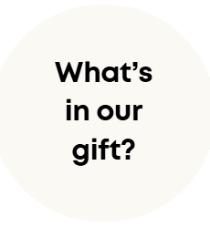
Notes:
Because of this, I want us to keep this question in mind throughout today. Yes, we will touch some key topics within VAWG prevention, but I want you to use this as an anchor. What's in our gift? What can we do within our roles, and within our settings for young people.

Slide 8
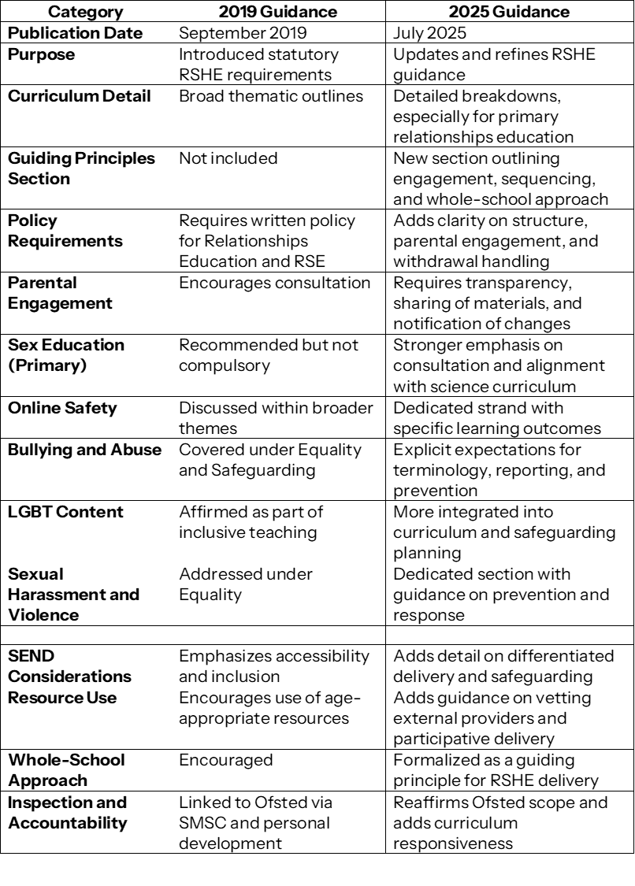

Slide 9
Digging deeper - Primary
Intended impact vs actual impact?
Primary relationships education should be anchored in an understanding of positive relationships, but should also equip children to keep themselves and others safe, and to recognise and report risks and abuse, including online
In addition, pupils should understand about bullying, and this can include the use of derogatory terms relating to sex, race, disability and sexual orientation.
Primary children should be introduced to protective and preventative content in a way that does not cause unreasonable alarm and does not appear to normalise risky behaviours or activities
There may also be cases, such as when they know that pupils have seen pornography, in which schools may feel the need to discuss online sexual content.

Slide 10
Digging deeper - Secondary
Intended impact vs actual impact?
Pupils should be equipped to recognise misogyny and other forms of prejudice.
Pupils should have an opportunity to discuss some sub-cultures might influence our understanding of sexual ethics, including the sexual norms endorsed by so-called “involuntary celibates” (incels) or online influencers.
That AI chatbots are an example of how AI is rapidly developing and that these can pose risks by creating fake intimacy or offering harmful advice. It is important to be able to think critically about new types of technology as they appear online and how they might pose a risk.

Slide 11
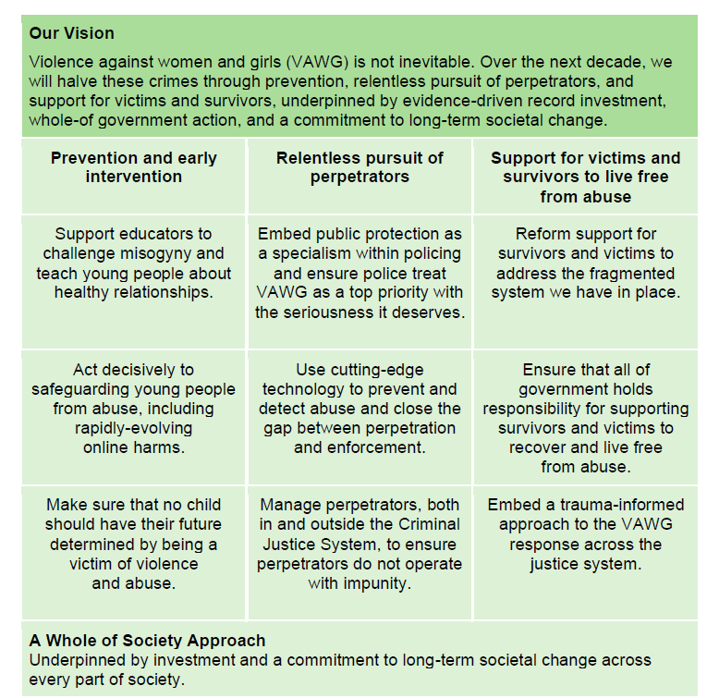
Notes:
By the end of this parliament in 2029, every secondary school in England will have a credible offer for educating students about healthy and respectful relationships, with every child able to access support. There are different ways of deliering this kind of education – through the improved RSHE curriculum, specialist training to deliver teaching in-house, working with external providers to provide whole school sessions, or mentoring – and we will give schools the choice on which approach to use. We will invest £3 million in a teacher training fund over the next two years to ensure that the new curriculum has the greatest impact and £5 million to pilot healthy relationships training delivered by external providers. (£200 million for SEND, curriculum training, Ofsted trainng)

Slide 12


Slide 13
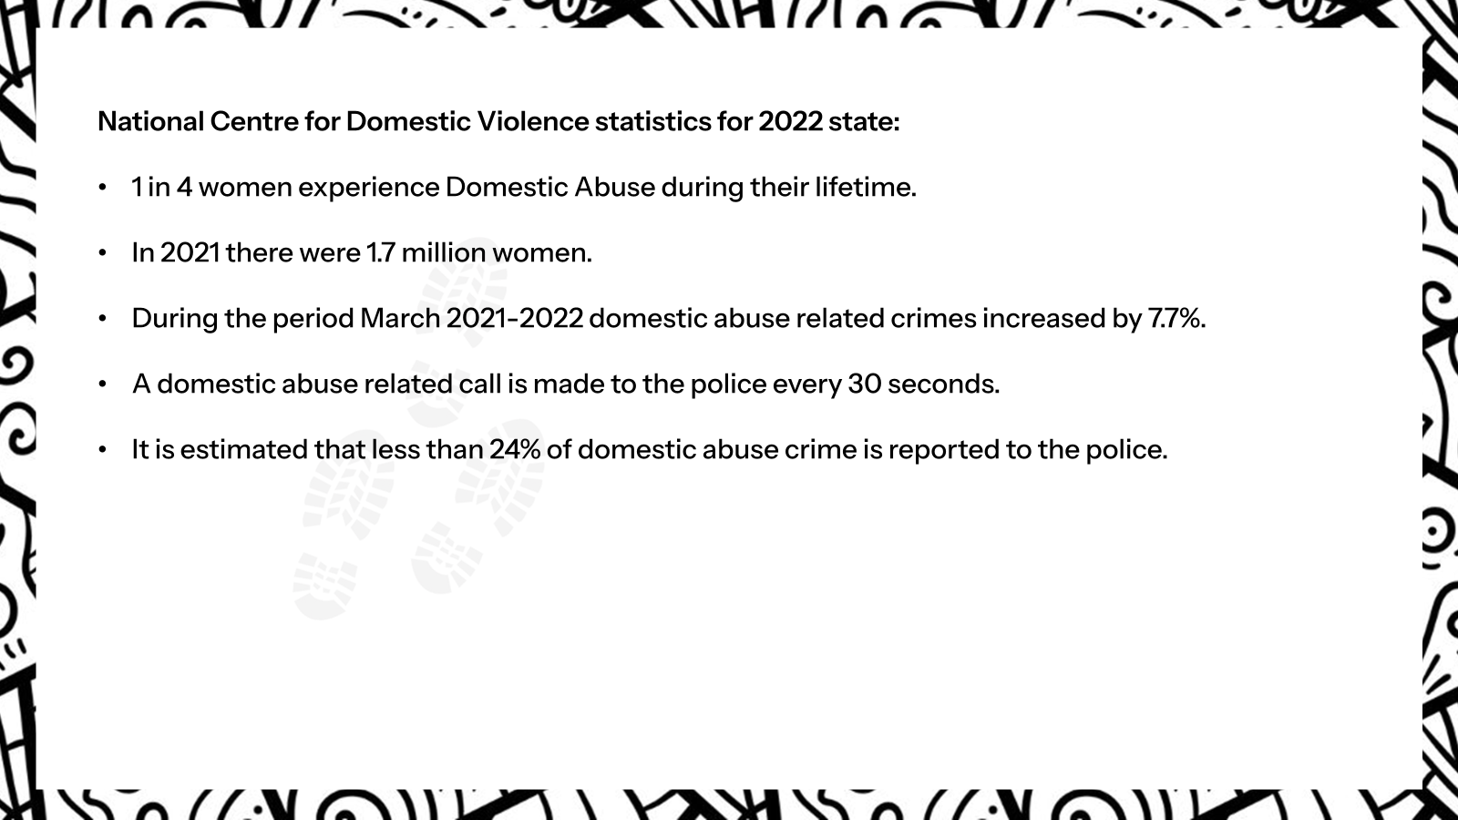

Slide 14
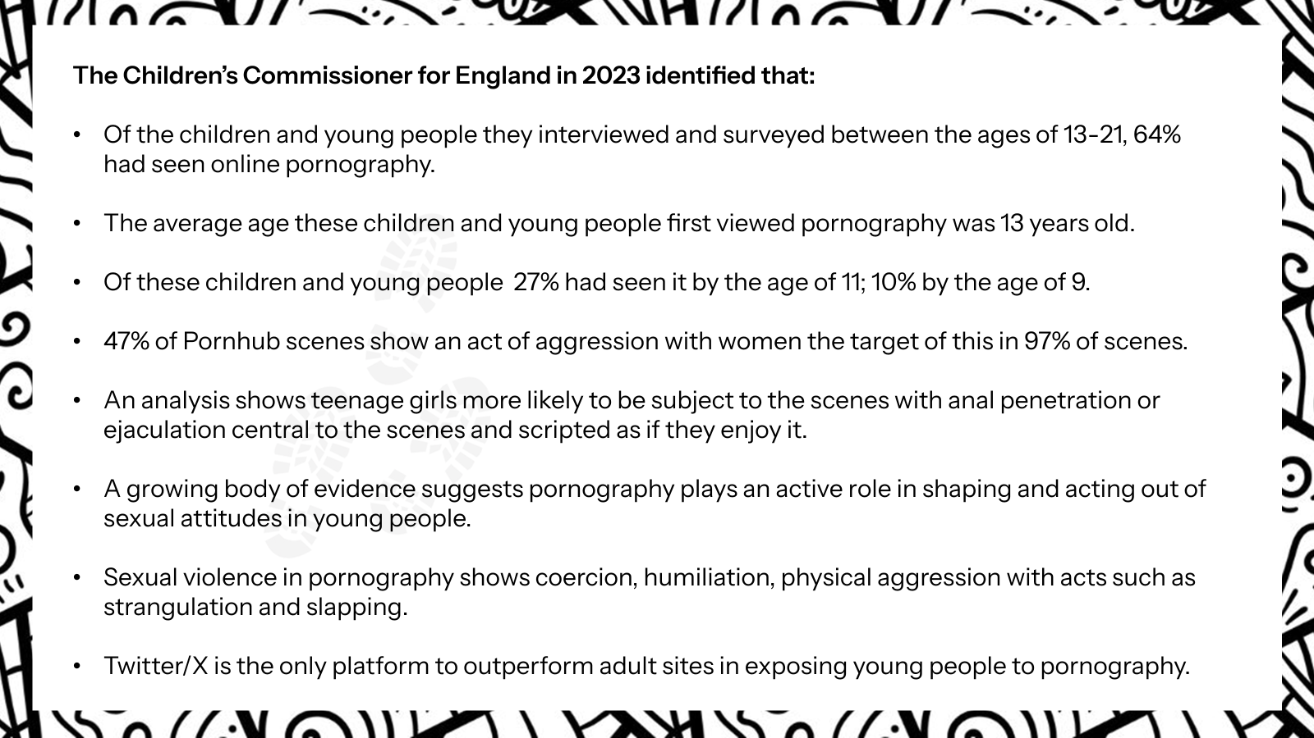

Slide 15
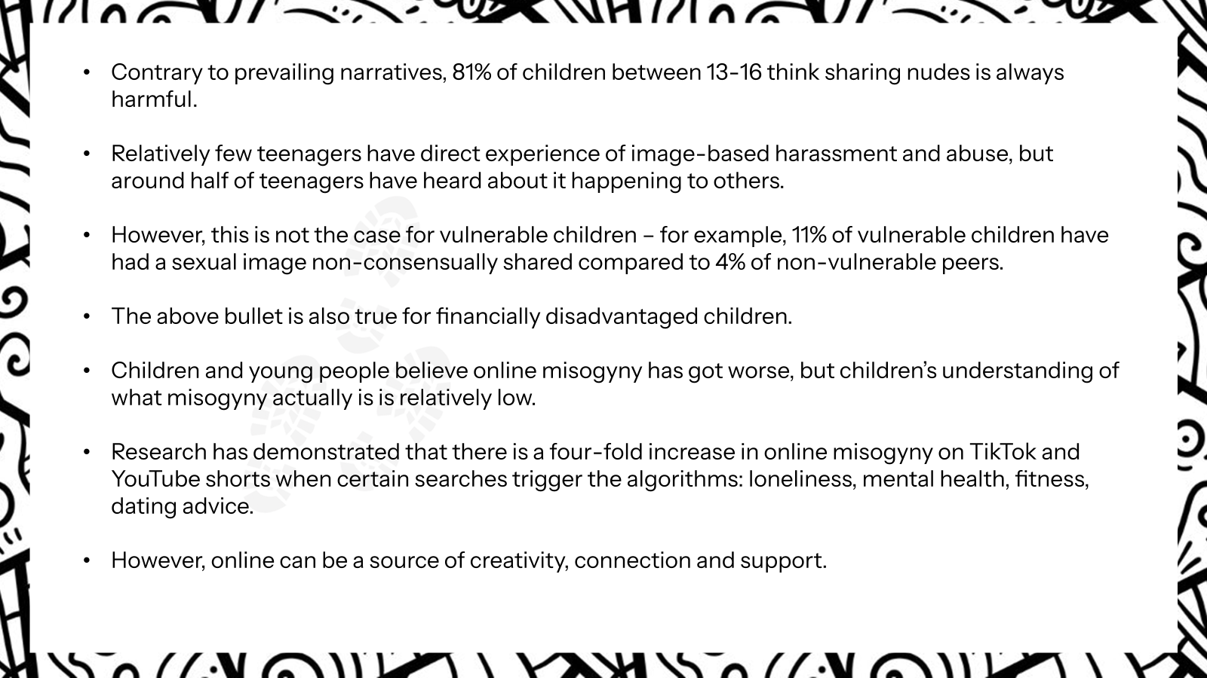

Slide 16
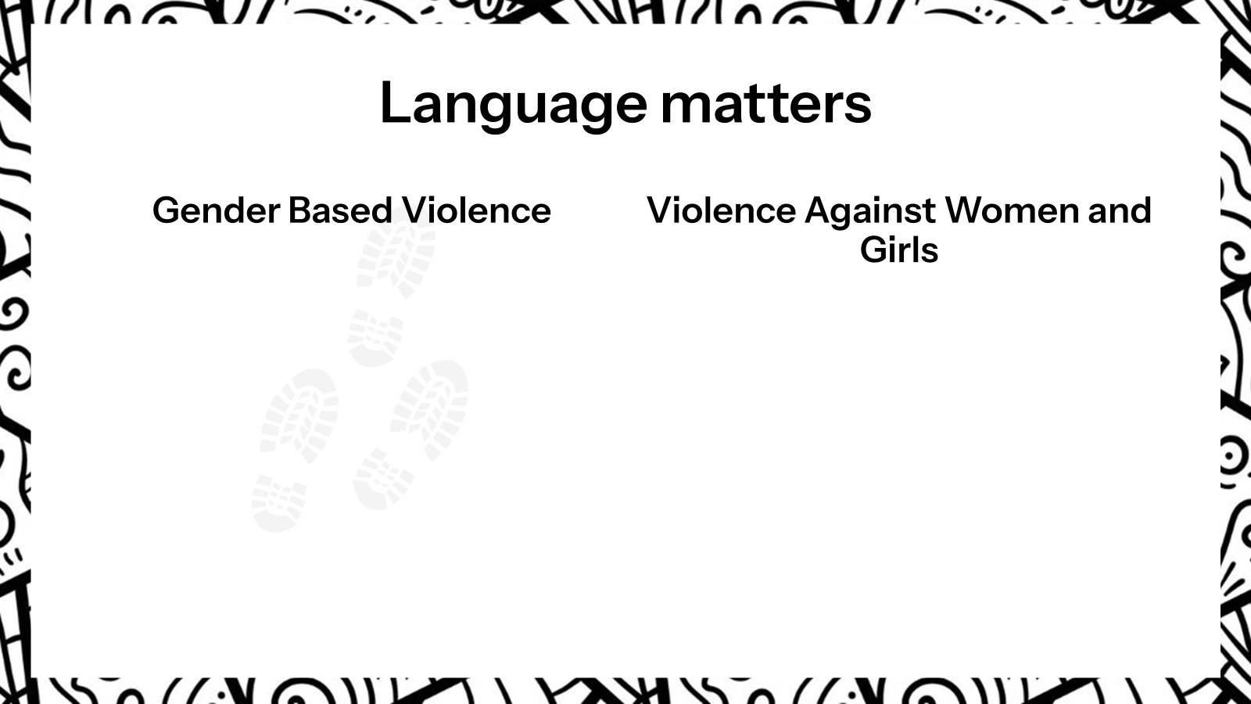

Slide 17
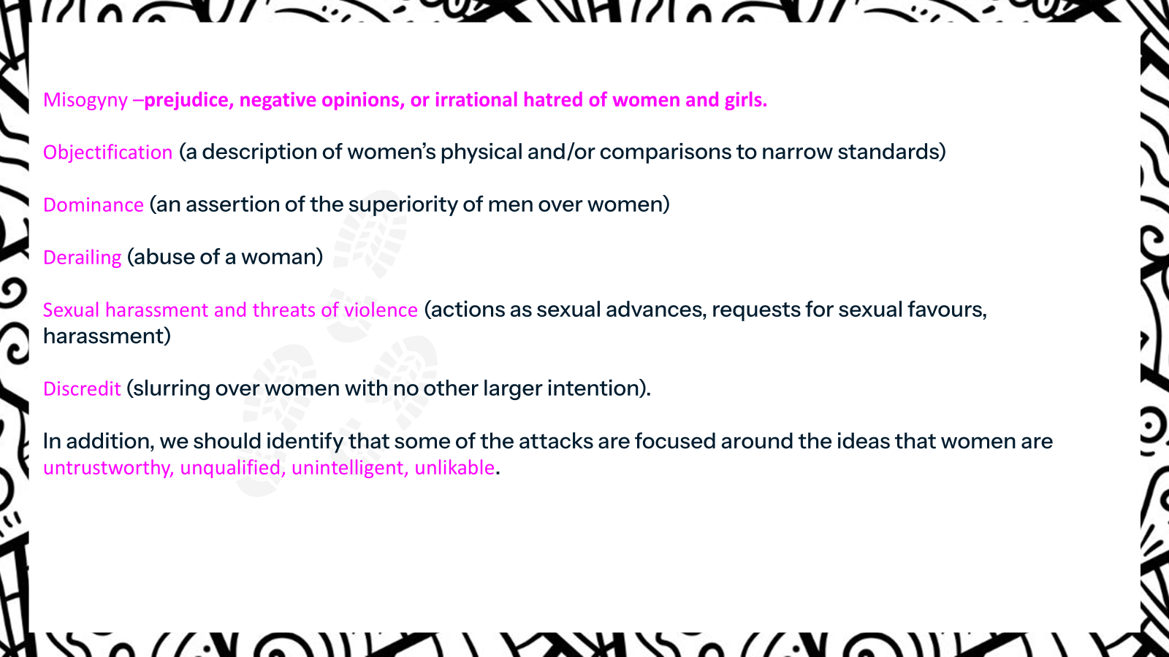

Slide 18
Why is a shared understanding of language important?
When we talk about language, we need to think about where pupils pick up their language. If we look at the following, what type of language would children use in relation to women and girls that is:
Immediate – influenced by their peers, family or neighbourhood.
Institutions – faith or community groups, youth clubs, schools.
Serendipitous – random personal experiences.
Media – whether online, main stream, or digital echo-chambers.
Notes:
Transparent footprints- used on conference leaflet, additional information for schools

Slide 19
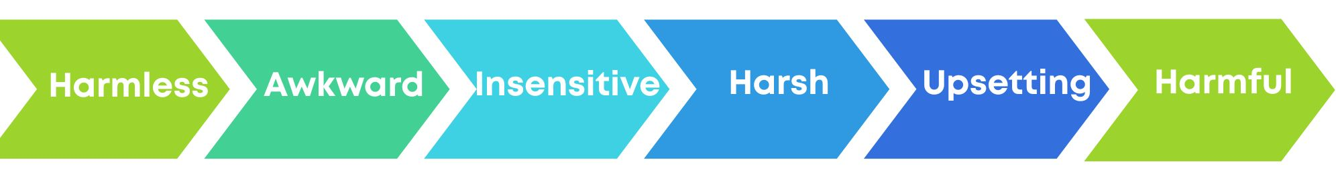
Notes:
Transparent footprints- used on conference leaflet, additional information for schools

Slide 20
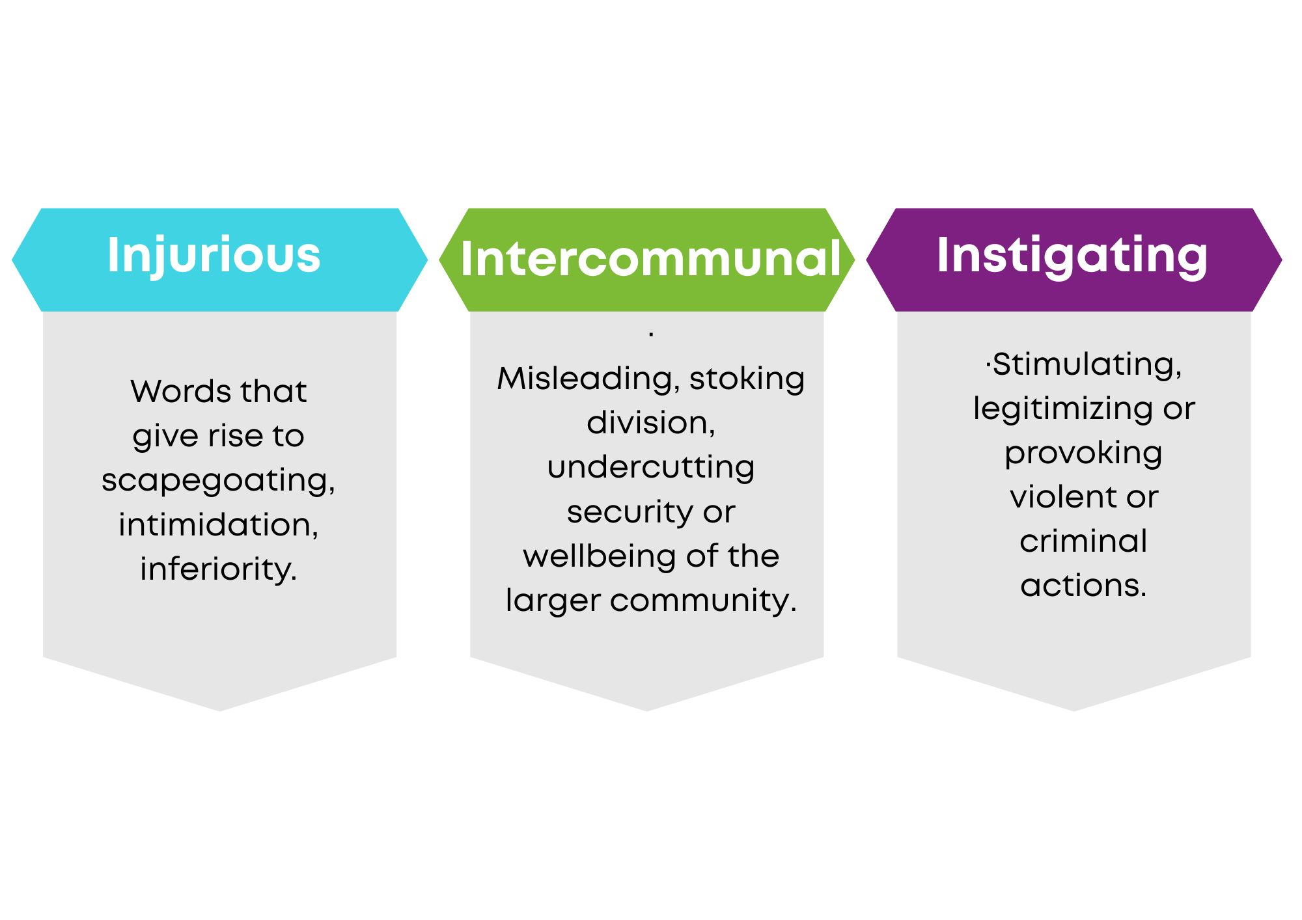
Notes:
Transparent footprints- used on conference leaflet, additional information for schools

Slide 21
Language does matter
We must always be alert to the impact that language can have positively and also negatively. When negative and derogatory language is used it prevents our schools from being a safe space and if people do not feel physically safe, they will not feel psychologically safe.
The clarity of language that is understood by all is very important: the words we use are loaded with history – both personal and public, context, culture. We need as staff and pupils to be conscious of the language we use and to understand that you can’t just assume a comment is trivial – language matters. There is a cost to our community if we do not address language as it happens: “What happens anywhere, matters everywhere.” (Madeleine Allbright).
Notes:
Transparent footprints- used on conference leaflet, additional information for schools

Slide 23
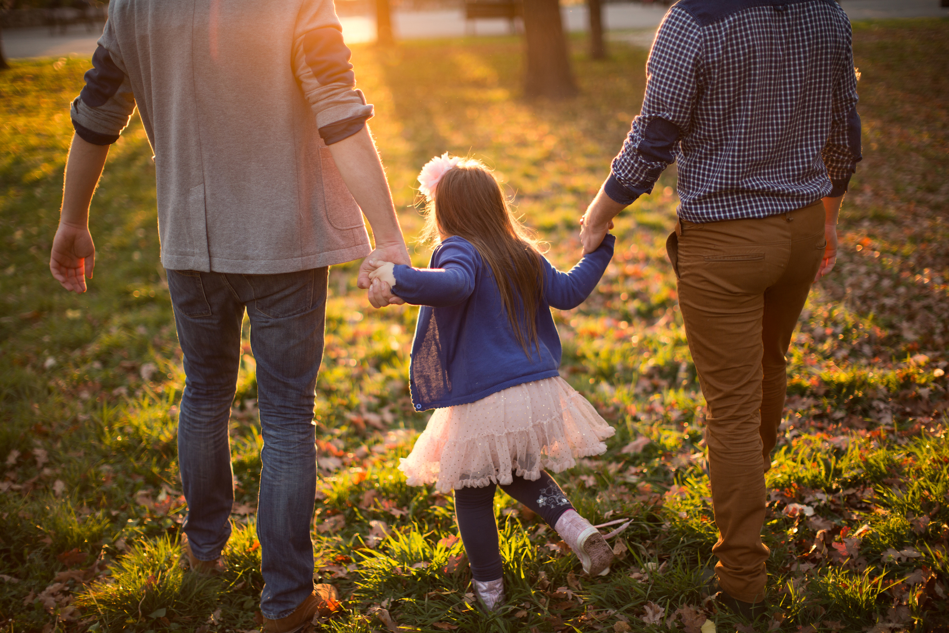



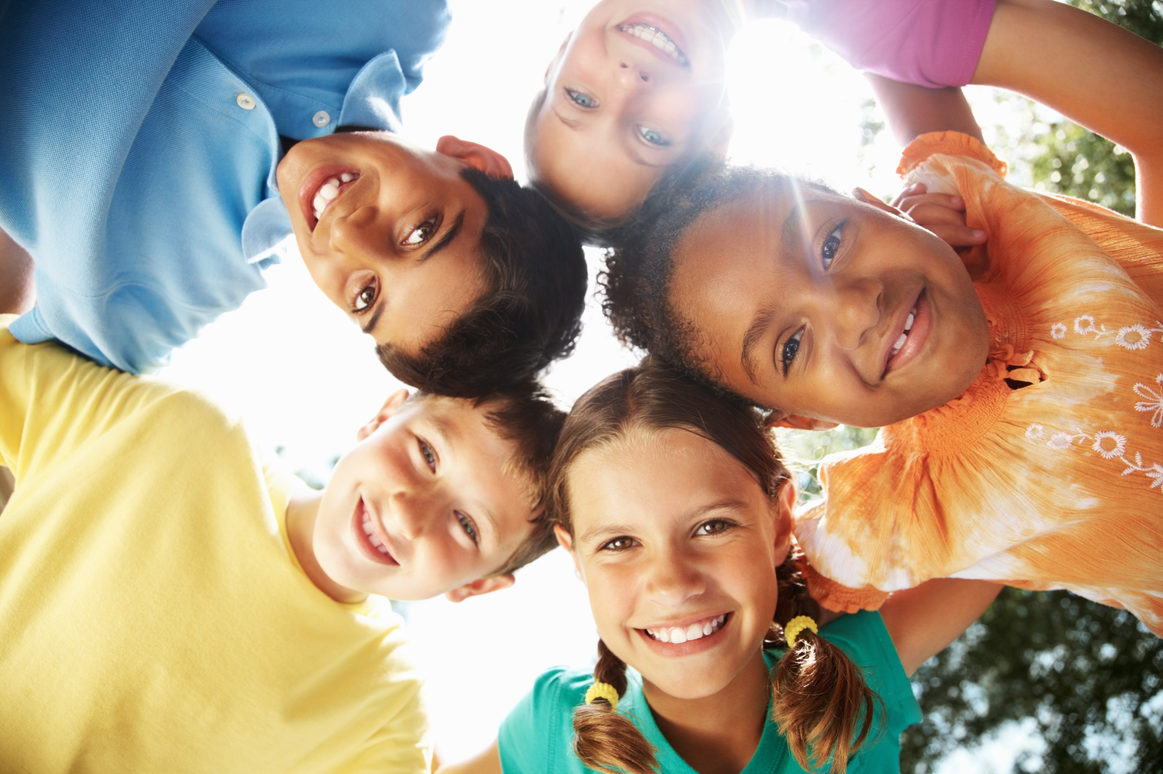

Your understanding and expectations reflect a collection of different sources

Slide 24
Because of this, we take the approach that gender is socially constructed

Slide 25
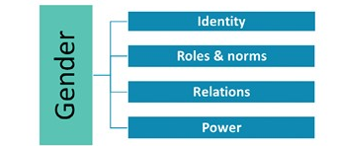
Social Constructivism
Gender refers to the characteristics of women, men, girls and boys that are socially constructed. This includes norms, behaviours and roles associated with being a woman, man, girl or boy, as well as relationships with each other. As a social construct, gender varies from society to society and can change over time. – World Health Organisation
Notes:
This is called, social constructivism. I think the def. from WHO captures this very well. When we talk about gender, we’re talking about those characteristics that we associate with w/m/g/b. Essentially, how do we perceive different identities. These characteristics also affect how we understand the roles/norms within society, relations between groups, and who has power/dominance/influence over others.
However, these are not set in stone, they can change. And they have changed! We all have seen this throughout our lifetimes. We aren’t tied to socially constructed ideas of gender, we do not have to follow them, and it’s very likely that in some way or another, even subtly, many people go against what is expected of their gender identity. We approach this in the curriculum in Week 1 and 2, and highlight to pupils that gender stereotypes are restricting, limiting, and are harmful to what we think of ourselves and others.
We take this approach as it provides a framework for us to understand how YP may be building their understanding of gender, and how we can support them to have a healthy approach, which means they will be able to identify unhealthy messaging that enables forms of VAWG.

Slide 26
Psychology
Language and culture are frameworks that help us understand our world.
Our construction of knowledge can be influenced by those we perceive as ‘experts’.
Sociology
Interactions, identities, and roles are shaped by repeatedly enforced social norms. (Indirectly and explicitly)
Harmful norms can be reproduced, and transmitted to younger generations (Butler, 1990).

Slide 27
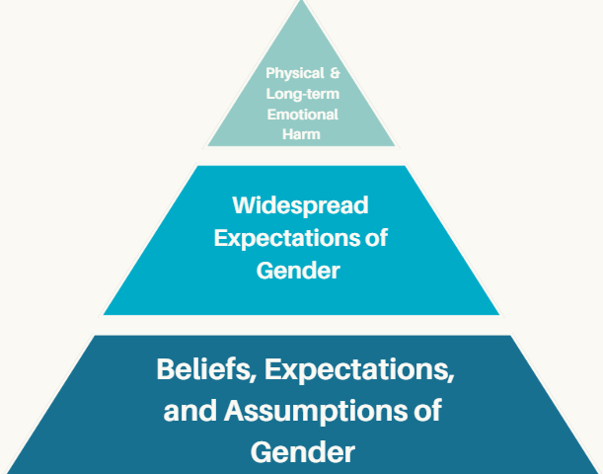
Long Term Prevention
Reduction of criminal offences
Early identification of harmful behaviours that may escalate
Social, generational shift
Harmful expectations no longer normalised
Support for wellbeing
Healthy relationships
Education
1:1 work

Slide 28
Why is There a Focus on Boys?
Notes:
You might be thinking, and it comes up with pupils too, why is there is a focus on boys though? We all experience gender, why are we working with just them?
There is a focus as there’s a wide acknowledgement, the majority of perpetrators of VAWG are male, and the victims are female. There is a gendered element to it. This doesn’t mean that all boys are future perpetrators, however it does mean we need to acknowledge that there is something missing in how we are supporting the personal development of boys, and if we address it we can reduce the likelihood of future incidents of VAWG.

Slide 29
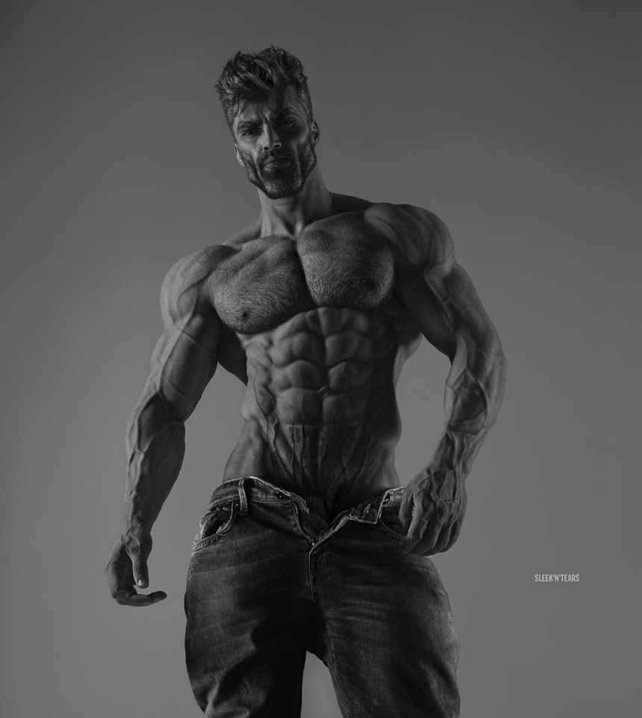

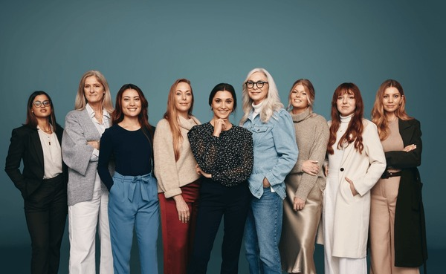
Hegemonic/Aspirational Masculinity
To prevent VAWG, we’re looking to address how gender role stress from masculinity enables VAWG
Men
Not Masculine

Slide 30
Why Should We Take This Approach?

Slide 31
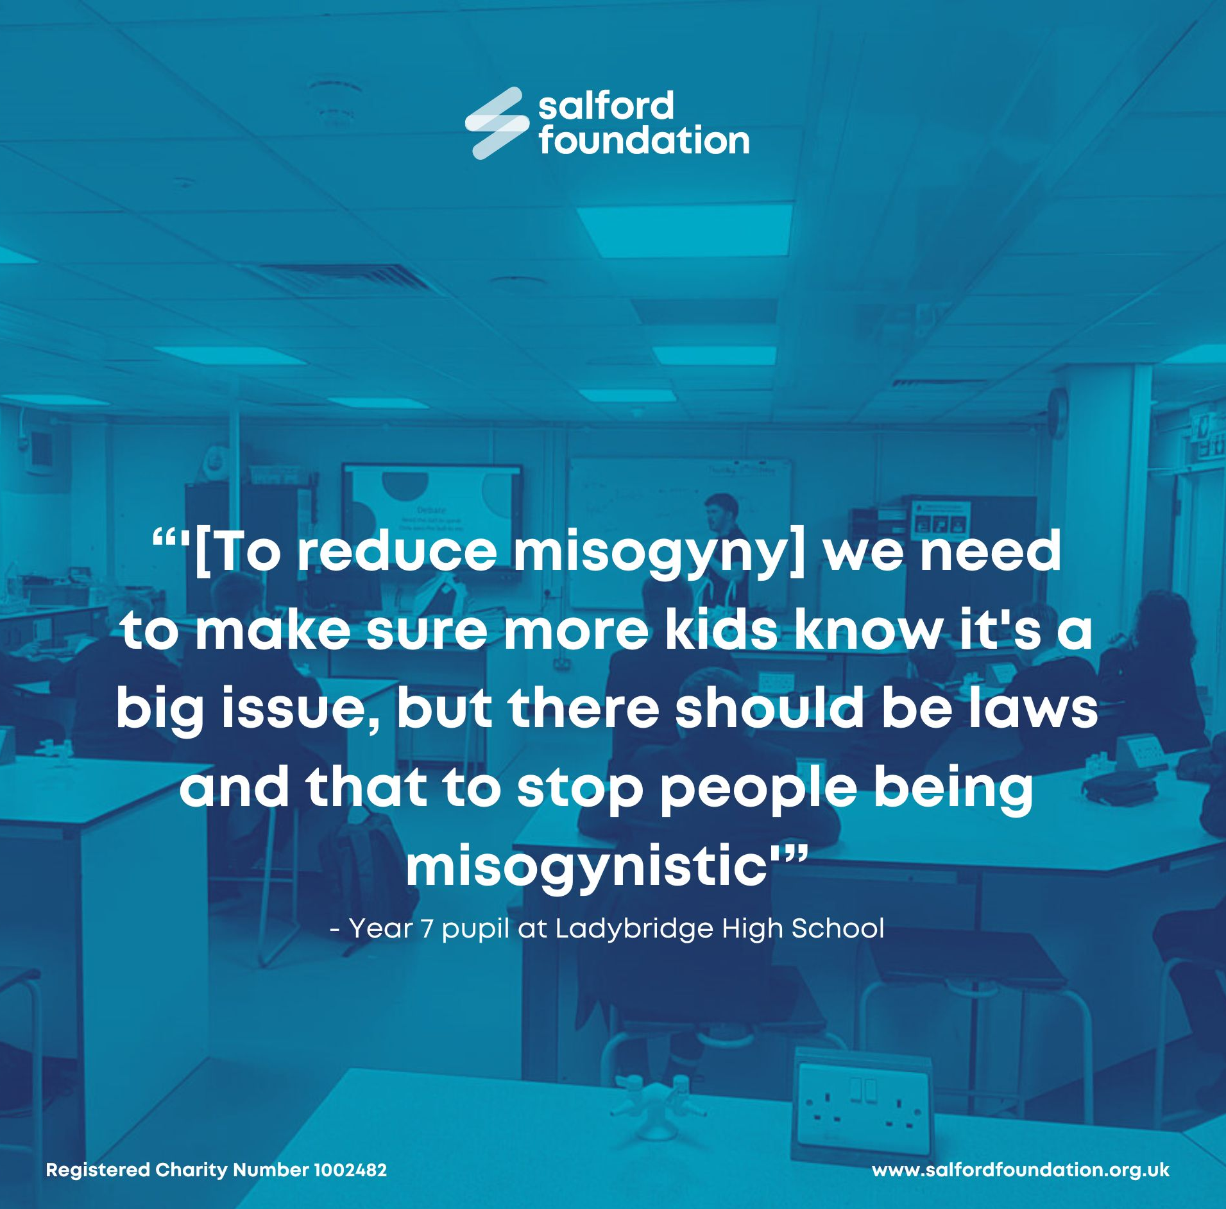
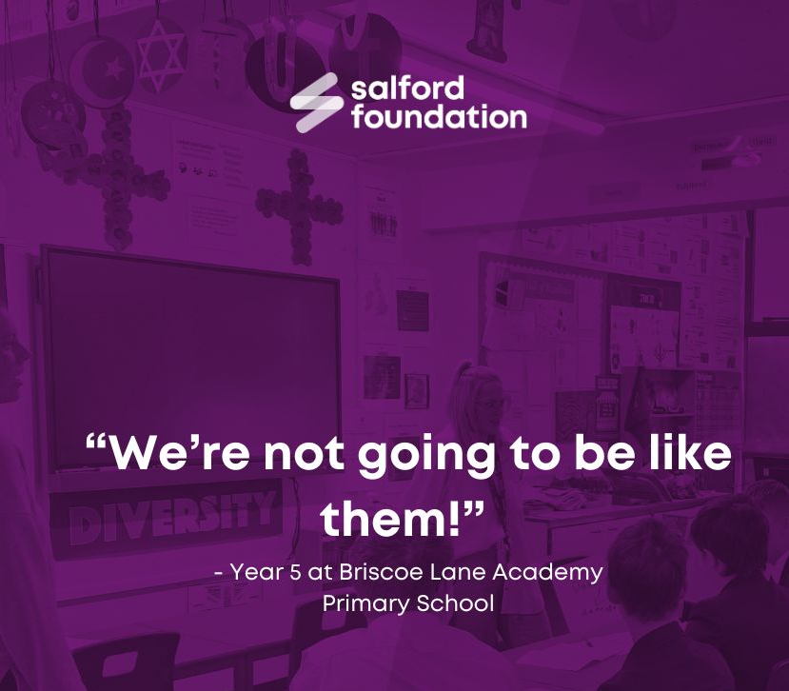
Boys
Raises awareness of progress and current issues regarding gender inequality.
Highlights potential for genuine participation in social change
Affirms autonomy over their identity, and responsibility in their interactions

Slide 32
Professionals
“[Female teachers talking about masculinity and misogyny] brings moral and ethical questions… without training, puts an implicit requirement of emotional and psychological risk” – Blower and Rainford, 2025
Acknowledgement of the impact of addressing and educating about a social issue.
Promotes reflexivity and opportunities to model skills
Aligns with relational learning approaches (working alliance)
“[Reflexive practice]… in turn can help us adjust our educational practices, expectations of students, and beliefs about how students will respond.” (Feutch, Brownlee, Shraw, 2017)

Slide 33

Online Content

Slide 34
Hands up

Slide 35
Awareness of VAWG
&
Media Literacy

Slide 36
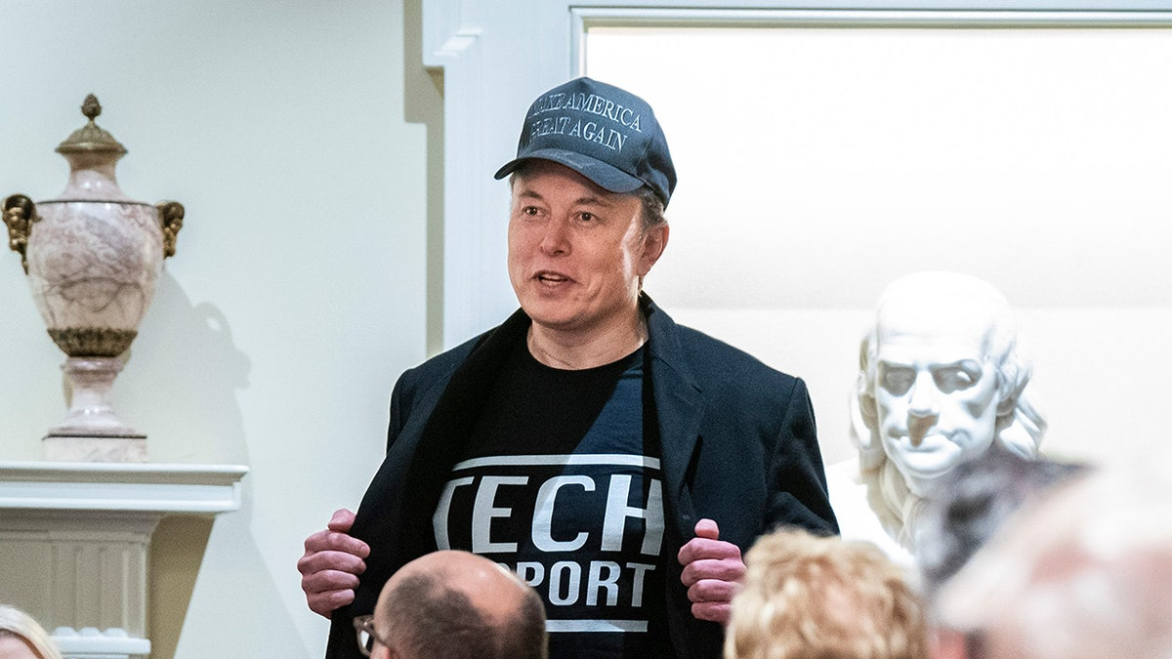
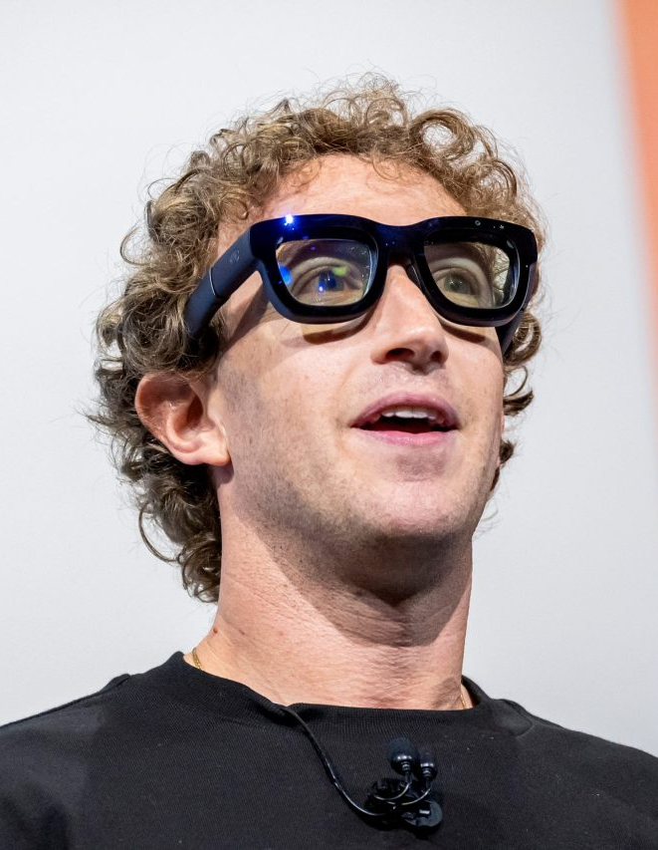
The Social Internet
(2016 onwards)
The use of the internet to facilitate mass social interaction and communication.

Slide 37
Is Online Misogyny New?

Slide 38
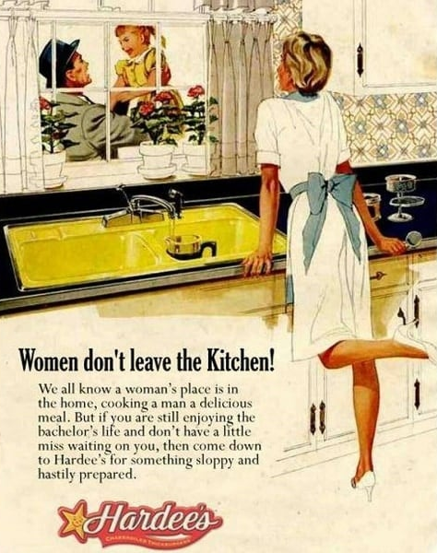
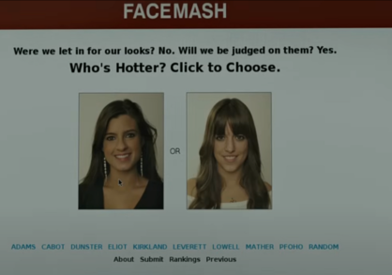
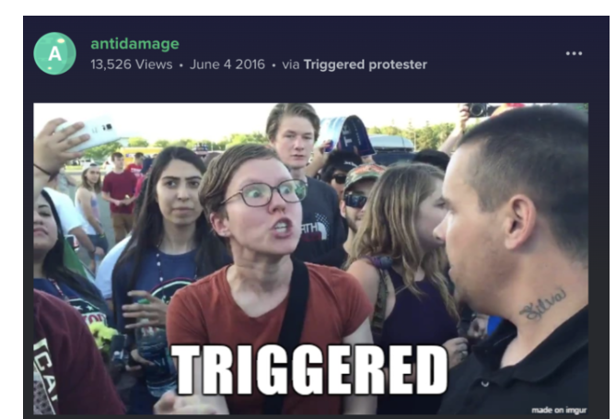
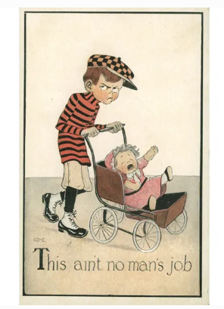
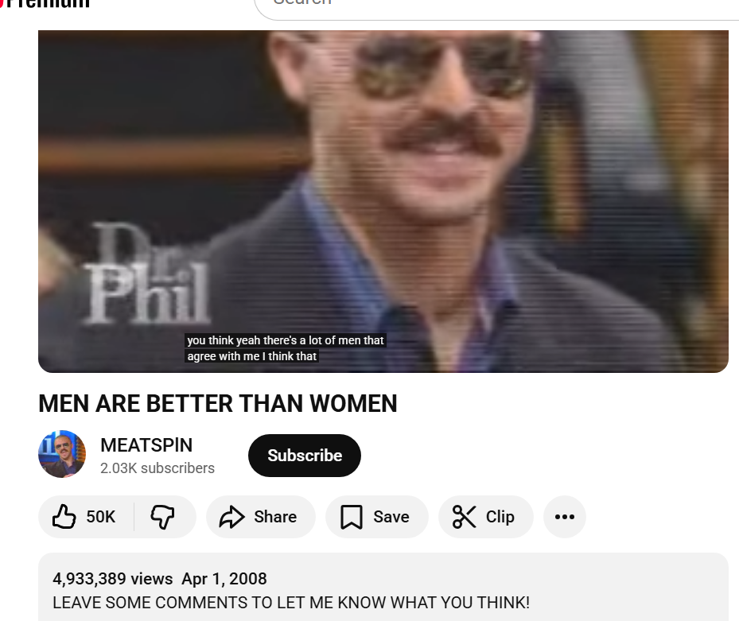
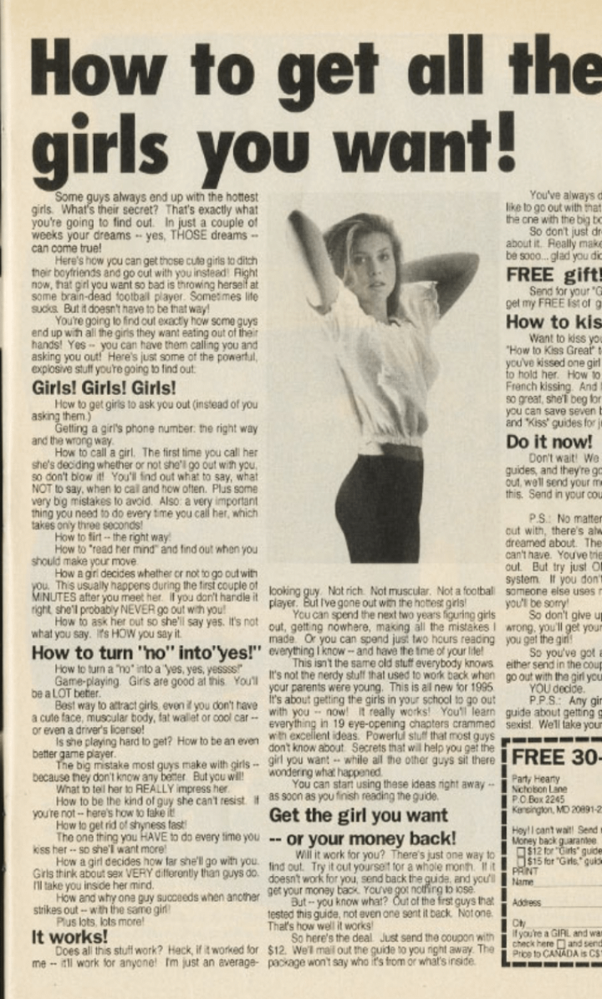
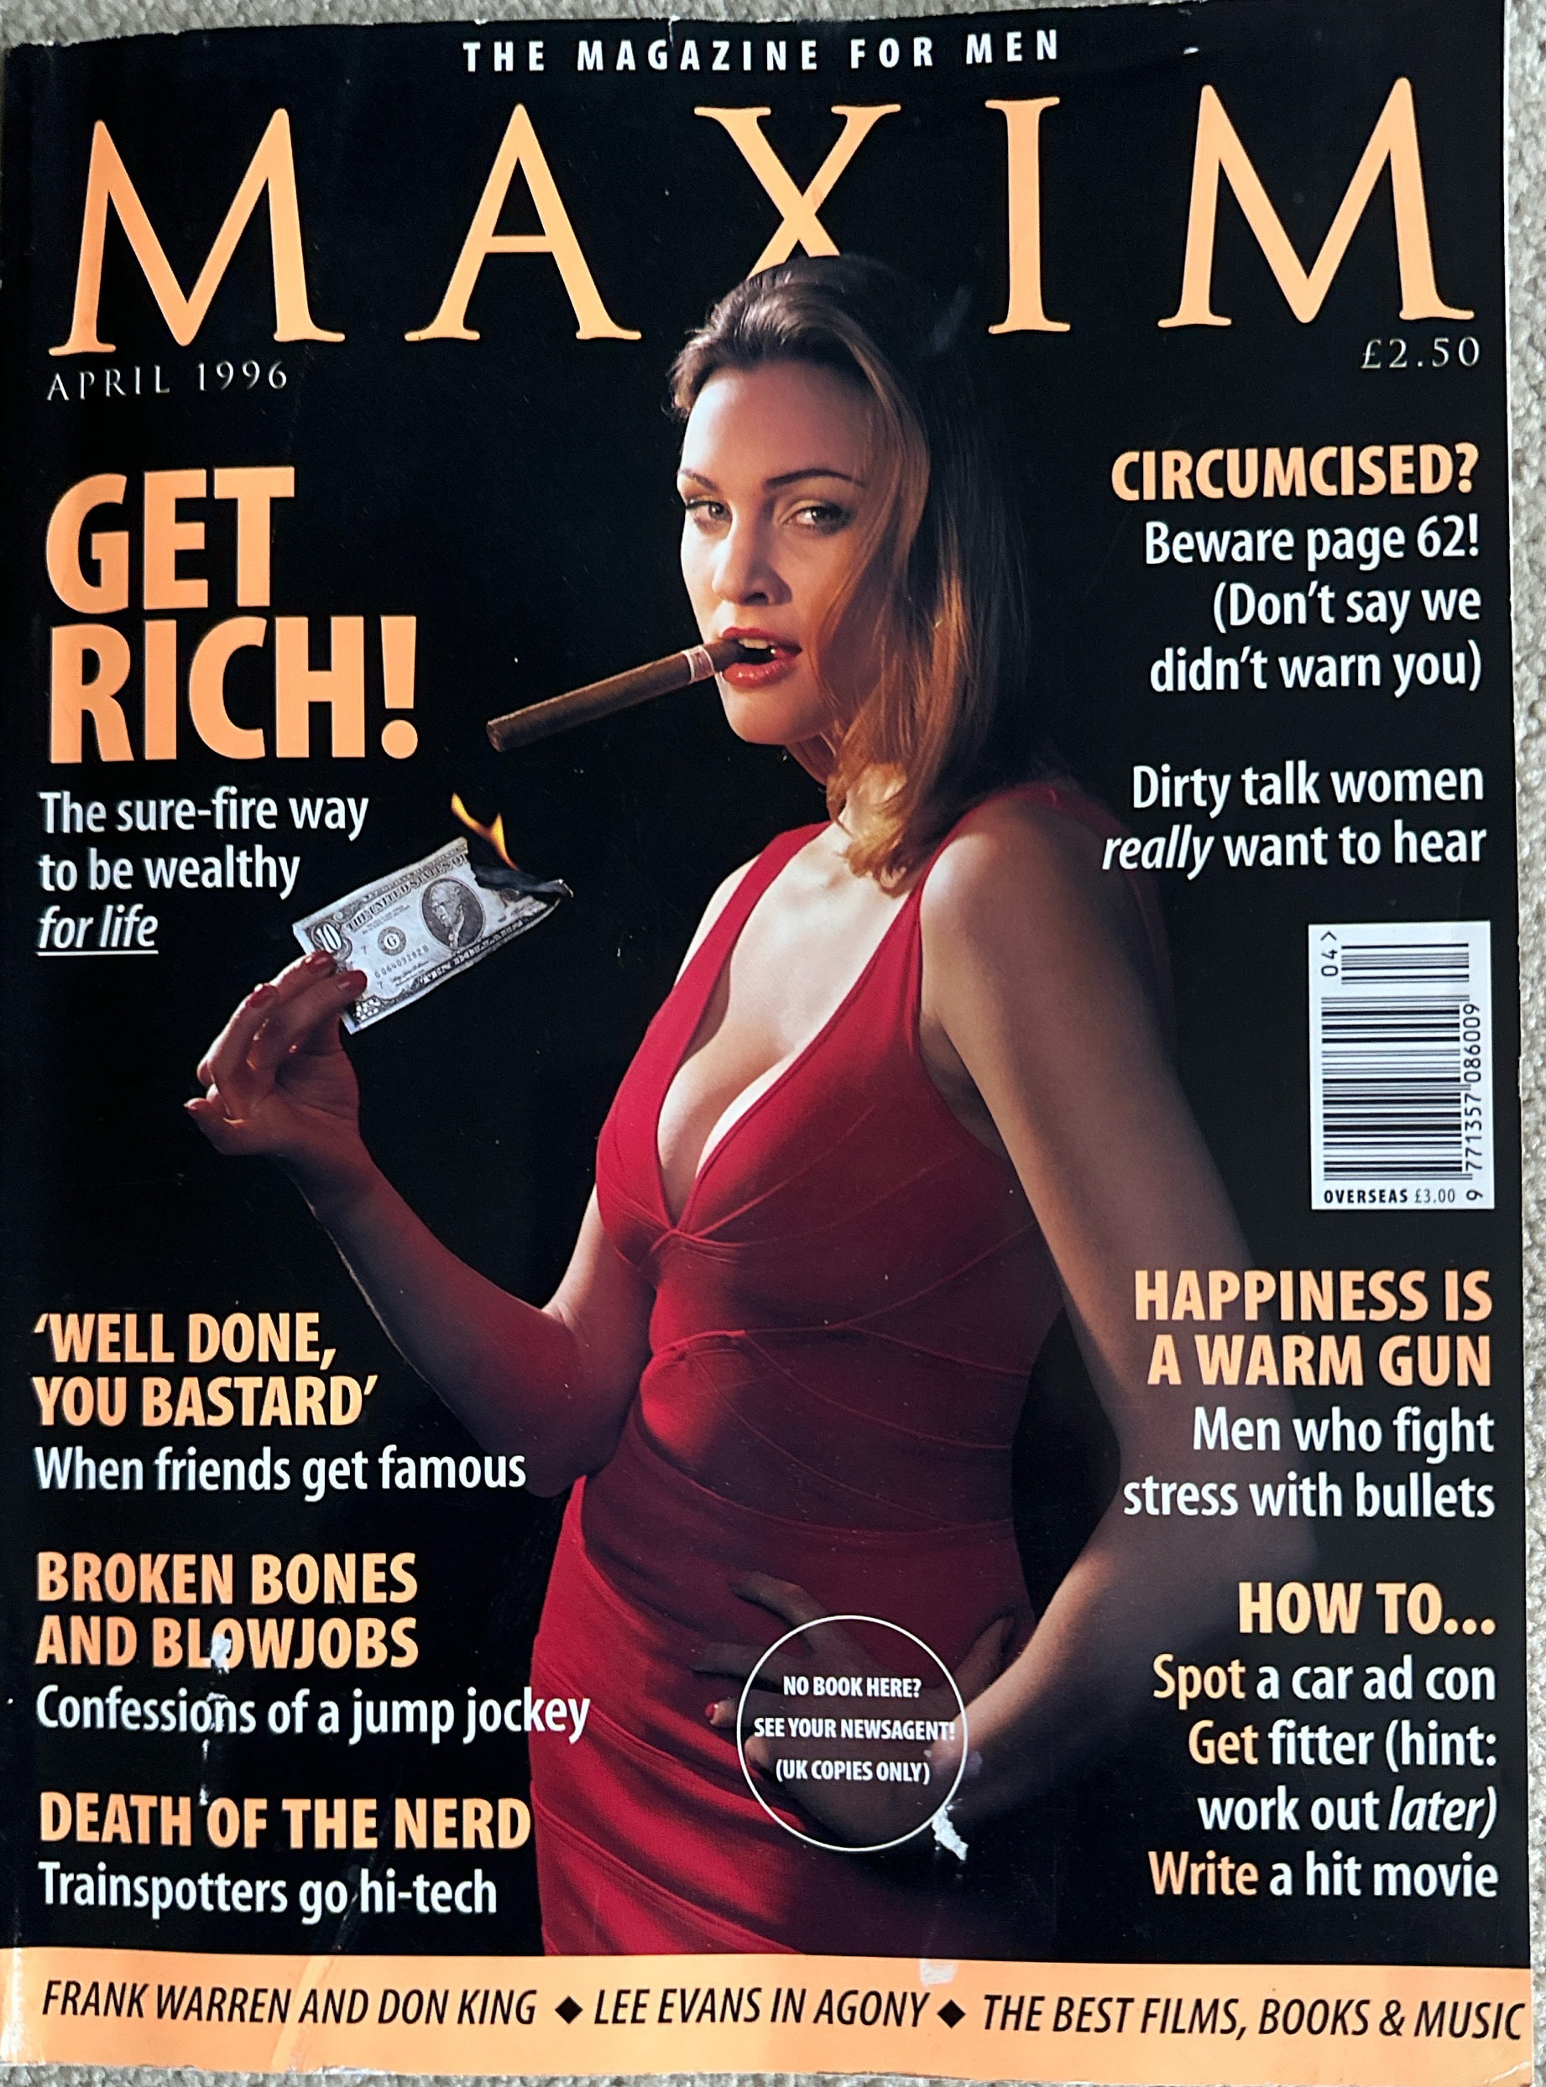
Notes:
I’d argue, no. Here’s a few examples of forms of misogyny through communications/public spaces I could find. This is essentially, men are the best, men should get lots of girls, women are only to be judged by their looks/subservience to others and if they’re not conventially attractive they will be mocked and ridiculed.
The misogyny is not new, but the way it’s being shared is. These took me at least 30 mins to find from different pages, and now YP can see messages like this just through scrolling on a page.

Slide 39
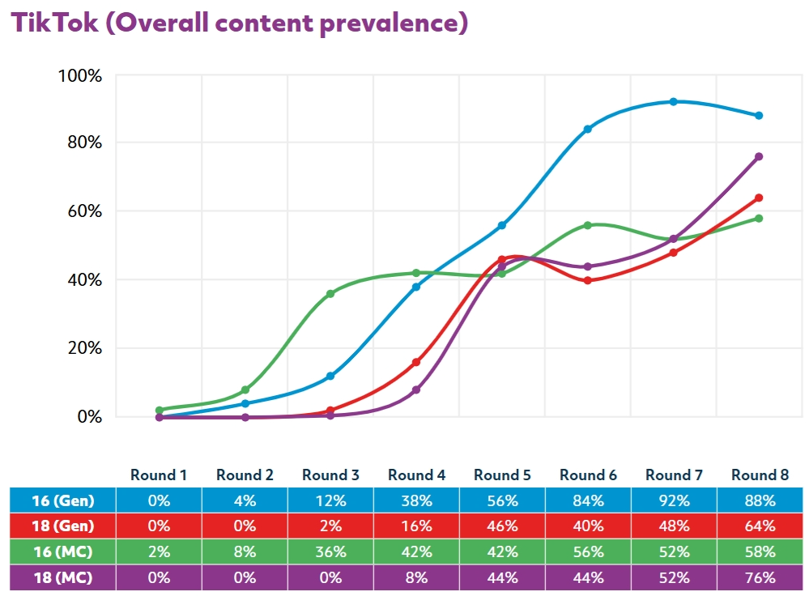
Notes:
To keep it brief, this is the results of a study done by Dublin college uni. They created blank accounts that were listed as boys either aged 16 or 18. The accounts that (gen) only engaged with content focusing on typically male hobbies eg football, video games. The accounts with MC intentionally searched manosphere related content. All accounts showed that every time they logged in, more and more misogynistic content was shown to them. I’d like to point out, increasing the age of access to social media/a social media ban like the one in Australia for under 16s wouldn’t prevent the harm that could happen from this!

Slide 40
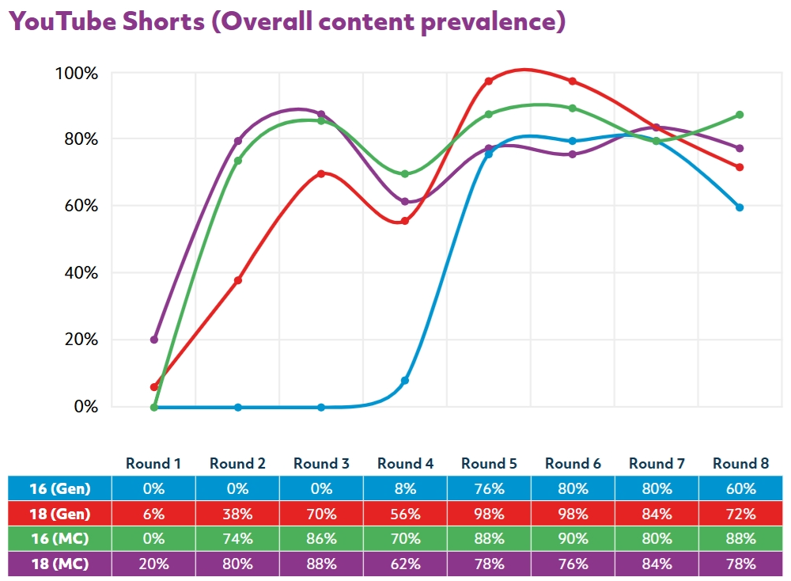
Notes:
For those who might be interested, this is what they found for youtube shorts.
I put these graphs in to illustrate then , we can’t simply focus on incel culture or see the manosphere as a specific ‘place’ or group that is deliberately looking to get boys on their side. Instead, what we need to understand and share with young people is that misogyny is becoming mainstreamed through online spaces and how they’re structured.

Slide 41
.
Kids are not talking about the manosphere, in the vast majority of cases they are not talking about incels or incel terminology… the vast majority are not members of incel communities, they are coming across this misogyny further downstream
– Laura Bates, 2025
Notes:
This is why I think it’s important to keep this quote in mind. The misogyny being shown isn’t new, and like previously it’s also not something that’s being expressed by a shady group of extremists on the fringes of society. Young people are coming across these views in a concentrated way online. We need to encourage both awareness of what the impact of this messaging is, and why it’s being shown.

Slide 42
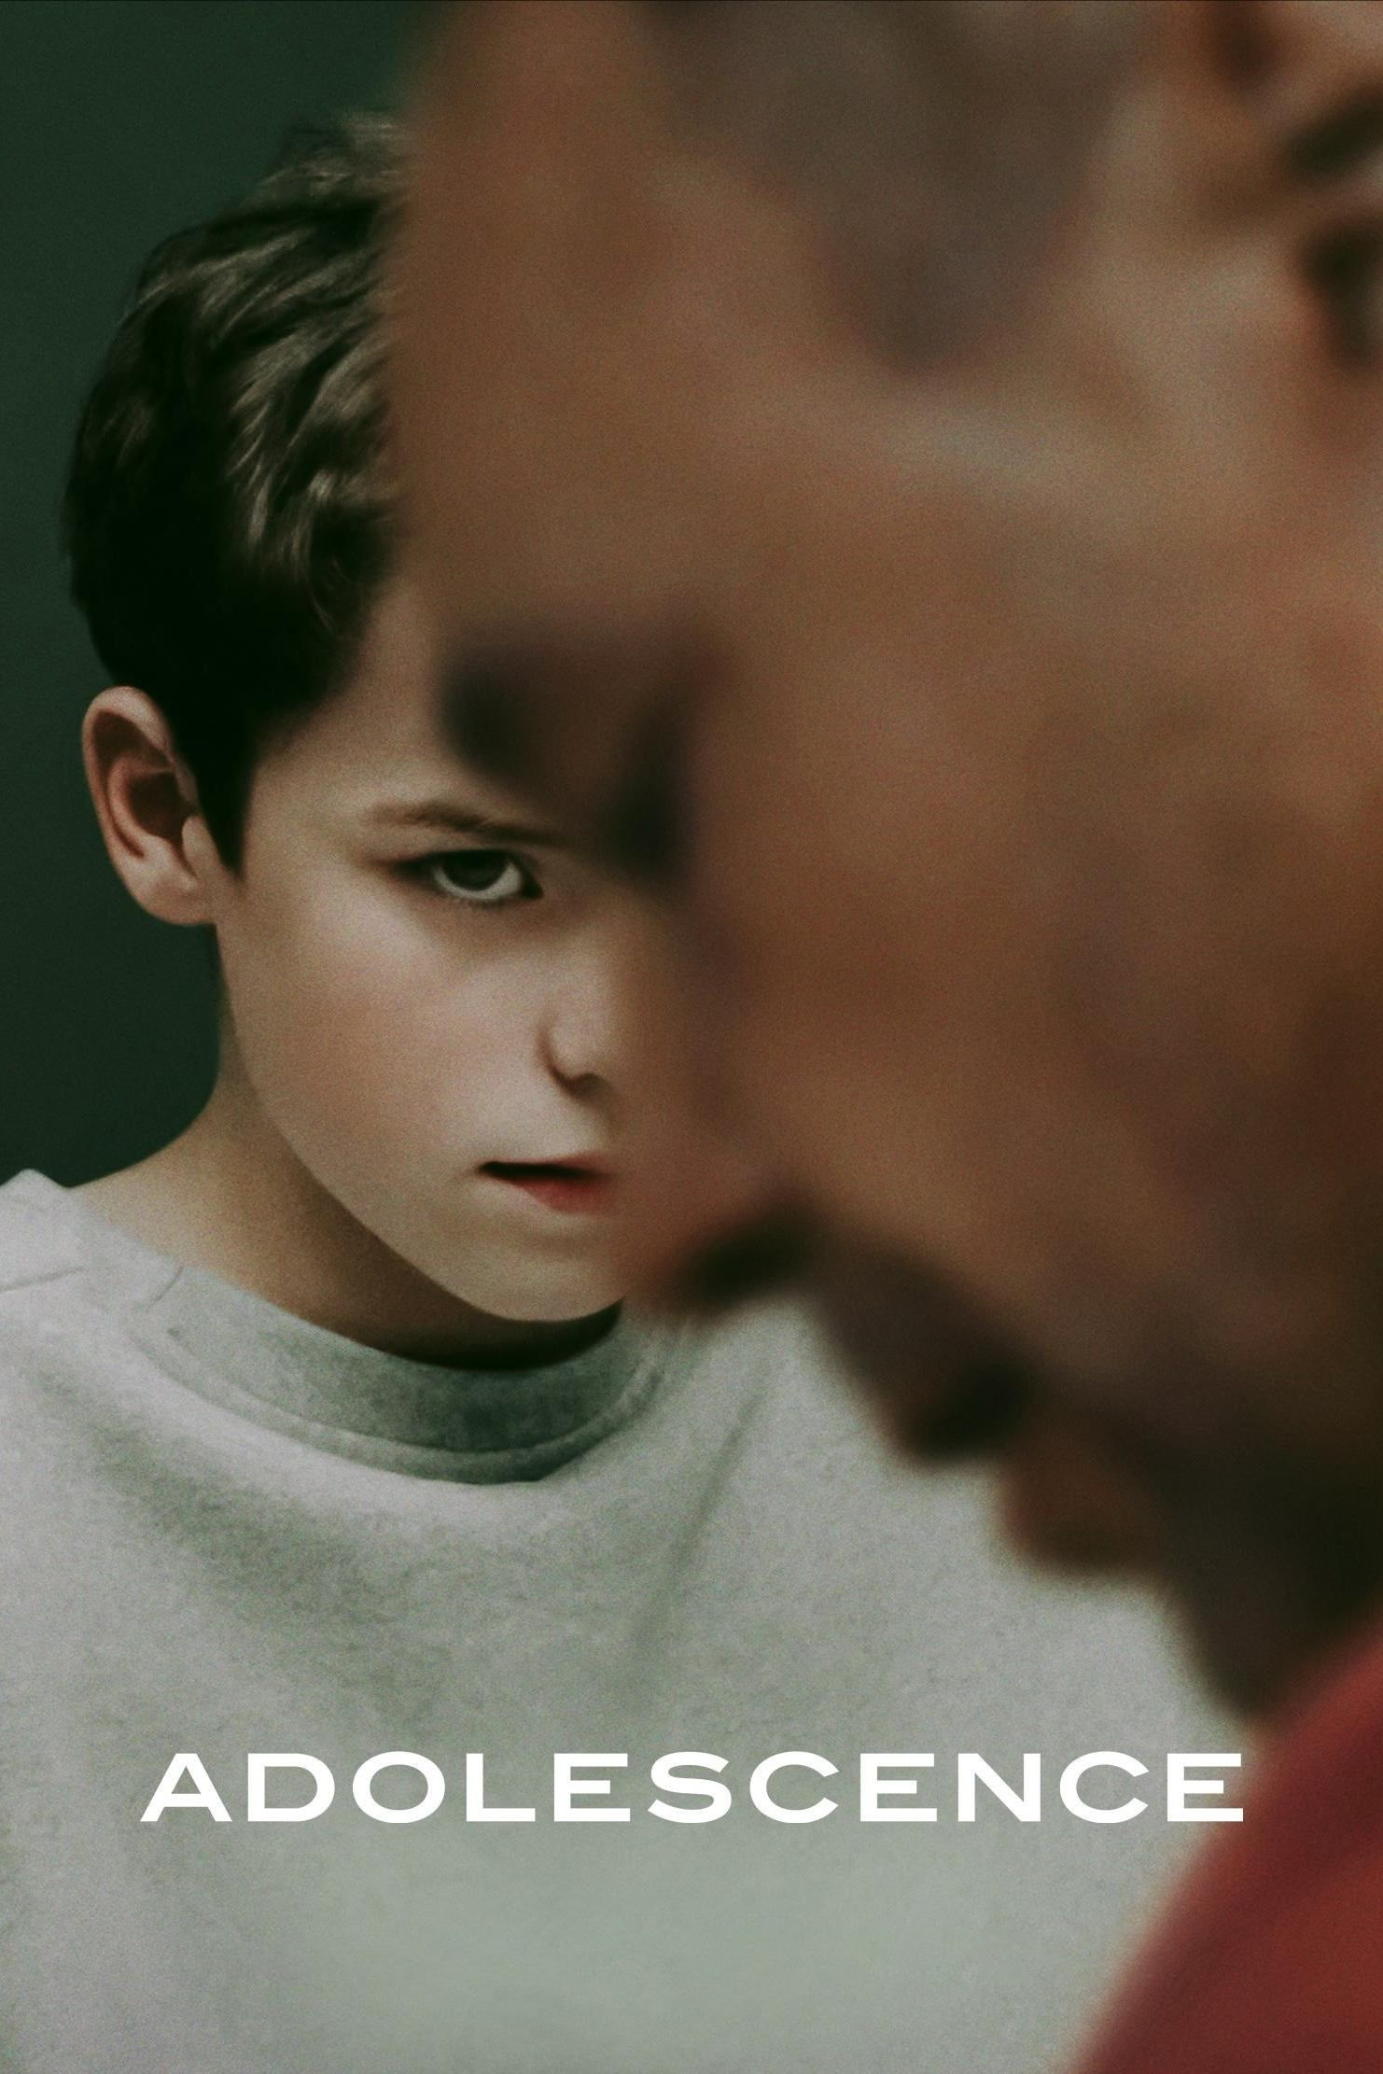
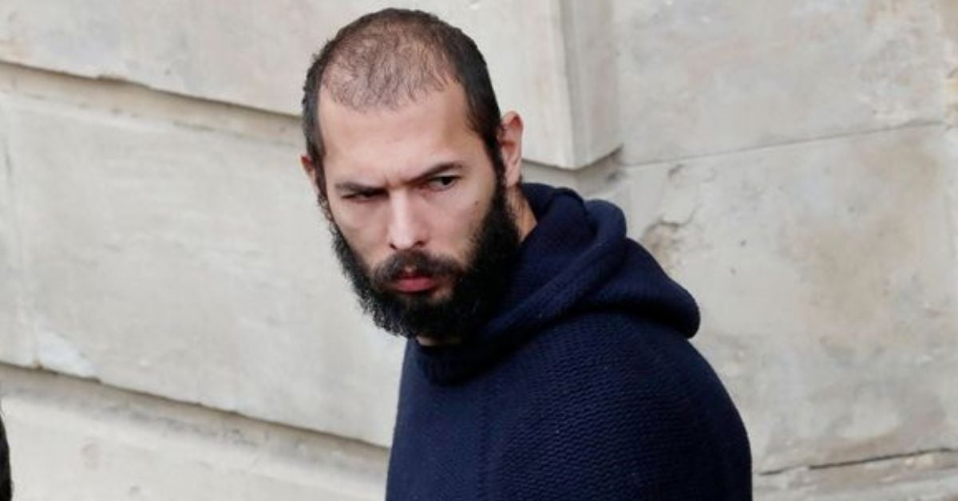
Notes:
However, it’s important to note, the media can, and will amplify coverage of certain topics. This is likely to shape what is on our minds when implementing relevant work. Both of these images represent trends, not the truth when it comes to online misogyny
AT – Reached an immensely quick peak, however media coverage and focus on him within education professional spheres lasted longer than his actual influence. Focus on him from adults contrasted how some YP were seeing him , and then led to punitive approaches, thus creating a divide.
A – Immense coverage, to the point the Gov funded it being shown in schools. Arguably intentionally, mashed together an array of buzz words like incels, red pill etc.

Slide 43
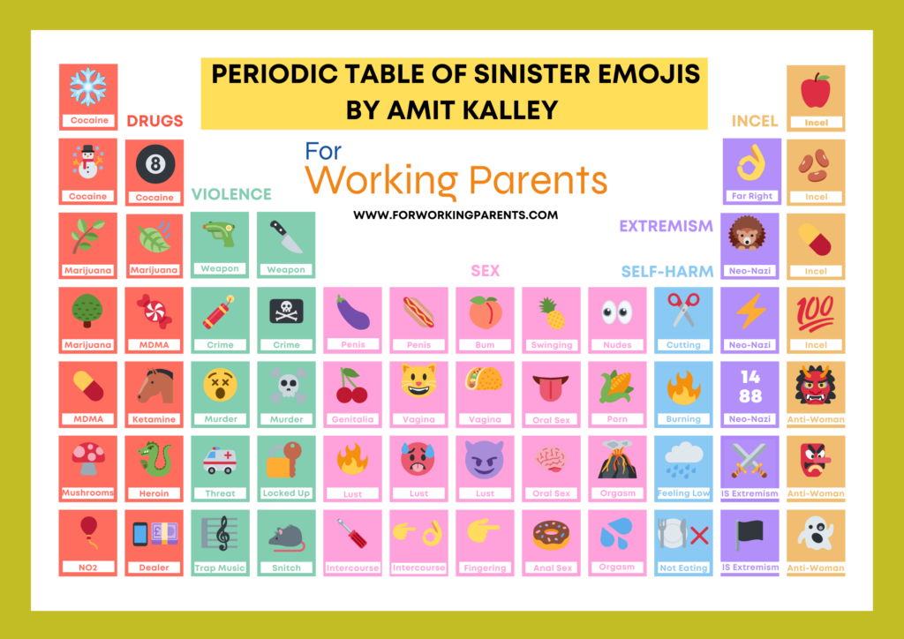
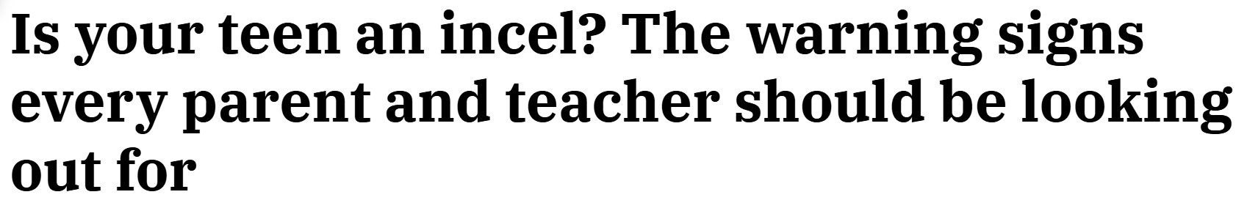
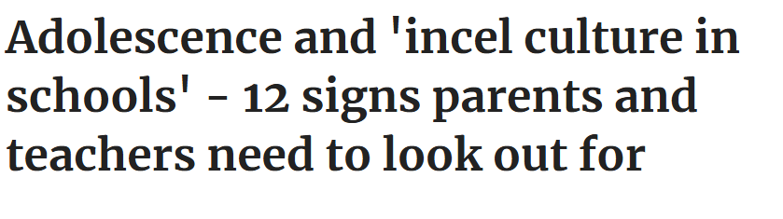
How might these trends impact how we engage with our male students?
Notes:
Group discussion

Slide 44
Why does it feel like there’s more misogynistic content online now?
Notes:
But why is there so much MC though?

Slide 45

Notes:
It can make people money! Or at least, people think they can make money from it.

Slide 46
“Despite claiming to uphold community standards, platforms often allow harmful accounts to remain active until public backlash forces action.
The cost of misogyny is social; the profit is commercial.
This lack of accountability… [means] misogyny online is not just a cultural or ideological problem, but it remains profitable, unregulated, and protected by design.”
Dr Mihaela Popa-Wyatt (Submission to Call for Evidence, June 2025)
.

Slide 47
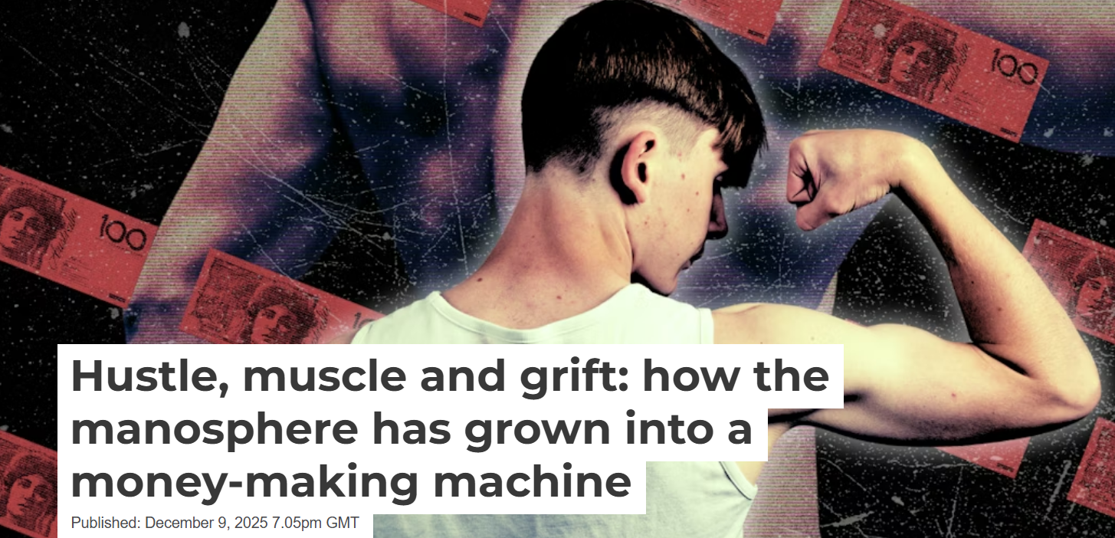
Notes:
If you’re interested in reading more about this, I’d recommend this article from the conversation

Slide 48
Male targeted content can draw on existing worries such as:
Uncertain financial futures that are already exacerbated by the COVID pandemic.
Current cost of living crisis
Fears about availability of jobs.
Managing shifts in family, community, and social depictions of ‘male’ role.
Ultimately, women and girls will be presented as the causes of these worries.
Notes:
.

Slide 49
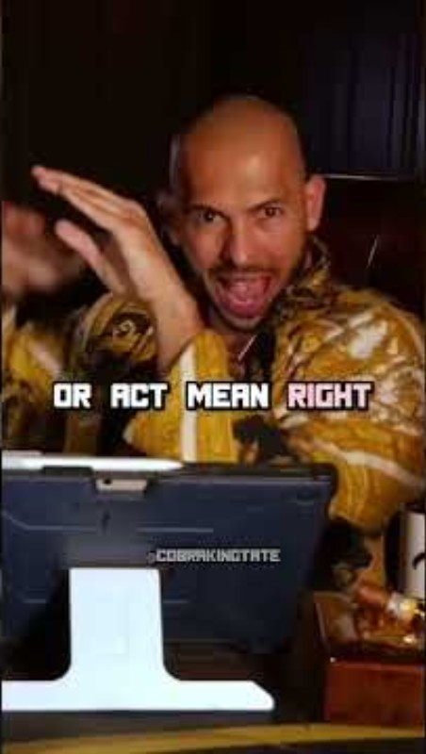
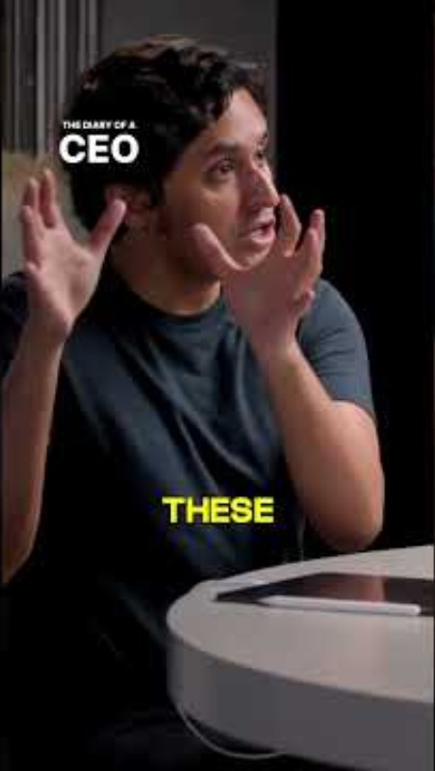
Notes:
However, misogyny won’t just come in the form of Andrew tate. It’s also becoming increasingly mainstreamed through other creators, such as DOAC.

Slide 50
What can be done?
Notes:
We must not feed into this controversy by responding as adversaries, as the villains in the stories created by Tate and instead as allies with answers of our own.
We must listen compassionately and carefully to what at times can be difficult conversations. We must take young men and boys concerns and issues seriously, and allow them to inform how we teach them about misogyny and gender. This does not mean we pander or allow masculinity to be defined by them, but if we do not invite them into this conversation, then someone else will. We want to make sure we can cultivate trust, so they know they can turn to us to have these conversations.

Slide 51
Inclusive/Indviduality - We look to bring boys into conversations, where we acknowledge their individuality and potential shared experiences.
Developmental - Provide young people a space for reflective conversation. Provide tools (vocab, modelled skills) to enable further learning. We need to give the time for it to happen.
Reflexive practice - Continually reflect on and refine our approach, incorporating feedback from staff, pupils, and other stake holders. Understand that this is a complex and evolving issue and that we might not always get it right.

Slide 52

Licensing
Creative Commons Attribution-NonCommercial-NoDerivatives 4.0 International
This license requires that reusers give credit to the creator (GBV Education Team, Salford Foundation) It allows reusers to copy and distribute the material in any medium or format in unadapted form and for noncommercial purposes only.
BY
Credit must be given to the creator (GBV Education Team, Salford Foundation)
NC
Only noncommercial use of this work is permitted. Noncommercial means not primarily intended for or directed towards commercial advantage or monetary compensation.
ND
No derivatives or adaptations of this work are permitted.
See the License Deed

